Slide 1

Interview Skills
Welcome! Please take a name tent and folder
Resume Writing
Upon request, the information in this document can be made available in alternative formats for people with disabilities by contacting [INSERT PHONE NUMBER]
CareerForce is an equal opportunity employer and program provider and a proud partner of the American Job Center Network.

Slide 2

Agenda
Preparing for the interview
The interview
After the interview
Notes:
Talking Points
In this workshop we’ll talk about the importance of preparing prior to the interview, what to expect during the interview, developing a method to answer some of those tough questions, and what to do after the interview is over.

Slide 3

Prepare for the Interview - Research
Employer Research
Who will interview you?
Learn about the company
Do the company’s mission and vision match your goals?
Notes:
Talking Points
Your hard work has paid off and you received the call to come in for an interview. Interviews can be very stressful and even more so if you aren’t prepared. Now is the time to brush up by researching the employer, starting a list of questions, and doing practice interviews. The more prepared you are, the better you’ll be able to go into the interview with confidence.
Let’s start with the information you should know about the company.
When the interview is being scheduled, you should be notified who will be interviewing you and their job title or their role at the company.
LinkedIn is a great tool to look them up to learn how long they’ve been with the company and understand their background. Even if you don’t have an account, you can goggle the person/people and use the company name you will probably be able to see their public LinkedIn profile.
Research the company - how do they align with your values and goals?
Use the "Business Finder" on the DEED website (mn.gov/deed), LinkedIn, the company’s website, social media, Glassdoor, Reference USA or do a Google search on the company to learn as much as you can about the company. For example: locations; number of employees; services and products, how old the company is, who are the top people, current news, etc. It’s a good idea to look at their website and at least one other non-company site such as Reference USA which you can find online though a library, if you have a library card.
Jot down some notes you can review the day before the interview.
While researching the company, you should be preparing specific questions that relate to the organization as well some designed to engage the interviewer. Let's discuss some of the types of questions you might consider.

Slide 4

Prepare for the Interview - Research
Ask smart questions that will foster a two-way conversation
Connect
Culture
Challenges
Close
Notes:
Talking Points
Note: Optional - Ask attendees to give examples of questions for each of the four question categories below (Connecting, Culture, Challenges, Closing) or just continue with these examples.
Here are some examples of questions that will help you connect with the interviewer;
How did you come to work here?
What do you love most about working here?
How can you get insight about the culture to determine if its going to be a good fit for you?
Who’s the most successful hire you’ve made recently and why has that person been very successful in their role?
Who didn’t succeed and why?
Ask: What can you learn from these questions?
Questions about challenges, can give you better insight into things like stress level, stability of the company, responsibilities of your job, how your performance will be evaluated etc. Some examples include;
What’s the company’s biggest challenge this year and how will this job help overcome it?
How will I measure my own performance, so I know I’m having a positive impact on this challenge?
What is the greatest challenge for this position?
In closing, you want to end in a positive way and establish next steps. You can do this by asking;
What additional skills or experience do you feel I need in order to be successful in this role?
What are the next steps in the process?
Note: HO Questions to Ask in an Interview

Slide 5
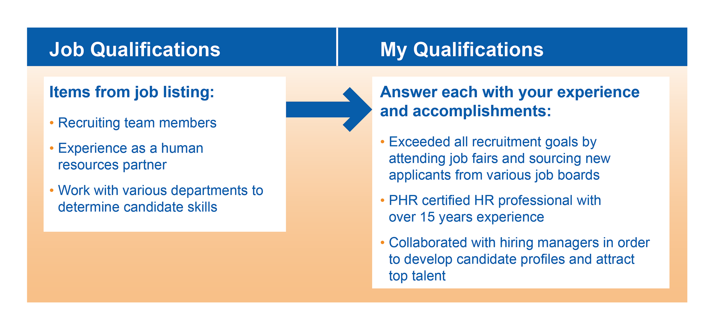
Prepare for the Interview – Match Your Skills
Notes:
Talking Points
Another part of preparation is to assess your skills in relationship to the job.
You can use a “T – chart” or “T – Table” like this one to help you identify how you meet the company’s needs
Start by listing job requirements and keywords and from the job posting in the left column
Next, write out your accomplishments or experiences that match with the keyword or job requirements.
In this case she employer is looking for someone experienced with recruiting team members.
The individual preparing to interview for this position matched the requirement by jotting down that she/he had exceeding recruiting goals in a previous position by recruiting at job fairs and sourcing from numerous job boards.
This process will help to give you a clear picture how you fit this position, help prepare talking points for the interview and help you answer the interviewer’s questions.

Slide 6


Prepare for the Interview – Are You Ready?
Mental preparation
Positive attitude
Truthful and realistic
Avoid any negativity
Physical preparation
Neat, clean, and well groomed
Be aware of scents
Proper attire
Notes:
Talking Points
Mental or psychological preparation is key, because our thinking impacts our moods which impact our body language and even the words we use.
Employers are looking for people with a positive attitude. So you are going to want to be able to find ways to show your enthusiasm for the job, the company and your willingness to learn, cooperate, and show your respect for the employer.
Never say anything negative about your current/previous employers or co-workers. Even if you had a falling out at work or a bad experience, you should still find a way to talk about the situation without speaking unfavorably.
What message do you think you’re sending the interviewer if you say things like, “The last company I worked for was horrible!” or “My last boss was a nightmare to work for!” or “I can’t believe how lazy all of my co-workers were!”
It’s important to rehearse how you’ll present yourself. Along with staying positive, it’s necessary to always be truthful and realistic. It’s not difficult for a competent interviewer to catch you embellishing on your accomplishments or coming off as fake or vague.
We all know the importance of presenting yourself in the best way possible, but there’s much more to it than just showering before the interview to make a good impression with your physical appearance.
Aside from the obvious things like getting a good night’s sleep, shaving, brushing your teeth, combing/brushing your hair, it’s a good idea to clean your fingernails, conceal or take out body piercings, be sensible and conservative with makeup, fingernail polish, and jewelry, and of course leave the sunglasses and anything else you won’t need in the car.
You should also be aware of any scents or odors. Avoid smoking before the interview, use deodorant so you don’t have issues with body odor, and never wear any fragrances (women or men).
If you think you’ll get away with having a cigarette before the interview and then spray yourself down with Fabreeze or Axe body spray, you’ll only succeed in having two overpowering smells coming off your clothing.
Keep in mind that many companies are now scent-free – wearing perfume or cologne could cause the interviewer to predetermine that you won’t fit in their company culture.
When it comes to what to wear to the interview, dress conservatively.
When deciding how to dress also consider the job. If you are going to be working as construction worker and you come to the interview wearing a black suit, white shirt and a tie, what might they think?
However, for general business attire:
For women: Either pants, suits, or skirted suits are appropriate. Skirt length should be at or just below the knee. Make sure your clothing is not too tight and avoid showing cleavage. Wear clean, low-heeled shoes, no open toe scandals and stay away from faddish clothing, limit jewelry, cover tattoos
For men: Make sure your belt matches your shoes, keep facial hair neatly trimmed and match the tie to your suit or sports coat. Comb your hair neatly and wear clean and polished dress shoes.
Remember to also be mindful of your body language. The way you sit, your eye contact, whether or not you’re fidgety, if you smirk, etc. can have a huge impact in the eyes of the interviewer. So don’t slouch, give eye contact to whomever is speaking, keep your hands in your lap if you tend to fidget, and control your facial expressions!

Slide 7



Prepare for the Interview – Are You Ready?
Location
Know the route
Arrive 15 minutes before your interview
Be courteous to everyone on site
Driving time
Have a travel plan
Plan for 30 minutes of additional travel time
Parking
Know where to park
Act professionally – even in the parking lot
Notes:
Talking Points
Additional preparation includes knowing how to get there and where to park.
Research multiple routes to take to the interview in case the main route is inaccessible. Remember there maybe be traffic backups due construction work. Make sure you’re aware of any additional instructions from the employer; such as, parking specifics, where the company may be located if within a multi-business complex, etc.
Be sure to utilize navigation apps to predict how long it will take you to get to your interview (check traffic for the actual time you’d need to leave for your interview). If you’re not driving, remember to have necessary transportation arranged, whether that be planning to use a ride share such as Uber or Lyft, money for a cab, or a public transportation schedule. You could also benefit by doing a “dry run” and going to the location a day or two prior to the actual interview (remember, plan the drive to be in traffic at the same time of day as you would be on the day of the interview).
Add a buffer for the unexpected – an extra half hour can save the day if you take a wrong turn, get off at the wrong stop, or run into unexpected traffic.
Parking can often be a headache and put you in a bad mood – especially in a larger city where parking structures are your only option. Obtain any coordinating instructions from the interview scheduler about where to park and what to expect. Consider whether or not you have to pay before leaving the building, is there a parking attendant, or is it cash only? Remember to plan for all possibilities so that you’re not late.
Arrive 15 minutes before your scheduled interview. Give yourself time to check in with the receptionist, use the rest room if necessary, review your resume, the job description, questions you’ve written down, and collect your thoughts.
Be courteous to everyone you meet – even those that aren’t interviewing you. It is likely that the hiring manager will even speak with the receptionist to learn their first impression of you.
Remember, your interview starts in the parking lot and ends in the parking lot. Act as if someone from the company is observing you as you arrive so remember to conduct yourself professionally at all times.
Now that you have prepared for the interview, let’s discuss the interview itself.

Slide 8

The Interview – Types of Interviews
Screening – telephone call, saves time, be organized
Behavior – “tell me about a time…”
Stress – re-creates challenging situations
Work sample – show your work, portfolios, sales presentation
Video conference – save travel costs, still a person-to-person interview
Peer group – meet and talk with prospective coworkers
Group – group of other candidates, more than one interviewer
Luncheon/coffee – social situation
Notes:
Talking Points
There are several different interview types – each one serving a specific purpose.
Screening interviews are typically done by telephone so the employer can save time by identifying candidates quickly that aren’t best suited for the position.
They may briefly ask about your education, employment history, and qualifications to determine if you align with the type of candidate for which they are looking before spending the time on an in-person interview.
Recently, some employers have started using video screening by having the candidate click on a link and respond to pre-determined questions while being recorded.
Behavioral interviews provides the employer with some insight about your on-the-job behavior, personality, and character. You’ll be asked how you’ve handled specific situations in the past. A question might be: “Describe a time when you had to overcome a stressful work situation and how you dealt with it.” You’ll learn how to prepare and answer these types of questions later in this workshop.
Work sample interviews give you the opportunity to show what you have done at previous jobs. This could be the type of interview for graphic artists to show their portfolios or salespeople making a sales presentation.
Peer Group interviews give your potential peers the opportunity to get to know you a little bit and you them. This is a great opportunity to help you in assessing fit, etc. They will probably have a say in who gets the job offer.
Group interviews take place with multiple candidates simultaneously and can include more than one interviewer.
Be polite and courteous with other candidates, try to show confidence by volunteering to respond first to a few questions, but do not dominate the entire interview.
When answering questions, make sure you direct your answer to the individual asking the question.
Luncheon/coffee interviews are used to assess how well you can handle yourself in a social situation. Choose your meal selection carefully and be mindful of spilling on yourself. Select healthy and easy things to eat so you can answer questions and pay attention to the conversation. This would NOT be the time to order a rack of ribs or anything else that is typically messy.
Stress interviews Re-create challenging situations you might run into on the job. The interviewer asks a number of tough questions that are designed to make you somewhat uncomfortable. For example, you may be presented with a job-related scenario and asked to explain how you would respond. Stay calm and take your time responding.
Virtual (formerly video conferencing) interviews were first used in order to have a face-to-face interview of sorts when you or the employer aren’t in the same state or area. Today they are becoming more and more common as well as varied.
In many cases, you may encounter multiple interview types with the same company depending on their hiring process. You may start with a telephone screening with someone in the HR department to determine your qualifications. If you make it to the next round, you may encounter a behavioral, work sample, or stress interview. The employer may then go through another round of interviews and meet you for lunch or coffee to make a final determination about you.

Slide 9

The Interview – General Questions
General questions
“What have you done to improve your knowledge in the last year?”
“Why do you want to work for us?”
“Tell me about a professional accomplishment you are proudest of.”
Tips
Always keep the company and job description in mind when answering.
Use a balance of “I” and “we” statements.
Notes:
Talking Points
You’ll encounter a number of general questions which are typically about why you want to work there, what do you know about the company, and why should the company hire you. Some examples are:
What have you done to improve your knowledge in the last year?
Try to include improvement activities that relate to the job.
A wide variety of activities can be mentioned as positive self-improvement, make sure you are working on some educational activities.
2. Why do you want to work for this organization?
This may take some thought and certainly, should be based on the research you have done on the organization.
Sincerity is extremely important here; the interviewer will be able to tell if you’re being honest or phony.
Relate your answer to your own career goals.
3. Tell me about the professional accomplishment you are proudest of ?
Talk about skills that are most relevant to the job for which you are interviewing.
Bring up skills that you had to use to reach that achievement; such as persistence, communication skills, or problem solving.
Mention any coworkers that helped you achieve success – this will show the hiring manager that you are a team player.
Explain what made this moment a proud one for you. Was there an award, promotion, recognition, or other outcome that rewarded you for your efforts?
Make sure whichever story you choose to tell focuses on your skills, experiences, and qualifications that make you right for the job.
Remember to use a balance of “I” and “we” statements. Though it’s important to share how well you participate in a team, interviewers also want to know how you will contribute individually.

Slide 10
The Interview – Behavioral Questions
Behavioral questions – probe past behaviors in direct relationship to future responsibilities
  “Give me an example of how you have set goals.”
  “Describe a time you had to solve a difficult problem.”
  “Tell me about a time when you took the lead on a challenging project.”
When answering, describe what you did in the situation
Keep in mind the qualities and characteristics the company is looking for
Notes:
Talking Points
We talked about Behavioral Interviews earlier and I promised we’ d talk more about how to handle this type of question.
Behavioral questions can be a the most difficult to answer.
The employer is looking for specific situations that you’ve encountered and how you dealt with them.
Your responses will help the employer to identify how you’ll respond to similar situations in the future. It’s key for you to prepare for these questions as much as possible.
You could have interview that is all behavioral questions, or one in which you get a few behavioral questions.
Some examples are;
1. Give me an example of how you have set goals.
If you aren’t prepared, interviewers will notice when you stumble through your answer and end up rambling.
You can prepare a number of “example” answers that can be used for various questions.
2. Describe a time you had to solve a difficult problem.
It’s important to be able to show the process you go through when presented with a problem.
State the problem and the steps you followed to reach the solution.
3. Tell me about a time when you took the lead on a challenging project.
Even if you haven’t had the title of lead worker, supervisor, or manager, give examples of when you recognized a job needed to be done and you did it.
You can use an example outside of work if it fits, however, work or school related are usually preferred.
When responding describe what you did in the situation. They are assessing your behavior.
Keep in mind the qualities and characteristics the company is interested in.
An excellent way to prepare answers for behavioral questions is to develop short stories that quickly explain the situation and outcome. You can use the STAR method to effectively answer these questions.

Slide 11
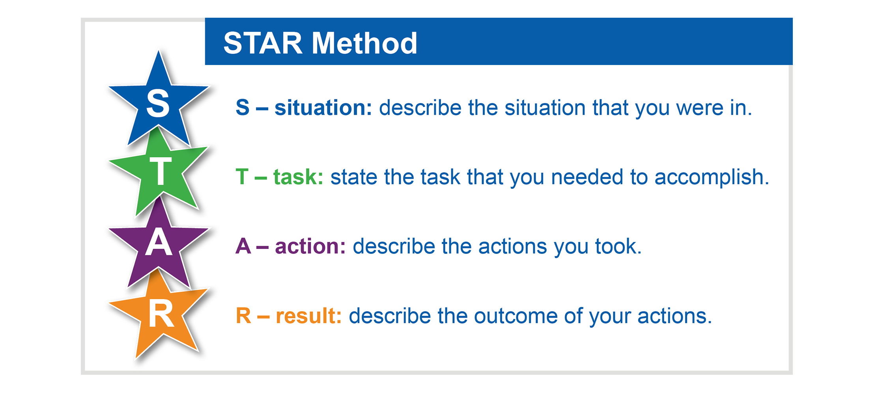
The Interview – Responding to Behavioral Questions
Notes:
Talking Points
The STAR response technique is a way of answering behavioral interview questions. These types of questions center on your past behavior. As they say, “the best predictor of future behavior is past behavior”. Past behavior in similar circumstances is even better. Therefore they ask you to give them a particular situation.
Learning the STAR method will help you answer questions concisely and with a clear message.
STAR stands for;
S – Situation: Describe the situation that you were in.
T – Task: State the task that you needed to accomplish.
A – Action: Describe the actions you took to address the situation with an appropriate amount of detail and keep the focus on YOU.
R – Result: Describe the outcome of your actions and don’t be shy about taking credit for your behavior. How did the event end? What did you accomplish?
Note: HO The Star Interview Response and briefly review
Activity: Create STAR story (Optional if time) Time 10 min.
Ask each participant to create one star story
Ask for 2-3 people to read their STAR story aloud
Provide feedback and suggestions as necessary and or ask others to provide them as well.
How have you handled a difficult situation?
S: I was a part of a team working on a presentation meant to help us secure a major new client for our company. The weather was bad, and as a result my supervisor got caught in a snowstorm and was unable to make it back in time. It looked like we were going to have to cancel the meeting and potentially lose the client.
T: I had been looking for ways to take on more responsibility, so I volunteered to finish up the presentation.
A: I worked with my supervisor via the phone and between the two of us, we were able to go ahead with the scheduled meeting.
R: As a result of my initiative, we not only landed the client, but I was also recommended for a promotion.

Slide 12
The Interview – Answering Techniques
Sandwich technique
“What personal weakness has caused you the greatest difficulty on the job?”
  Open with a positive, briefly discuss the negative, and end with another positive.
Softening technique
“Tell me a time when you had a conflict with a co-worker, how did you handle it?”
  Repeat the question back using softer language: “A time that I had a miscommunication with a co-worker was…”
Less is more technique
“Describe a time you made a mistake and how you handled it.”
  Briefly explain the mistake and quickly switch over to what you learned and how you improved.
Notes:
Talking Points
Answering techniques are methods you can use to quickly answer questions that typically have a negative connotation. They are not intended to be used for every question. These techniques seek to mitigate the effect of the negative aspect of the question by briefly addressing it and then putting increased focus on a positive response or outcome. Let’s look at these 3 technique, starting with the Sandwich.
Let’s say you get this question; “What personal weakness has caused you the greatest difficulty on the job?”
Sandwich the negative information between two positive statements as an effective way to minimize questions with a negative connotation.
“If given a choice, I like to spend as much time as possible in front of my prospects selling, as opposed to shuffling paperwork back at the office. Of course, I learned long ago the importance of filing paperwork properly, and I do it conscientiously. But what I really love to do is sell.”
The softening technique example is illustrated with the question; “Tell me a time when you had a conflict with a co-worker; how did you handle it?”
Repeat the question back using softer language – in this case, minimizing “conflict” with “miscommunication”.
“A time that I had a miscommunication with a co-worker was…”.
Lastly is the Less is more technique. For example “Describe a time you made a mistake; how did you handle it?”
Briefly explain what the mistake was, but don’t dwell on it. Quickly switch over to what you learned and how you improved after making that mistake. You might also explain the steps you took to make sure that mistake never happened again.
“I mistakenly submitted the wrong order which created an unhappy customer. After correcting the error, I developed my own quality assurance process – which was adopted by my entire team. Since then, there have been zero incorrect orders and the retention of our customers is at an all-time high!”

Slide 13

The Interview – Follow Up
Closing the interview
Stay positive and thank the interviewer
Ask “closing” questions
Record the date/time of your next contact
Following up after the interview
Sending thank you notes, letters, emails, or voicemails
Carefully consider the appropriate type of note
Be genuine and make it a point to highlight your fit and desire for the position
Contact and prepare your references
Consider your reference options
Create your reference list
Keep your references informed
Notes:
Talking Points
In closing the interview;
Always thank them for their time and interest in interviewing you.
Finish strong by being proactive and asking closing questions, such as;
Based on our conversation today, how well do you feel I fit your candidate profile?
When do you expect to make a hiring decision?
If I don’t hear from you in that time frame, may I contact you?
What is the next step in the hiring process
What if any, concerns do you have about my ability to do this job or fit in with the organization?
After you have asked your well-crafted questions; make a statement like: “I am very interested in this particular job due to the wide variety of interesting projects (fill in the blank) and I believe you will be very pleased with my performance”.
This makes the interviewer aware that you are indeed interested and will accept the position if offered.
You are confidently letting them know you are ready to move forward.
Remember to write down or put in your calendar the date and time of your next follow-up, if applicable.
At some point, whether it be during the interview or after, be sure to write down the name of the person that interviewed you and a couple notes about the content of the interview; you’ll be able to refer back to your specific conversation and maintain the rapport you built.
After the interview
Always send a thank you note to each person you interviewed with, within 24 hours.
While common forms of thank you notes include letters, handwritten cards, emails, or calling and leaving a voicemail, a handwritten letter or card is the most personal and may have a greater impact.
Make it a genuine note of thanks but make a point to highlight your fit and desire for the position as well as anything you may have forgotten to mention.
References should have been obtained ahead of time, prior to applying for jobs. Always, ask permission to use them as a reference before hand.
There are two basic types of references to consider: professional and character. You should have at least 3, lean more towards professional if you can.
When creating your reference list for an employer make sure you provide your relationship (co-worker, direct report, instructor, etc.) to your reference.
Ensure their contact information is current.
Bring your completed list of references with you to the interview just in case.
If you have any letters of recommendation, consider whether or not it would be appropriate to present them to the interviewer..
Contact your references and let them know:
The position for which you interviewed for.
The requirements of the position.
A brief overview of what was discussed.
Anything you mentioned in the interview that they could back up if called by the employer or anything you think could be of concern to the employer.
Send your resume that was targeted specifically for this position, cover letter, and job description to your reference so they are prepared to speak to the interviewer.
Also be aware of recommendations and endorsements you have on LinkedIn – it is common for employers to look you up on LinkedIn before or after the interview; they could be looking to see if your employment history, skills, and achievements match your resume. They could also be looking at any endorsements you have from others.

Slide 14

The Interview – Self-evaluation
Self-evaluation after the interview
Reflect
What went well?
What if the interview didn’t go well?
Keep some perspective and don’t take it personally
Learn from the experience
How can you improve?
Review the questions that could have been answered differently
Contact your interviewer
Notes:
Talking Points
Since employers usually won’t tell you how you did, it’s up to you to reflect back. Thinks through, what you did well such as;
Was appropriately confident and professional
Answered difficult questions well
Spoke calmly and clearly
Talked about my achievements
Was energetic and enthusiastic
Nonverbal communication was appropriate and I was aware and responded according to interviewer’s body language
Avoided talking about personal issues and saying anything negative about past employers and colleagues
Asked good questions about the position, company, and culture
Got the interviewer’s business card
Took 1-2 minutes to answer each question.
Ended the interview by saying I wanted the job
Secondly, think about things you could have done better
Interviews can be stressful enough without beating yourself up if it didn’t go well. This is about learning!
Apply what you learned from the experience so your next interview is even better.
If you receive a rejection letter or phone call, you can ask your interviewer for informal feedback. Though they are not inclined to answer, it certainly doesn’t hurt to ask.
Finally, ask yourself what specifically you can do to improve your interviewing skills. Some examples are:
Write out answers to behavioral questions
Practice your responses so you’re better prepared for the next interview.
Have someone conduct a mock interview (friends, family, CareerForce staff)

Slide 15

Salary Negotiation
When should you start talking about money?
Never during the interview
Let the employer bring it up first
Give a salary range
Negotiating tips
Know the salary range you can expect
Request at least 24 hours to consider the offer
Use your value, skills, experience, and education to negotiate
Negotiable items can extend beyond just the salary
Notes:
Talking Points
When is it appropriate to talk about money?
Try to avoid the issue entirely in the initial interview – the goal is to determine fit, not bring up salary, benefits, or perks.
Let the prospective employer bring up money first. If the interviewer asks, some responses are;
“What is the salary range for this position?”
“I am sure your company pays competitively and if this is a good fit, we’ll work that out.”
You can also give a salary range instead of a definite number.
Make sure before you interview you conduct some research.
Resources like DEED (select Data Tools then career and education explorer), www.salary.com, www.glassdoor.com, and www.careeronestop.org, can help.
Negotiating tips
Know the salary you can reasonably accept and expect, based on your experience, education, and industry wage standards for your area.
Whether you intend to accept or counter the offer, always request at least 24 hours to consider. Make sure all your questions about the offer have been answered.
When negotiating, review your value, skills, experience, and education as ways to justify your desired salary (within reason of course).
You can negotiate more than just salary, but there could be a give and take (less pay for more vacation?)
Salary
Benefits
Tuition assistance
Training
Vacation time
Flexible schedule / work from home
401k match / stock options
Keep in mind that not all medical plans, deductions, costs are the same and that the cost of a good benefits plan can be 50% of your salary or more.

Slide 16

Summary
Don’t forget to prepare
Research, research, research
Match your skills to the job posting
Your attitude and appearance matter
What to expect at the interview
Know the different types of interviews you could encounter
Remember to prepare for the questions you’ll be asked
Use the STAR method to answer those tough questions
There’s still more to do after the interview
Next steps in the hiring process and follow up with your references
Don’t forget to evaluate your performance – you can always improve
Know when to talk about money and how to negotiate salary
Notes:
Summary
We learned how to prepare for the interview by:
Researching the employer
Matching your skills and experiences to the job description
Being positive and dressing appropriately for the interview
Being mindful of location, drive time, and parking on the day of the interview
We talked about what to expect at the interview, such as:
The various types of interviews you could encounter
How to prepare to answer questions, especially those difficult behavioral questions
Using the STAR Method to create short stories to quickly and concisely answer questions
Finally, we talked about what to do after the interview is over:
The importance of following up not only with the interviewer to make sure you know the next steps, but also with your references to ensure they are prepared
The need to evaluate your performance in the interview, whether it was good or bad, and how to improve for the next one
When to talk about money and how to negotiate your salary

Slide 17
Questions?

Slide 18
Thank You!
First Name Last Name
Email address you might want to share with the class
CareerForceMN.com

