Slide 1

Resume Writing
Welcome! Please take a name tent and folder
Resume Writing
Upon request, the information in this document can be made available in alternative formats for people with disabilities by contacting [INSERT PHONE NUMBER]
CareerForce is an equal opportunity employer and program provider and a proud partner of the American Job Center Network.
Notes:
Talking Points
Welcome everyone
Introduce yourself and mention your experience in working with resumes

Slide 2

Introduce Yourself
Notes:
Talking Points
Note: Ask participants to introduce themselves by providing;
Their name
Sharing if they have a resume or not and if so, the responses they have gotten from employers
What do they hope to get from today’s class?

Slide 3

Agenda
A Good Resume
Best Practices
Formats
Targeting Resumes
Skills
The 4 Sections
File Formats
Test it
Cover Letters
Next Steps
Notes:
Talking Points
The goal of this workshop is to provide you with resume strategies to attract more interviews and also improve your networking opportunities.
We’ll be covering;
The purposes of resume
The two basic types of formats and how to decide which format will work best in your situation
The four basic parts of a resume
How to write accomplishment statements
Writing effective cover letters
Tips for completing applications
Ways to follow up after your interview
I will plan to stay 30 minutes after the class to help any of the participants who may have personal questions about the material.
Note: You can also have them schedule a one on one session online, or possibly make an a future appointment with you.
So let’s start with some guidelines in how to create a resume

Slide 4
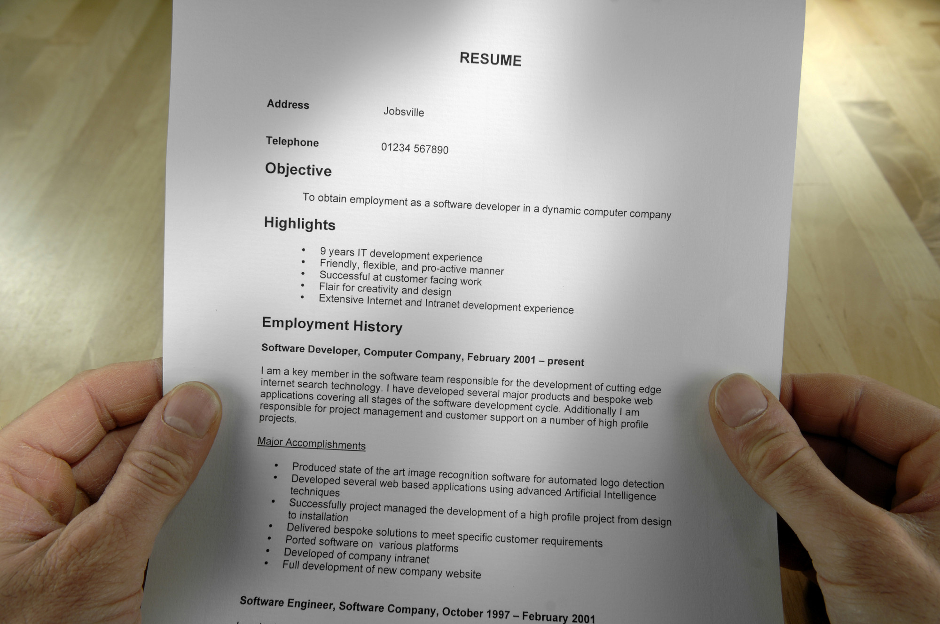
Many Ways to Compose a Resume
Everyone has an opinion
There is no single “right” way
Notes:
Talking Points
Everyone has an opinion on resumes
If you asked 5 people you would probably give you 10 different opinions
Always understand the why,. The why means explain to me why what you have recommended is a good change for my resume.
We all know there should be proper spelling and grammar. However, besides the obvious there no is no single “right” way because:
Different employers want different things.
Recruiters and hiring managers may look for different things.
For example people skills this time. A different manager at another organization who is hiring for the same type of position might be looking for the most up to date technical skills he can find because he knows his own technical skills aren’t up to date.

Slide 5

A Good Resume…
Improves communication and
yields more job interviews
Notes:
Talking Points
A good resume gives a preview of what you have to offer and makes the reader want to know more about you
You do not need to list everything you did in any given job
You want to showcase the skills and experience you have that are likely to be important to the hiring manager
In the end you must be proud of it and believe that it is a great representation of your qualifications for the position

Slide 6

Best Practices
1-2 pages, concise
Tailored and relevant to the position you are applying for
First third of the resume is the most important
Notes:
Talking Points
Best practices include;
Create a resume that is 1-2 pages and is written concisely and includes only relevant information
Exceptions to the 1-2 page guideline can include Federal and academic resumes
Certain occupations may require a CV, which is more in depth and lengthier than a resume
Your resume generally should include no more than 10-12 years of professional experience . However, this might not apply for certain industries and occupations. For example, to apply for certain IT positions, it might make more sense to create a resume that includes no more than 5 years of experience, since technology changes rapidly.
The first third of the resume is most important. Why might that be?

Slide 7

Resume Formats
Chronological
  Emphasizes work experience
  Preferred by many employers
Combination
  Helps reduce focus on employment gaps
  Good for career changers
Notes:
Talking Points
Pick a resume format that best highlights your skills, achievements, your situation (i.e. changing occupations, have been promoted and looking for same occupation, etc.). There 2 basic styles or formats.
HO Robert Doyle resume and point out;
This resume is chronological because it emphasizes work experience and is a historical timeline of your work experience
The chronological format good choice when you want to show your career progression, and you are staying in the same type of work
Some job seekers use it when the name of a former employer might be important to the perspective employer
The chronological is more traditional and many employers prefer them
HO Susan Poe’s resume and point out;
Susan’s resume is a combination because it emphasizes relevant skills and abilities and also includes the employment history that provides evidence of her skills and abilities.
It helps reduce focus on employment gaps
This style is good for those changing careers because it highlights the skills you have that are related to your new career goal a know as your transferable skills
The combination format allows for a great deal of flexibility as the bullets you use under any skill aren’t tied to a particular employer, date or any job (so you can think about the things you did off the job as well)

Slide 8

Target Resumes To Job Postings
A targeted resume could focus on:
  A specific job posting
  An occupation
  An industry
  An employer
Notes:
Talking Points
Targeting your resume simply means to customize your resume to the company and to the specific job posting you are apply for. In other words you will create a resume with a type of position in mind such as a Business Analyst, then when you are actually applying for a posting for a Business Analyst you will want to read the posting thoroughly and modify your resume to match as much as possible including use of the same exact skill words, using the exact job title, moving what seems to be the most important items closer to the top etc.
Some people keep what is called a Master Resume which has everything on it, all your adult work history, education, skills etc. This is a resume you never send as its way too long with way too much information some of which probably isn’t relevant.
You can use your Maser Resume however, to create a customized resume by copying and pasting selected items in the appropriate locations on the resume you are going to use to apply for a specific position.
Remember, you are trying to show how you can meet the employer’s needs. Resumes are about marketing yourself (skills, experience, education) in a way which the employer finds beneficial. The resume isn’t about you so much as it is about the employer!

Slide 9

Now You’re The Recruiter
Notes:
Activity: Resume Review Time:10 min
HO CareerForce Resume Review Activity, Resume 1= Ivana and Resume 2= Anita. If the resumes are in a package and point out they are asked to not open the resume package until asked to do so, or alternatively hand them out face down and ask for them to remain face down until asked to do so.
Note: This is mainly an exercise to show why using a targeted resume is more effective than using a general resume. It also illustrates how skills/combination-based resumes can work best for career changers.
Instruct the participants to take the role of the recruiter to select a candidate for a job interview. Have them briefly review the job posting for a Customer Service Representative, paying close attention to the required skills. Then give them 14 seconds to review two resumes. Instruct them to begin and time them. Afterward ask them to share which candidate they choose and why. Note: Typically the participants will choose Anita Nujob because her resume has demonstrated that she meets the required skills.
Point out why Anita’s resume demonstrates that she meets the requirements and why Ivana ‘s resume doesn’t. You might also talk about other factors that makes Anita’s resume appealing, such as the format, readability and use of a professional summary.
Mention that they are the same job candidate and that CareerForce staff helped “Anita” create the more effective resume.

Slide 10

Determine Your Skills
Notes:
Talking Points
Your resume must include the specific skills you have that will help the employer see that you can do the job you are applying for.
Refer to the job posting and add related skills you have that match the employer’s need
When you are first creating your resume and not yet applying for a posting, you can
Use a tools such CareerForceMN.com
Check out Profiles on LinkedIn by searching for people that are working at the job you want
Review actual job postings you are interested in and see what skills, qualifications, etc. they are looking for
Include mostly job specific skills and add a couple of soft skills (traits)
Emphasize transferable skills when changing careers
Note: Distribute and Refer to HO “Moving Forward.” Tell participants that the handouts will help them identify soft skills and job- specific skills they can transfer to another occupation. Suggest they do this exercise in their free time.

Slide 11

Four Required Sections
Notes:
Talking Points
Your resume should include a minimum of 4 sections
Contact information
A Summary (can be bullets or a statement) and can be included with or without an objective
Employment History
Education/Training
While these can be arranged differently on the resume depending upon the format and your situation, they should all be included
Other sections you might add could include Selected Accomplishments, Community Service or Volunteer Work as well as hobbies and interests only if related to the job

Slide 12
Contact Information
Robert Doyle
(763) 792-2175
rsdoyle@internet.com
What’s Missing?
Notes:
Talking Points
What is missing from this example of contact information?
The physical address ( address including city, state and zip code ), as this is now optional.
If the job you are applying for is near where you reside you might want to at least add your city and state
There is no Linked URL or address. If your LI Profile is ready, and you enable it to be seen on the internet, LI will assign you a URL that should be added to your contact information. It can be placed after your email address
Whether or not an employer looks at your LI profile, you’re letting them know that you are aware of social media and that you can use it

Slide 13

Example: Summary
Production Assembler with over 15 years experience.
Produced more than $2 million in government products per year with an average acceptance rate of 99.5 percent.
Notes:
Talking Points
Note: Ask the participants what the difference is between an Objective and Summary on a resume. An Objective tells the employer what the job seeker wants. ( The Summary is a quick overview of your experience as related to the company and position. It essentially tells the employer what you can do for them ).
Note: Review the Summary on the slide
Notice that the 2nd statement clearly highlights an accomplishment
You can also include key skills, talk about what makes you standout from other applicants, mention what you are known for, or what you have been recognized for, etc.
Your Summary is like a short commercial. It needs to be engaging to encourage the reader to review the rest of your resume.
Option - Activity: Create Your Own Summary Time: 5-10 min.
This is an activity to be done in participants’ free time (unless the workshop is longer than 90 minutes). Explain how to complete the activity.
HO Summary Statements
Explain Side 1 (an example of a Summary statement)
Explain Side 2 and the purpose of the worksheet
If their resume doesn’t have a summary statement, they can use the answers to create one. If they need further help, encourage them to stay after the workshop or come back for resume coaching.
If they have a resume, recommend they compare their answers with their current summary statement. By doing so, they can make improvements.
Note: If your workshop is 90 minutes, you can quickly explain the exercise and have them do it outside of the class.

Slide 14

Employment History
Production Assembler
MN Diversified Industries, St. Paul, MN 52014
Notes:
Talking Points
For your Job Title you will typically use your exact job title, however in certain circumstances you may want to consider writing a descriptive Job Title. For example: If your job title was Administrative Assistant II, but you spent a significant part of your time organizing events, you could use the title: Administrative Assistant / Event Coordinator. Be sure to put spaces between slashes so that Applicant Tracking System will capture the title as keywords.
Your Employment History should also include the company name and the city and state and the start and end dates you worked there. Omitting the dates and using number of years may make the employer wonder what you are trying to hide.
Best practice for placement of dates would be the far right of the resume and the dates for each job should line up with each other so an employer can look down the right side of the resume and very easily find the dates of all your jobs.
On a Chronological resume, under each position you will use bullets to highlight your accomplishments and skills

Slide 15
Example: Employment History Chronological Format
Production Assembler
MN Diversified Industries, St. Paul, MN 52014
Stocked packaging machine, and operated fast-paced wrapping machine
Reduced production time and saved money by examining circuit boards and repairing errors quickly and efficiently
Notes:
Talking Points
This is an example of a couple statements included in the Employment History portion of Doyle’s Resume.
The first statement about stocking is really highlighting his skills (stocking, packaging, wrapping, machine operation
The second one is a nice strong accomplishment statement. Notice that it starts off with what the outcome of his efforts were (not the task). The task, or how he reduced production time and saved money comes in the second part of the statement. By having the statement in this order ( results/outcome and then task) the employer is much more likely to actually see the most important part which is how Robert actually contributed to the company.
If Robert had numbers such as how much he saved in time or money that would even be better!
You may have done the same tasks as others who will apply for the same job, but your accomplishments are uniquely yours.

Slide 16
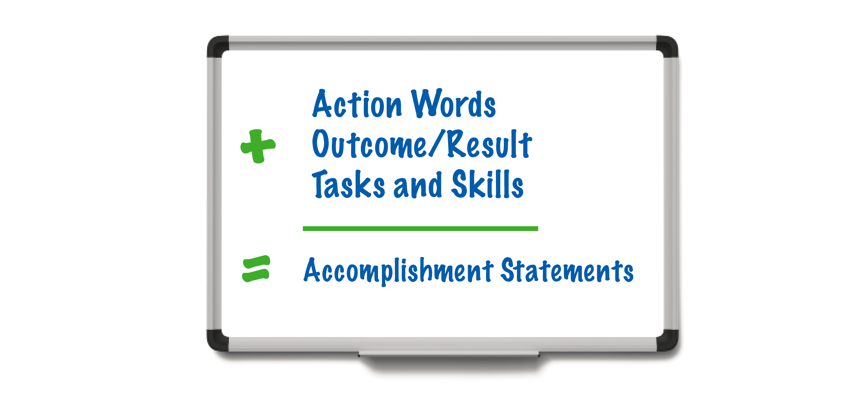
Writing Accomplishment Statements
Notes:
Talking Points
Remember It’s most effective to put the result for the organization first, and then task or skill
Your resume wherever possible, should show what you accomplished in your statements not simply your tasks or responsibilities. You need to think beyond the task and ask yourself what was the benefit to the company or department of you doing that task. Employers are looking for results!
Let's look at a couple more examples.
Talking Points
Remember It’s most effective to put the result for the organization first, and then task or skill
Your resume wherever possible, should show what you accomplished in your statements not simply your tasks or responsibilities. You need to think beyond the task and ask yourself what was the benefit to the company or department of you doing that task. Employers are looking for results!
Let's look at a couple more examples.

Slide 17
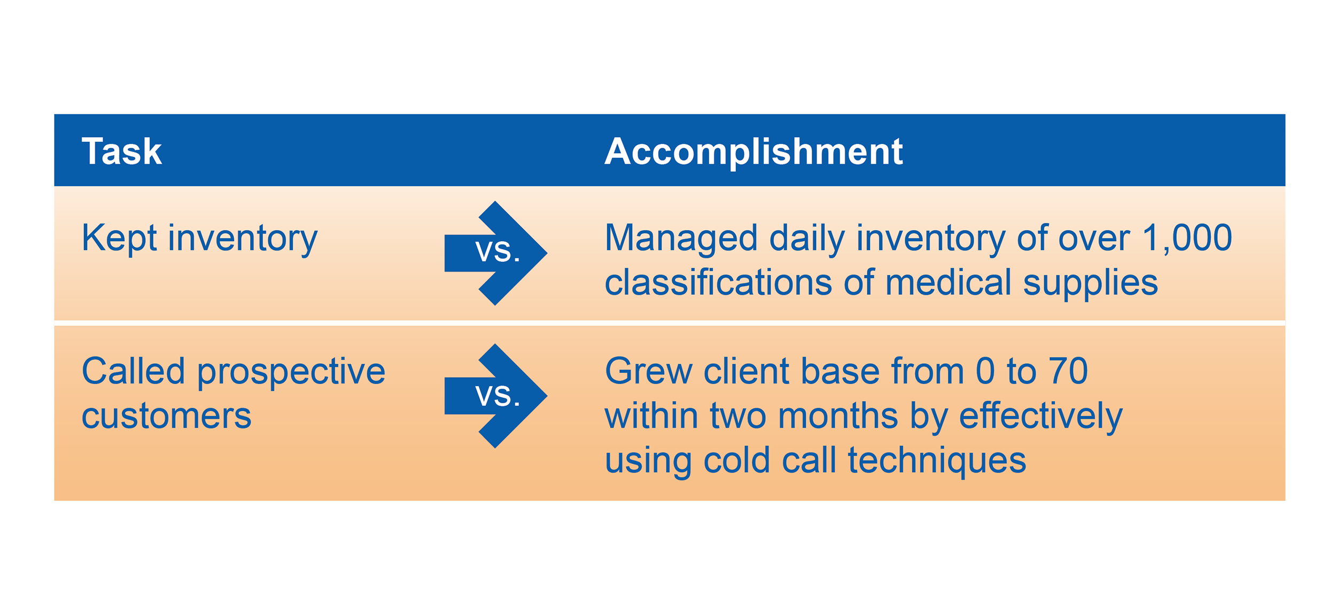
Tasks vs. Accomplishments
Notes:
Talking Points
Note: Ask them what the difference is between the first Task and the related Accomplishment. ( added numbers, added time frame, managed )
The reader clearly gets more and better information from the accomplishment than the task
What’s the difference between the 2nd task and it’s accomplishment statement ? (numbers, specific results, timeframe)
The second accomplishment statement is especially effective because the result for the organization is clearly highlighted. The task is described afterward.

Slide 18

Write an Accomplishment Statement
Notes:
Activity – Write an Accomplishment Statement 5-10 minutes
HO Better Bullets for Resumes and Accomplishment Statements for Resumes. Have them use them as guides
Each participant is to write out at least one accomplishment statement. Remind them that accomplishment statements should start with an action word.
Give them approximately 5 minutes to complete the exercise
Ask them to share their accomplishment statement
Note: If you think the participants need more clarification, you can provide an additional example.
For example, “Increased the number of subscribers 25 percent in a one-year period by improving writing quality and choosing more relevant topics.”
Note: If you have participants who are having difficulties, assure them that you will help them after the workshop and refer them to one-on-one coaching, if needed.

Slide 19

Education is a Key Aspect
Notes:
Talking Points
Education refers to formal education such as a degree or a certificate. However, you can add or substitute the word Training for Education and include related training that you have taken either on your own or that a previous employer sent you to
If you have competed a degree or a certification through a 2 or 4 year college or technical school you won’t need to include your high school information

Slide 20

Education vs. Training
Education
B.S. Accounting University of Minnesota Minneapolis, MN
Diploma White Bear Lake Senior High White Bear Lake, MN
Training
Leadership Skills Boston Scientific Maple Grove, MN
Coaching For Performance Medtronic Fridley, MN
Notes:
Talking Points
List your most recent education first
For each item you will start with the credential or if its training the name of the class and bold it.. Then add in the name of the school or the company who provided it and finally the city and state
Dates are not required and need not be used if you graduated / left school 5-10 years ago
Include institution if you didn’t graduate. For example:
- Studied liberal arts at University of St. Thomas, St. Paul, MN
In general use the highest level of education, but the goal is to be a perfect fit for the job. If your highest level of education is irrelevant or makes you seem overqualified you might leave it out.

Slide 21

Optional Sections
Notes:
Optional Headings
Community Involvement
Military Experience
Professional Affiliations – if you had a particular role in the organization such as Treasurer make sure you add it
Awards
Licenses
Other Relevant Experience - Title, Company Name, City, State
Selected Accomplishments or Achievements
Interests or Hobbies only if related to the work, company or specific job you are applying for

Slide 22

Formatting
Include plenty of white space
11- or 12-point font
Arial or Calibri – or any “non-ornate” font
No errors
Have someone proof for you
Notes:
HO File Formatting Options
Talking Points
Plenty of white space
11 or 12 point font
Arial and Calibri or any font that is not ornate or has “tails”
If the posting tells you what format, use it. If not refer to the handout Note: Review HO
Some ATS analyze the credibility of your skills by how many times they appear on your resume.
Make sure it is error-free in every way.
Best practice.is to have someone else proof it for you.

Slide 23

Test Your Resume
JobScan.co
TagCrowd.com
Notes:
Talking Points
To test/compare your targeted resume to the job posting use;
JobScan.co – Shows match between your post and resume, with keyword comparisons and other tips
When you sign up with an email you get 5 free resume full match reports with suggestions for improvements
Monthly scan rollover if not used
TagCrowd.com - Create word cloud from any text to visualize word frequency
Make the necessary changes
Review again
Have someone else proofread it
Note: Give an example showing why job seekers should proofread.

Slide 24
Cover Letter Outline
First Paragraph: Your ad for an Administrative Assistant on CareerForceMN.com on _______ caught my attention. As a recent graduate, I have the up-to-date skills you are looking for, as you can see from my resume.
Second Paragraph: Allina Health has an excellent reputation as a quality health care provider and my skills are a great match for your requirements. I recently completed a FT Internship with Children's HeartLink where I successfully performed a variety of administrative work including: answering a multiline phone; assisting clients with questions; scheduling appointments; and maintaining a client database. My PowerPoint and Excel skills helped in supporting the Director of Nursing.
Third Paragraph: I am very interested in discussing how my qualifications would benefit Allina Health. Thank you for your time and consideration. I look forward to hearing from you soon.
Sincerely,
Notes:
Talking Points
Best practice is to always send a cover letter even if its optional
It shows your writing and grammar skills
Is an opportunity to market yourself and tell them why you want that particular position and why at that company.
A common mistake is to just repeat what you have said on your resume
Note: HO Creative Job Search General Outline for Cover letter and HO Creative Job Search Email Cover Letter General Outline for Cover letter
This is a formal business letter and therefore on the letter you will include your name and address as well as that of the person you are sending it to. If you have it make sure you use the person’s actual name on the greeting/salutation
Notice that all you need are three paragraphs
1st paragraph: Why you are writing, which job you are applying for and why, any referral, how did you find out about the position and when was it posted. Make sure to include the job reference number if there is one
2nd paragraph: Why are you the best candidate. Demonstrate why, more skills. Describe different relevant skills and accomplishments
3rd Paragraph: Give active close. Ask for interview Thank the recipient

Slide 25

Next Steps
Review resume again
Have you included everything?
Run through electronic checking tools
Ask someone to proof it one last time
Notes:
Note: HO Moving Forward Using Resume Checklist
Talking Points
Resume Review
Review resume for accomplishment statements.
Consider adding optional sections to your resume
Ask someone else to proof your resume after running it though JobScan or Tag Crowd
Next Step: Need More Resume Help?
I will stay another 30 minutes after the class to help any of you who may have personal questions about the material.
Register for Advanced Resume workshop
Register for one-on-one review session
Make an appointment with me.

Slide 26

CareerForce Services
One-on-One Coaching
Workshops
Networking Groups
Hiring Events
Virtual Services
Notes:
Customize slide as needed for your location

Slide 27
Questions?
Notes:
Note Review slide
Talking Points
Need more assistance?
Register for one-on-one session.
Make an appointment with a CareerForce Career Counselor

Slide 28
Thank You!
First Name Last Name
Email address you might want to share with the class
CareerForceMN.com

