Slide 1

Resume Writing Advanced
Welcome! Please take a name tent and folder
Resume Writing
Upon request, the information in this document can be made available in alternative formats for people with disabilities by contacting [INSERT PHONE NUMBER]
CareerForce is an equal opportunity employer and program provider and a proud partner of the American Job Center Network.
Notes:
Talking Points
Welcome everyone
Introduce yourself and mention your experience in working with resumes

Slide 2

Introduce Yourself
Picture only silde
Notes:
Talking Points
Welcome everyone
Introduce yourself and mention your experience in working with resumes
Note: Ask participants to introduce themselves by providing;
Their name
What job they are looking for?
One fun or interesting fact about themselves*
*Cut fun or interesting fact if time is a concern

Slide 3

Agenda
Resume formats
Targeting your resume
How to create strong accomplishment statements
How to get past applicant tracking systems
Notes:
Talking Points
The goal of this workshop is for you to learn how to improve your resume by targeting your content more concisely to get noticed.
We’ll be covering;
Resume formats
Targeting your resume
How to create strong accomplishment statements
How to get past applicant tracking systems

Slide 4

Is There a Perfect Resume?
Notes:
Talking Points
There are many different opinions on and strategies for writing a resume; depending on who you ask, what type of job you are looking for, etc.
We provide you with best practices
The bottom line is you have to be comfortable with it. You will have to love it enough to sell it!
Let’s start with a couple of tips

Slide 5

For Starters…
Know your skills
Read the job posting well
Notes:
Talking Points
Tip 1: In order to create a good resume, you need to know your job skills, be able to articulate them, and be able to demonstrate how you have used them to create value for the organizations you have worked for in the past.
Remember, you are persuading the employer, that you have what it takes and that they can have confidence in you. They are focused on what we can do for them.
If you are unsure about the skills necessary for your desired position you can:
Take the skills assessment on CareerForceMN.com
Find most used skill words for your profession on onetonline.org
Tip 2: Read the job posting carefully
Which skills is this employer looking for? Highlight the skills the employer is looking for and compare those to your resume. Then make any necessary modifications to your resume.
This brings us to the topic of Targeting your resume

Slide 6

Review of Resume Formats
Chronological:
  Emphasis on job history
Combination:
  Emphasis on skills
All resumes should be targeted to the job you are applying for!
https://www.careerforcemn.com/resumes
Notes:
Note: HO and refer to the Chronological (Robert Doyle) and the Combination (Susan Pope) as you share the information below.
In this Advanced class, we will do a quick reminder of the different styles of resume. A chronological resume focuses on your employment history chronologically starting with most recent employment. Most employers are familiar with a chronological resume and many Applicant Tracking Systems are set up for a chronological resume format.
It is important to evaluate and choose the most effective resume format depending on your particular situation.
A combination (or skills resume) focuses on your specific skills and can showcase aspects of your experience without highlighting gaps in employment or your age.
It focuses on skills most transferable to the job you are seeking
It has less focus on your employment history than the chronological resume does
To clarify, your employment history will still be included in this format, but it will be placed at the bottom of your resume and will be a simple listing rather than detailing out what you accomplished at each position.
By focusing and highlighting your transferable skills, you shift the focus off of your previous positions and titles and put it on your relevant skills.
This can make it easier for the employer to see what a good candidate you really are.
Now let’s look at targeting resumes

Slide 7

Targeting Your Resume
A targeted resume could focus on:
  A specific job posting
  An occupation
  An industry
  An employer
Notes:
Talking Points
Targeting your resume means to tailor or customize it. This will make a significant difference. Its kind of like the difference between tailored suit and one that’s not. The tailored suit is going to fit and look and feel much better on you than one you might buy off the rack. In the case of a resume your targeted resume will “fit” the position much better.
A targeted resume targets:
A specific occupation
A specific job posting
An industry
An employer
Note: Ask what are some ways you can take your generic or master resume for a type of job and change it into a targeted resume when you are applying? Why is this important?
The job of a resume is to get you an interview – don’t be afraid to change it, if you are applying for jobs you are qualified for and not getting interviews
How you communicate the value you bring to a job is also critical. Let’s examine the best way to do that.

Slide 8
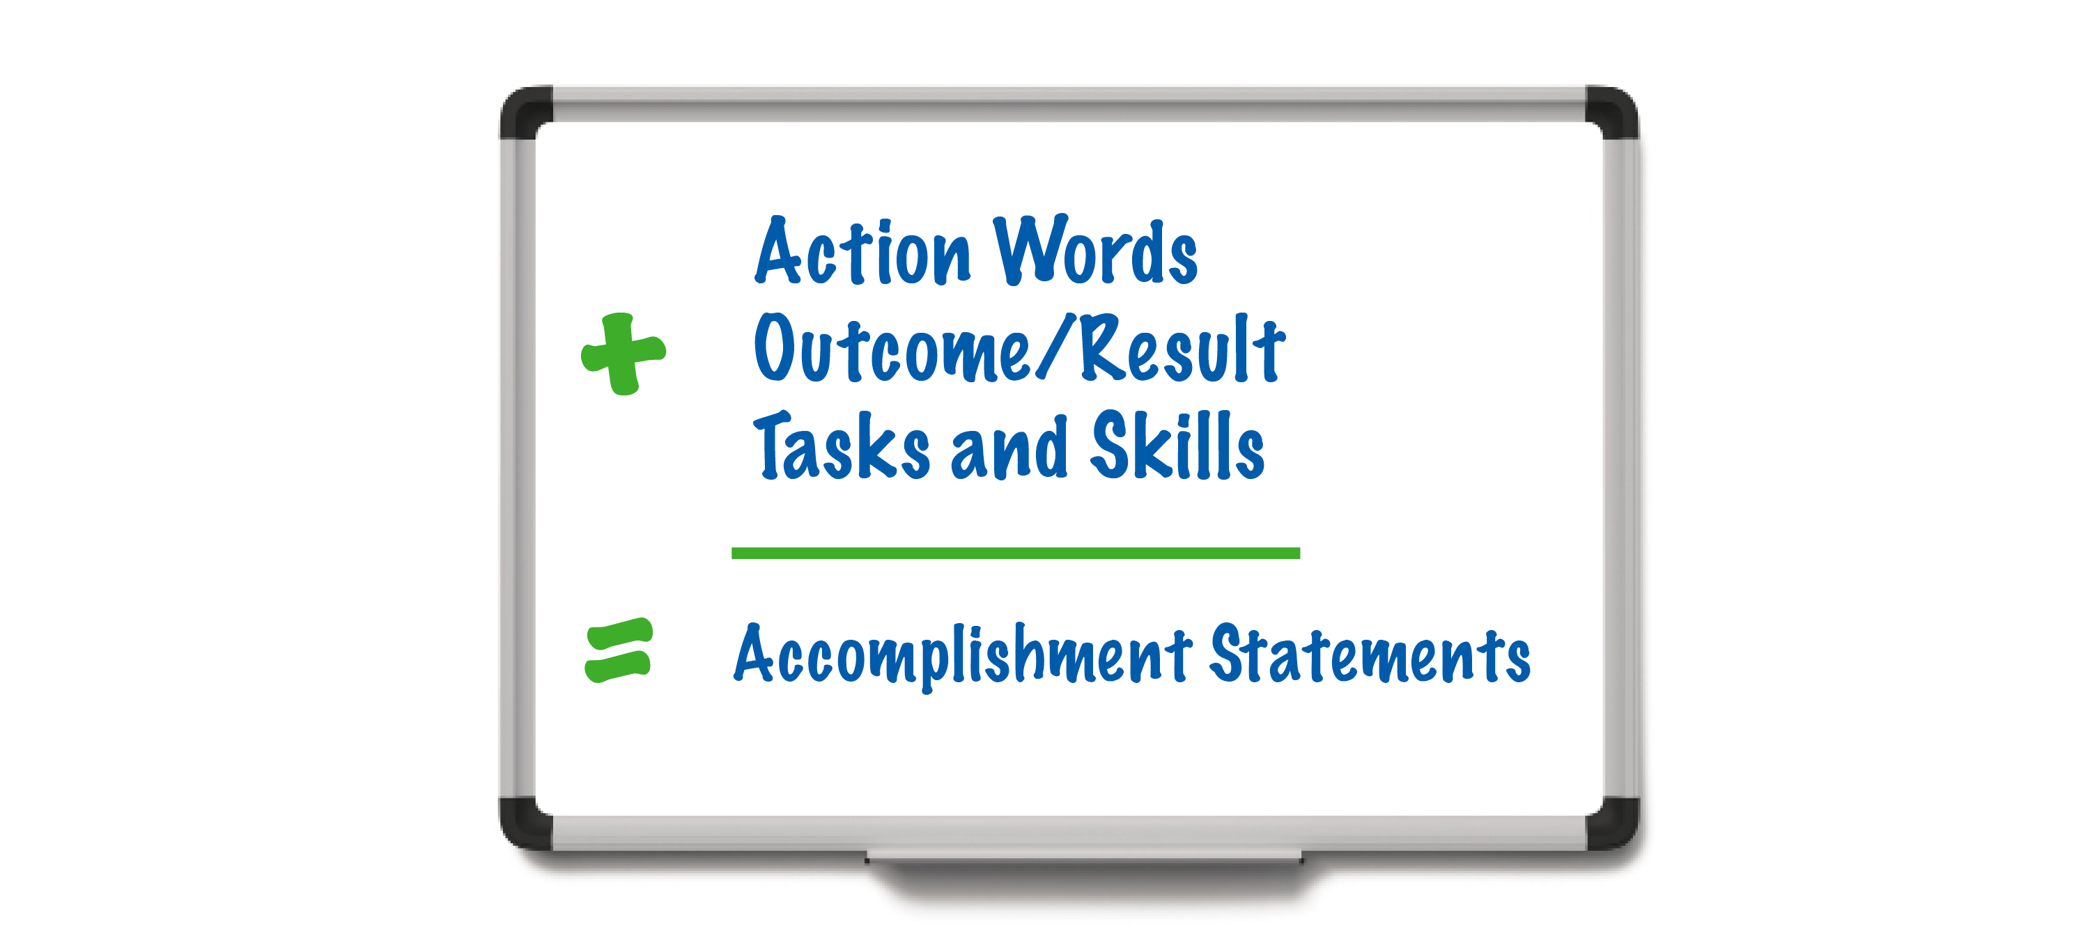
Advanced Resume Strategies:
Writing Results-Based Statements
Notes:
Talking Points
Best practice is to write accomplishment statements, not simply a list of tasks.
There is an important distinction between a task and an accomplishment.
A task tells the reader what you did. They are kind of like a job description (what the job is responsible to do)
Accomplishments tell how you did on the job, the results you obtained ( the difference you made for the organization)

Slide 9
Advanced Resume Strategies:
Writing Results-Based Statements
Focus on:
WHAT you did,
HOW WELL you did it, and
THE DIFFERENCE IT MADE!!
Notes:
Talking Points
Let’s look at an example of each. I am going to read one to you and you tell me if it’s an accomplishment or a task;
Wrote weekly reports on sales and submitted these to home office. (task)
Completed 156 summary reports on sales, including weekly volume, percent of increase, new clients seen. (accomplishment)
Which do you think will impress an employer more? Why?
Accomplishments give employers a much better idea of how you have contributed to the department and organization.

Slide 10
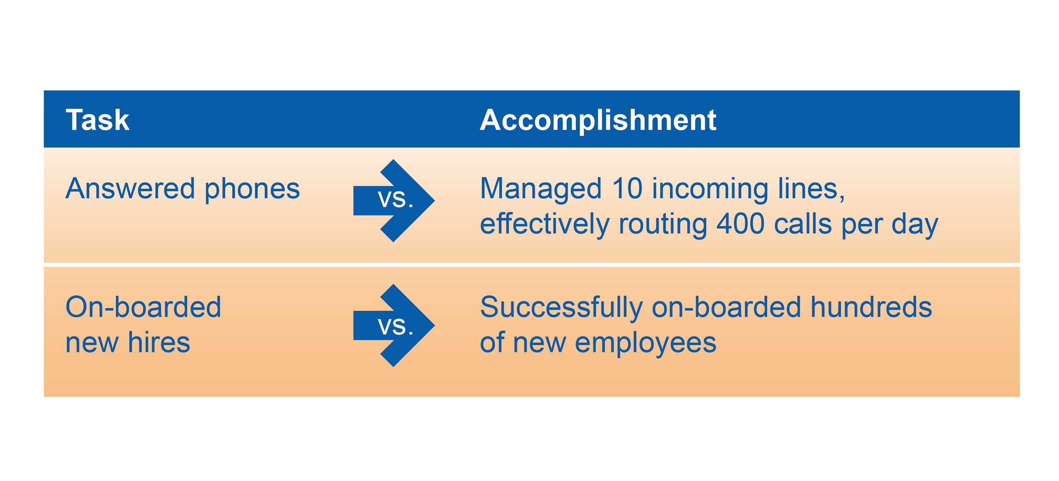
Tasks vs. Accomplishments
Notes:
Talking Points
Your bullet points should be accomplishment statements – a combination of tasks and skills that show your value.
To make your accomplishment statements more meaningful, use numbers wherever you can.
You can quantify in several ways: How much of something? What was the change (i.e. 0 to 70)? How often?(daily/weekly/monthly), etc.
Using numbers may require some thought on your part, however most of us can come up with some types of measurements (size of the warehouse, number of people supervised, customer calls per day, etc.)
Your numbers should not include confidential or proprietary company information.
If you don’t have exact numbers do your best to make a reasonable estimate.
Even if you don’t have numbers, accomplishment statements are still stronger than a task-based statement.
Example: Grew client base by effectively using cold call techniques
Example: Worked with team members to inspect products for defects and reported findings to supervisors
Begin accomplishments with a good action verb that shows a skill – Example: “Coordinated monthly schedule…. “ instead of “Responsible for coordinating the monthly schedule…”

Slide 11

How Have You Made a Difference?
Made money, increased revenue?
Saved money, cut costs or expenses?
Saved time, created a better, faster way?
Helped achieve the department or organizational goals?
Notes:
Talking Points
Here are 4 solid considerations when you are writing your accomplishment statements. Of course there are more but let’s work with these for now.
Writing accomplishment statements based on any of these will make your resume stronger. Specifically, accomplishment statements address the things the employer is interested in, which is the bottom line. They also give you much more credibility in terms of persuading the recruiter and manager that you are a great candidate.
In some cases the organization’s goals for the job seeker may well be their job duties. How well did they do their job duties is what their next employer wants them to articulate.
Note: Refer to HO examples of strong statements from the resume examples in the folder. Point out the strong accomplishment statements on a few of the resumes
Note: Refer to HO on strong accomplishment statements
Activity: Writing an Accomplishment Statement 10 min
1. Instruct the participants to look at their own resume. Note: In case everyone does not have their resume with them you should be prepared with some task statements they could use to practice with.
2. Ask the participants to select a task they think could be rewritten to better highlight their accomplishments.
3. Remind them of the above questions.
4. Have them rewrite a task from their resume changing it to an accomplishment. Assist those who may be having a difficult time.
5. Ask for 2 or more people to share their rewrite as time permits. If a few people haven’t been able to complete one, ask the class members how they might approach it.

Slide 12
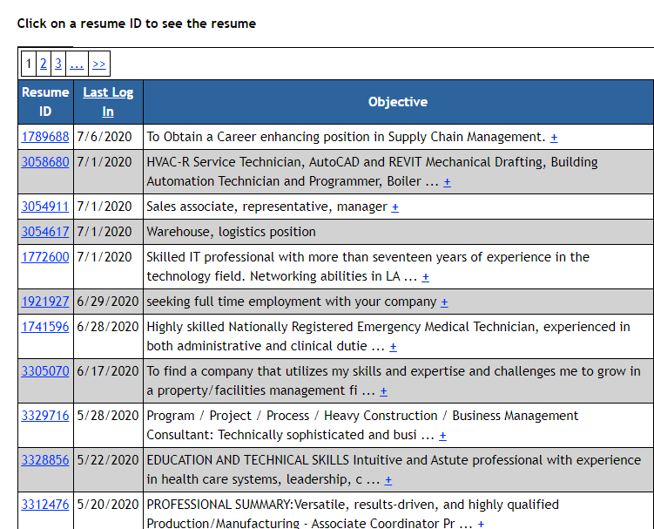
Applicant Tracking Systems (ATS)
Software applications designed to handle recruitment and hiring electronically
Your resume has to get through to be seen!
Notes:
Talking Points
An ATS (Applicant Tracking System) is a software application that enables electronic handling of the organization’s recruitment and hiring needs. In some respects they are similar to CRM (Customer Relationship Management) systems which allow organizations to manage their customer relationships.
There are many kinds of ATS and they do things a little different. This make it challenging for job seekers as you don’t know what company has what kind of system and how they actually work.
The other challenge ATS create for job seekers, is writing a resume that will get through the system while simultaneously being appealing to the human eye.
Most resumes are not seen by a human being because these systems are designed to weed through the unqualified to allow for focus on those who are qualified. In other words, they filter out those they determine to be unqualified.
This information was taken from the following articles/webpages:
https://choosework.ssa.gov/blog/2018-10-25-applicant-tracking-systems-is-your-resume-hitting-the-mark
https://www.cio.com/article/3117052/4-tips-to-get-around-resume-filtering.html
https://www.glassdoor.com/blog/is-it-ever-okay-to-apply-for-a-job-if-youre-underqualified/
https://www.hloom.com/resumes/ats-resume-templates/
https://www.jobscan.co/blog/use-jobscan-to-get-past-an-applicant-tracking-system/

Slide 13

Applicant Tracking Systems (ATS)
Match keywords from the job posting with words in your resume
Notes:
Talking Points
Keywords are terms that are related to the type of position you are looking for. Applicant Tracking Systems (ATS) search for keywords which are entered by the recruiter or manager.
When the words on your resume match the keywords on the posting, you increase the likelihood that your resume will be seen by the recruiter or manager.
Applicant Tracking Systems (ATS) basically measure the percentage of skills and other keywords that match what the company is looking for.
Ask: So how do we know what the keywords are for the job we want?
Look at multiple postings for the jobs you are interested in and qualified for and make a list.
Use onetonline.org.
Look on LinkedIn and see who has the kind of job you are after and look at their skills and experience.
Use free online tools, which we will discuss next.
This information was taken from the following articles/webpages:
https://choosework.ssa.gov/blog/2018-10-25-applicant-tracking-systems-is-your-resume-hitting-the-mark
https://www.cio.com/article/3117052/4-tips-to-get-around-resume-filtering.html
https://www.glassdoor.com/blog/is-it-ever-okay-to-apply-for-a-job-if-youre-underqualified/
https://www.hloom.com/resumes/ats-resume-templates/
https://www.jobscan.co/blog/use-jobscan-to-get-past-an-applicant-tracking-system/
Note: Distribute and Review HO “Why Keywords Matter” by John Shields.
The handout points out different names for the same thing, job titles and the most important one, tense on page 2 of the handout.
ATS systems cannot read tense. Most job posting are in present tense. Mirror the tense too!
To be successful you need to mirror the language of the job posting. If you don't take the time to do this, you take significant risk that even though you are a great candidate, your resume is never seen.

Slide 14

Cloud Software Help
Wordart.com
TagCrowd.com
JobScan.co
Notes:
Talking Points
Here are a few sites that help with skill words and keywords for Applicant Tracking Systems.
Wordart.com was used to create the graphic here
TagCrowd.com is free and you can upload the job posting and it will show you the most used keywords
JobScan.co gives you 5 free scans per week, you can upload both your resume and a job posting and it will tell you how close of a match you are.
Expert opinions on ATS systems vary on what match rate a jobseeker’s resume should aim for. Some say as low as 70% and others suggest as high as 80-90%. We recommend you have a minimum of 80% match.
Ask if 1-2 people have brought their resumes and if they would want to use them as examples for how to match job posting language using Jobscan.co It would be best if they also had access to a relevant job posting
Review how to find keywords in a job posting
OR
Log in to Jobscan.co, go to Tutorials and play the How to Beat the ATS with Job Scan (2:02 min) and the play Resume Match Report (2.22 min).
HO How to Use Jobscan.co for Free and Tips for Getting Your Resume Through Applicant Tracking Systems and review briefly.

Slide 15

Advanced Resume Checklist
Notes:
Talking Points
Note: Skip this if you are running out of time. They can take it home with them.
Note: Distribute and Refer to HO Checklist-Advanced Resume. Tell participants that this handout reviews key points to have on your resume and things to avoid on your resume.

Slide 16
Questions?
Notes:
Talking Points
By applying the 3 strategies of Targeting, Accomplishment Statements and ATS, you will increase the chances that your resumes will get you in for the interviews.
Need More Resume Help? Register for one-on-one resume review session.
Note: Tell them how they can do that as pertains to your location

Slide 17
Thank You!
First Name Last Name
Email address you might want to share with the class
CareerForceMN.com

