Slide 1
Career Exploration
Welcome! Please take a name tent and folder
Upon request, the information in this document can be made available in alternative formats for people with disabilities by contacting [INSERT PHONE NUMBER]
CareerForce is an equal opportunity employer and program provider and a proud partner of the American Job Center Network.

Slide 2
Agenda
Factors which may influence your career decisions
How using assessments can appraise your skills, values, experience and interests
Taking an action step toward a career path
Notes:
Note: Review slide

Slide 3
CareerForce Career Counselors
We Can
Provide ideas and resources to help you in the process
Offer guidance and suggestions
We Cannot
Tell you what job is right for you
Notes:
Talking Points:
Americans typically change jobs multiple times over their working lifetime. Think back to your first job, are you still doing that job today?
Not only do we typically change jobs, changing to different careers is now occurring 5-7 times over the course of one’s work life.
Knowing how to explore careers is very helpful with that process.
Career Exploration can seem like a daunting undertaking, but CareerForce Career Counselors are here to help you.
Note: Review slide
Why can’t we just tell you what job is right for you? Because Career Exploration is a process that depends on your individual strengths, skills, and interests.

Slide 4
Career Exploration is an ongoing process
First, know yourself.
Next, investigate “The World of Work.”
Finally - Decision Making!
Notes:
Talking Points:
Career Exploration can be seen as a lifelong, ongoing process, but we may not always be as planful or proactive with that process as we could be.
How many of us carefully plan out our upcoming vacations? Do you research the area you will be visiting? See when is the best time of year to go there, what to do, where to stay etc.? We want that vacation to be something we enjoy right?
Do we use similar processes when planning our careers? Or have we fallen into a line of work more by accident than by planning?
Using a career exploration process will assist you with taking charge of your career.
Career Exploration in a very general way can be looked at as a 3-step process:
First, know yourself.
Next, investigate “The World of Work” – what is out there in the job market.
Third is Decision Making – selecting occupations which you want to steer your job search towards.

Slide 5
What Factors Influence Career Decisions?
Notes:
Talking Points:
Part of knowing yourself includes being aware of what factors influence your career decisions. Those factors may not be something that you have specifically thought about before but they likely have influenced your career decisions. Let’s make a list of common factors together.
ACTIVITIES: Identifying Factors that Influence our Career Decisions 10 minutes
Ask the class to identify factors that may come into play when making career decisions, such as what jobs to apply for. Write down their ideas on the board and discuss as time allows.
Add to the class’s list any of the following that are NOT named:
Life and Personal Values
Location of their home and of job
Physical requirements
Aptitudes required (natural, innate talent & ability you are born with)
Education required
Difficulty of courses required
Outlook (predicted availability of jobs)
Industry trends (growth, decline, changes)
Wages
Skills you have and like to use

Slide 6
It is important to have good balance between your values and your work.
Notes:
Talking Points:
Have any of you ever had that unsettled feeling in your stomach and anxiety as soon as you start thinking about your job or your next work day? I call it the “The pit of your stomach” test. We all can have off days but if that is the typical start to your day, it might be an indicator that the balance between your values and your job is off.
Your work values include the factors that are important to you. It is critically important to think through your underlying work needs and motivators, like what drives you throughout your day, and what your personal work values are, such as your beliefs and philosophies.
To have a good fit personally and professionally in a career, it is important to have balance between your values and your career. Therefore your work values are important things to be considered when you are exploring careers.
Optional HO: Determine your Values
The Instructor has the choice to do this HO in class or have the participants do it at home if attendees have questions on how to determine values.

Slide 7
SKILLS
Notes:
Talking Points
Introduce that another key element of Career Exploration is to know what activities you enjoy doing and thinking about what skills you already have.
ACTIVITIES: Identifying Skills through Past Enjoyable Activities 10 minutes
HO Identifying Skills through Past Enjoyable Activities
Have class participants list 5 activities they enjoyed and what skills they used while doing those activities.
Ask if a few class participants would be comfortable sharing what they wrote

Slide 8
Interest and Skills Assessments
Notes:
Talking Points
Have you ever wondered what the difference is between an assessment vs. a test?
On a test means there are right or wrong answers and a grade of some kind, while there are no “wrong” answers on an assessment.
Ask the class if they feel the activity they just completed would more closely relate to an assessment of their skills or a test of their skills?
Both tests and assessments can be beneficial ways to explore what different careers might be a good fit for your interests and skills.
ACTIVITY: Skills Assessment on CareerForceMN.com Demonstration 15 minutes
Go to CareerForceMN.com and select on “Online Tools” from the main menu bar, then click on “Take a skill assessment” and get class participation to complete the assessment to demonstrate how to complete the assessment.
When taking interest assessments, do not think about the job market or how much a job might pay. Remember you are only identifying your interests.
Those factors come into play later.
Do not “overthink” the questions. An interest assessment only asks “does this sound interesting” or “is this something I might like to do”
NOT – “am I good at it”
NOT – “do I want to do this activity for my lifetime career”

Slide 9
Complete Online Interest Assessment at CareerForceMN.com
Notes:
Facilitator direction: Proceed to the correct slide depending on which version of assessment is being used based on needs of the workshop/site. How to review job zones/careers matches will be explained on slide 12
Versions of assessment available
1. In class computerized personal assessment-slide 9
2. In class paper and pencil person assessment-slide 10
3. In class review of assessment by doing a practice group assessment- slide 11
Talking Points For slide 10
To determine your personality type and what career types and occupations most closely match your personality type you would take an interest assessment.
In class computerized personal assessment- workshop attendees individually go to careerforcemn.com and do interest profiler
Tools needed for attendees:
email to be sent to workshop attendee 1 week prior to workshop with instructions for to sign up for CareerForceMN.com account – a person doesn’t need an account to take the assessment but they will need an account if they want to save their assessment results and match them to potential career options that would be good fits for them
individual computers to use
Allow for approximately 30 minutes to complete assessment
To take an interest assessment, go to CareerForcemn.com and select “Online Tools” from the main menu bar, then select “Take an interest assessment”.

Slide 10
Complete Paper Skills Assessment
Notes:
Talking Points
To determine your personality type and what career most closely match your personality type you would take an interest assessment.
In class paper and pencil personal assessment-
Give workshop attendees instructions for how to complete individual paper assessment
Allow for approximately 30 minutes to complete assessment
Tools needed for attendees – NOTE: this is best currently identified paper and pencil option, but discussions of other potentially less expensive paper and pencil assessment options are ongoing:
SDS- Adult (Self – Directed Search) materials
Where to order: https://www.parinc.com/Products/Pkey/506
Approximate costs:
11257-AB Standard SDS Assessment Booklets (pkg/25) $65.00
11258-AB Standard SDS Occupations Finders (pkg/25) $87.00

Slide 11
Complete Online Interest Assessment
Notes:
Talking Points
To determine your personality type and what career options most closely match your personality type you would take an interest assessment.
Review the assessment by doing a practice group assessment.
Allow for approximately 30 minutes to complete assessment
Tools needed:
Facilitator's computer
Facilitator does not need a CareerForceMN.com to take the assessment HOWEVER facilitator must have CareerForceMN.com account to save assessment results and to save potential career options that are a good fit based up on assessment results
To take the interest assessment, go to CareerForceMN.com and select “Online Tools” on the main menu bar, then select “Take an interest assessment”, read the questions out loud, and get class participation on which answers to select for each question to demonstrate how to complete the assessment.

Slide 12
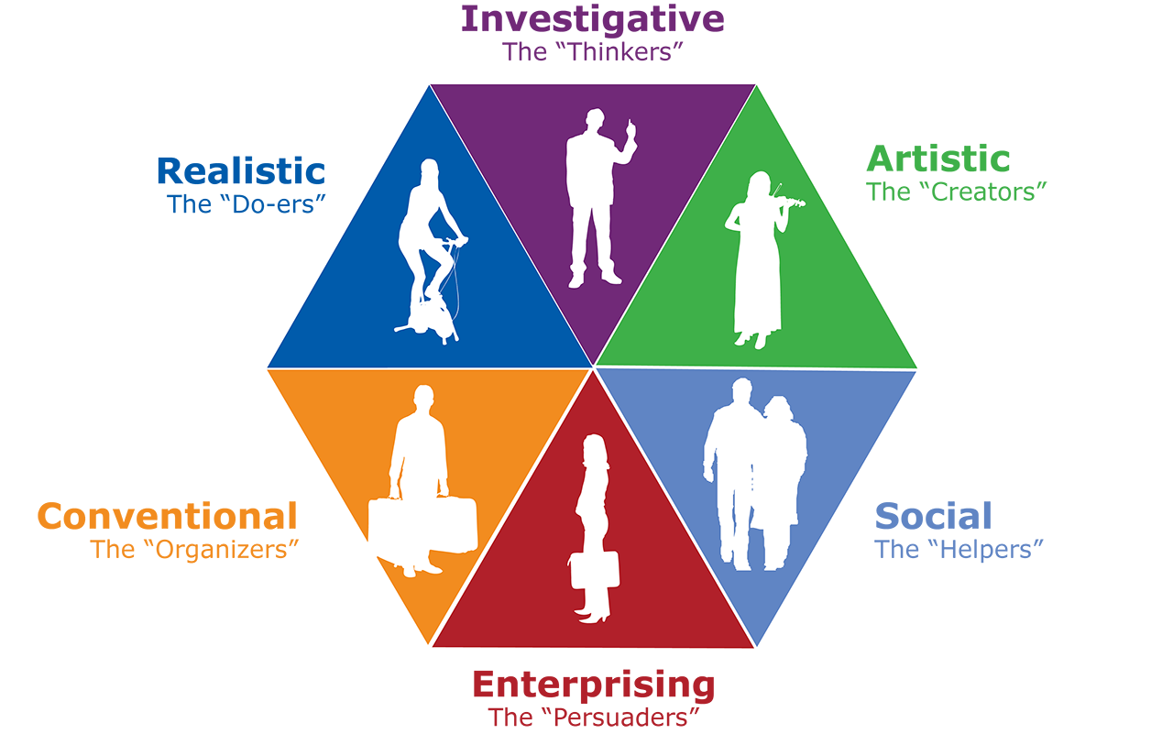
Understanding Holland’s RIASEC System
Notes:
Talking Points
Once assessment is completed, point out that on CareerForceMN.com there are recommended career types and occupations on the results page. These recommendations are based on Holland’s RIASEC system.
In vocational assessments one of the most widely used systems is based on a theory by John Holland Ph.D.
Holland was a job classification interviewer with U.S. Army and from that experience he realized there were some common personality types.
The Holland code assessment is based on the notion that we make work choices based on personality and that people look for environments where they can use their skills and abilities to express themselves.
Holland also said that people who work on an environment similar to their personality are more likely to be successful and fulfilled.
The 6 personality types are;
Realistic
Investigative
Artistic
Social
Enterprising
Conventional
All of these types are equal in importance and are needed in every organization, and it is good to know what personality types you most closely connect with.
Ask if a few class participants would be comfortable sharing their type and if they feel it is accurate for them.
ACTIVITY: Review how to explore career matches based on assessments on CareerForceMN.com
Show how you can select occupations as career goals that are presented as matches on the interest assessment results page on CareerForceMN.com
Then you can see MN specific demand, MN specific wage ranges, daily tasks, educational requirements, certification information and a short video for up to 6 occupations you select as career goals
Remind class participants that they can save career goals and assessment results if they have an account on CareerForceMN.com, but it is not necessary to have an account to take either the interest or skills assessment on CareerForceMN.com
ACTIVITY: explore job zones/ careers matches on O*NET -do an example using group info 10 minutes
WWW.MYNEXTMOVE.ORG
Go to: “Tell us what you like to do” (start)
Interest profiler – enter scores you obtained when do the assessment
Go to next to see graph
Job Zones – choose Job zone refers to the level of education typically needed for the position with1 being the least amount and 5 being the most (such as a Master’s or perhaps a PhD)
Review list of careers
Give out HO "Exploring Assessment and Career Exploration Resources on CareerForceMN.com" so they can explore further on their own outside of class.
Give out HO ”Exploring Onet” so they can explore further on their own outside of class.

Slide 13
Career Planning
WORLD OF WORK
YOU
Purpose
Interests
Values
Skills
Personality
Labor Market
Required skills/training
Trends/Outlook
Compensation
Shifts
Location
Decision Making
Set Career Goals
Ed/Training
Create Plan
Employment
Notes:
Talking Points
This is a model of the career planning process which gives you a roadmap and points out the stops along the way.
The first thing to consider is you. Who are you, what your interests are, etc.
But this alone is insufficient. You also have to take into consideration what is often called the “World of Work”. For example, if I want to be a Graphic Artist, but the labor market is saturated with Graphic Artists, that might not be a good choice. In addition you need to look at the skills needed for the desired position? Do you need training? What kind? How long is it? How can I afford it? How might the job affect my family, my life? Might I have to relocate? What days/shifts will I be required to work?
Finally, after these considerations you make a decision about your direction, set goals, create a plan, implement the plan.
Then guess what happens… Over time, you’ll start the process again. For a young person today, it might be 5-7 times.
This career planning process shows the pieces of the puzzle that you need to put together to make an informed career decision.

Slide 14
Have a Written Plan using SMART Goals
SMART Goals
Specific
Measurable
Attainable
Relevant
Timely
Notes:
Talking Points
You have been given a lot of information today, which for some of you might feel overwhelming, and for others might be exciting because now you have resources to start using. But when you are ready for next steps you are much more likely to act and follow through if you create a written plan including SMART goals.
A good way to do this is to have specific blocks of time scheduled on your calendar for career exploration activities
Note: Review SMART goals
Specific: NOT SPECIFIC: “I will attend a workshop” SPECIFIC: “I will attend the Interviewing workshop” Measurable: How will you know you’ve reached your goal? (I will have explored at least one assessment tool.) Attainable: Can you realistically accomplish this goal? (Yes, there’s a workshop next Tuesday.) Relevant: Do you really care about achieving this goal? (Yes! I want a job!) Timely: “Within 2 weeks, I will have attended the Interviewing workshop and completed at least one practice interview activity.”
SMART goals can be small short term goals that contribute towards a bigger long term goal.
HO SMART Goals Worksheet
Activity : “ SMART Goals Worksheet” 10 min.
Have the attendees work on creating a SMART goal to generate at least one measurable action step that will move them forward on their career path

Slide 15
Questions?
Notes:
Note Review slide
Talking Points
Need more assistance?
Register for one-on-one session.
Make an appointment with a CareerForce Career Counselor

Slide 16
Thank You!
First Name Last Name
Email address you might want to share with the class
CareerForceMN.com

