Slide 1
Notes:
Title Slide

Slide 2
minnESOTA CHAMBER FOUNDATION
Mission Statement
To bring stakeholders together to promote prosperity and long-term growth of Minnesota’s economy.
Purpose Statement
Preparing Minnesota for the future.

Slide 3
Minnesota Chamber Foundation Board of Directors
Susan Marvin, Marvin, Chair
Jon Campbell, Vice Chair
Rick Bauerly, Granite Equity Partners
Jeff DeYoung, Baker Tilly Virchow Krause, LLP
Hoyt Hsaio, Shaw Lundquist
Jean Kane, Colliers International
Ginny Morris, Hubbard Broadcasting
Bret Weiss, WSB

Slide 4
Foundation Economic Advisory Council
Kelly Asche, Center for Rural Policy and Development
King Banaian, St. Cloud State University
Chris Gudmastad, Securian
Mary Jeffries, Starkey Hearing Technologies
Jean Kane, Colliers International
Philip Kaufman, United Healthcare
Dale Kurschner, Kurschner and Associates
Myles Shaver, University of Minnesota, Carlson School
Michael Swenson, Wells Fargo
Notes:
So here is Minnesota:2030 Insight Number One:
Population and Labor Force growth is KEY.
Both are important to Minnesota’s Future Economic Growth.
Population growth projected to be about half a percent per year.
Labor force growth is also projected to be about half a percent per year.
Minnesota’s labor force participation rate is already highest or second highest in the country (70.3 percent - Nov. 2019), so we can’t expect too much more on that front.
Therefore, growing our future labor force will require population growth - Strengthening Net Domestic Migration and Encouraging/Welcoming International Migration – as well concerted efforts to keep older workers in the workforce, and do a better job educating and engaging young people.

Slide 5
minnESOTA CHAMBER FOUNDATION
Three areas of emphasis
Center for Economic Research
  Minnesota: 2030
  Impact of COVID-19
  Economic Recovery Dashboard
Center for Workforce Solutions
Leadership Development
  Leadership Minnesota
  Leaders Lab

Slide 6
Minnesota Economic Recovery Dashboard
Economic Recovery Dashboard
Notes:
So here is Minnesota:2030 Insight Number One:
Population and Labor Force growth is KEY.
Both are important to Minnesota’s Future Economic Growth.
Population growth projected to be about half a percent per year.
Labor force growth is also projected to be about half a percent per year.
Minnesota’s labor force participation rate is already highest or second highest in the country (70.3 percent - Nov. 2019), so we can’t expect too much more on that front.
Therefore, growing our future labor force will require population growth - Strengthening Net Domestic Migration and Encouraging/Welcoming International Migration – as well concerted efforts to keep older workers in the workforce, and do a better job educating and engaging young people.

Slide 7
Today’s agenda:
  Minnesota’s Economic Structure
  Impact of COVID-19
  Opportunities for Growth
Notes:
So here is Minnesota:2030 Insight Number One:
Population and Labor Force growth is KEY.
Both are important to Minnesota’s Future Economic Growth.
Population growth projected to be about half a percent per year.
Labor force growth is also projected to be about half a percent per year.
Minnesota’s labor force participation rate is already highest or second highest in the country (70.3 percent - Nov. 2019), so we can’t expect too much more on that front.
Therefore, growing our future labor force will require population growth - Strengthening Net Domestic Migration and Encouraging/Welcoming International Migration – as well concerted efforts to keep older workers in the workforce, and do a better job educating and engaging young people.

Slide 8
Minnesota at the close of the decade

Slide 9
Minnesota at the end of 2019
3 Characteristics Explain Competing Views on Minnesota’s Economy:
  1. Highly developed
  2. Slow growth
  3. Uneven outcomes

Slide 10

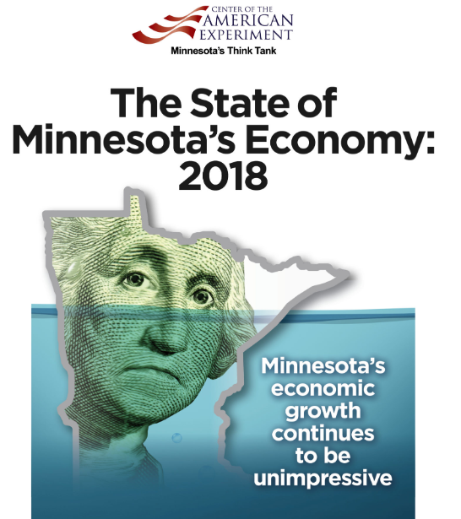
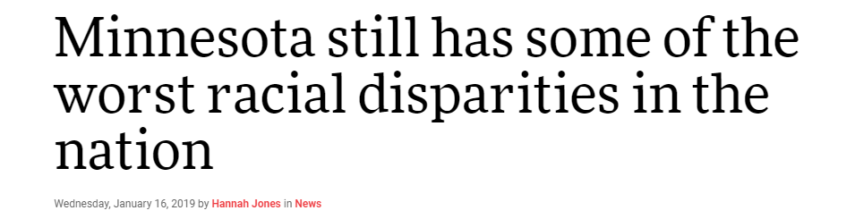
Competing views on Minnesota’s Economy

Slide 11
Minnesota Has A Highly Developed Economy
1
High Value. Per capita income, GDP per capita, and labor productivity levels.
Hard Working. Labor force participation and lowest unemployment rates in US.
Educated and Skilled Workforce. Education levels and concentrations of high skilled workers
Innovation. High rate patent activity
Corporate Hub. Fortune 500 headquarters and industry leading firms
Diverse Economy. Jobs spread across major industry sectors.
Industry clusters in key sectors. Health care and Med-tech, Food & Ag, HQ’s, Finance & Insurance, High Tech
2
3
4
5
7
8

Slide 12
Minnesota’s per capita income rose above U.S. levels in 1973 and has stayed there ever since

Slide 13
Minnesota has structurally higher employment rates than the U.S.
Notes:
So here is Minnesota:2030 Insight Number One:
Population and Labor Force growth is KEY.
Both are important to Minnesota’s Future Economic Growth.
Population growth projected to be about half a percent per year.
Labor force growth is also projected to be about half a percent per year.
Minnesota’s labor force participation rate is already highest or second highest in the country (70.3 percent - Nov. 2019), so we can’t expect too much more on that front.
Therefore, growing our future labor force will require population growth - Strengthening Net Domestic Migration and Encouraging/Welcoming International Migration – as well concerted efforts to keep older workers in the workforce, and do a better job educating and engaging young people.

Slide 14
Minnesota is the innovation hub of the upper Midwest
Source: Minnesota Chamber Foundation, U.S. Patent and Trademark Office
Notes:
The other exponential driver of economic growth and productivity for Minnesota is innovation.
Advances like the computer revolution of the 60s and 70s. Or the personal computer. Or the information age and the growth of the Internet – create major opportunity.
And innovation is a core Minnesota strength dating to that original computer revolution of the 60 and 70s, and companies such as Control Data, Unisys and Cray Research. And earlier, on the strengths of companies like 3M.
This chart shows patents registered per 1,000 people over roughly 50 years – and, as you can see, Minnesota – in the black line – has been the clear innovation hub of the upper Midwest.

Slide 15
Minnesota trails only slightly its most innovative peers
Source: Minnesota Chamber Foundation, U.S. Patent and Trademark Office
Notes:
In fact, Minnesota only slightly trails its most innovative peers nationally.
Again, Minnesota is represented as the black line.

Slide 16
Minnesota’s specialized sectors are stacked toward higher wage activities
Industry | LQ | Avg Ann Wages
Management of Companies and Enterprises | 1.77 | $125,823
Finance and Insurance | 1.22 | $106,825
Utilities | 1.11 | $105,435
Mining, Quarrying, and Oil and Gas Extraction | 0.43 | $92,493
Professional, Scientific, and Technical Services | 0.89 | $92,003
Wholesale Trade | 1.14 | $85,042
Information | 0.9 | $76,930
Manufacturing | 1.29 | $67,196
Construction | 0.88 | $63,158
Public Administration | 0.93 | $59,052
Total - All Industries | 1 | $57,709
Transportation and Warehousing | 0.88 | $54,663
Real Estate and Rental and Leasing | 0.8 | $54,424
Health Care and Social Assistance | 1.15 | $53,910
Educational Services | 0.93 | $48,898
Agriculture, Forestry, Fishing and Hunting | 1.22 | $47,178
Administrative and Support and Waste Management and Remediation Services | 0.72 | $40,463
Arts, Entertainment, and Recreation | 1 | $34,681
Retail Trade | 0.97 | $31,240
Other Services (except Public Administration) | 1 | $31,132
Accommodation and Food Services | 0.85 | $20,624
MN employment share > U.S. ave
Average Industry Wages in Minnesota

Slide 17
Minnesota is a national and global hub for medical innovation
487,612
Minnesotans work in healthcare or medical related industries
16%
share of total state employment
(Minnesota has 22% more hospital workers than the U.S. average)
This doesn’t include healthcare related software companies, social assistance, or diversified manufacturers that make medical goods but may get classified under a different industry.
(Minnesota has nearly 10 times the national average of medical device manufacturing)

Slide 18
Evidence of Minnesota’s Slow Economic Growth
Minnesota’s economic growth as measured by…
Real GDP
Employment Growth
Per Capita Income

Slide 19
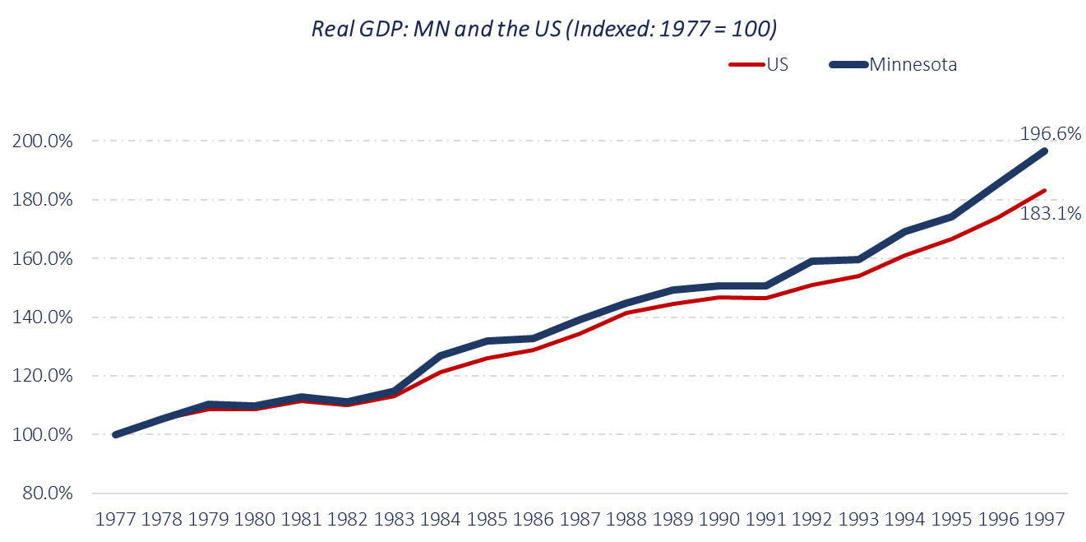
Minnesota out-performed the U.S. economy for almost three decades… from 1977 to 2004
Real GDP: Minnesota and the U.S. (Indexed: 1977 = 100)
MN Ave Ann. GDP = 3.4%
Minnesota
U.S.
Source: Minnesota Chamber Foundation, Bureau of Economic Analysis
Notes:
Overall, Minnesota’s economic growth story is more complicated.
For almost three decades, roughly from 1977 to 2004… Minnesota outperformed the U.S., transforming from a primarily ag, natural resources and manufacturing state, like its Midwestern neighbors, to become a larger, more innovation-driven economy with higher concentrations of jobs in healthcare, medical technology, corporate headquarters, high-tech manufacturing, insurance and financial services. This transformation occurred primarily in Minnesota’s urban regions, particularly the Twin Cities, with smaller towns and rural areas not always experiencing that same kind of growth.
Comparing Minnesota’s Real GDP to the U.S. – indexed in this chart to 100 in 1977 – you’ll see Minnesota’s economy grew faster than the U.S. for nearly three decades… in a clear, extended, economic “winning streak.”

Slide 20
Since 2005, Minnesota has often grown more slowly than the U.S. in terms of real GDP
MN Ave Ann. GDP = 1.7%
Source: Minnesota Chamber Foundation, Bureau of Economic Analysis
Notes:
It’s a bit of a different story since 2005, however.
This chart indexes Minnesota’s economy and the U.S. again to 100 – this time in 1997.
You’ll see that Minnesota’s economy – in terms of Real GDP – has been growing more slowly than the U.S. basically since 2005.
That’s a surprising fourteen years.

Slide 21
Job growth was strong – with jobs in Minnesota
growing faster than the U.S. for almost three decades
Annual job growth:
Minnesota win-loss record vs. United States
1970 | 1971 | 1972 | 1973 | 1974 | 1975 | 1976 | 1977 | 1978 | 1979 | 1980 | 1981 | 1982 | 1983 | 1984 | 1985 | 1986 | 1987 | 1988 | 1989 | 1990
w | w | w | w | w | w |  | w | w | w |  |  |  |  | w |  | w | w | w | w | w
 |  |  |  |  |  | L |  |  |  |  | L | L | L |  | L
 |  |  |  |  |  |  |  |  |  | T
Win
Loss
Tie
1991 | 1992 | 1993 | 1994 | 1995 | 1996 | 1997 | 1998 | 1999
w | w | w | w | w |  |  | w | w
 |  |  |  |  |  | L
 |  |  |  |  | T
(Minnesota’s W-L-T record 1970-1999)
22 - 6 - 2
Win
Loss
Tie
Source: Minnesota Chamber Foundation, Bureau of Economic Analysis
Notes:
Job growth is particularly important to an economy – and, again, job growth in Minnesota has been strong.
In fact, for almost three decades, Minnesota’s job growth outpaced the U.S.
This chart looks at annual job growth like a “box score.” Did Minnesota win – growing jobs faster than the U.S.? Or did we lose… growing jobs more slowly than the U.S. average?
In the 70s, 80s, and 90s… you’ll see Minnesota was on an extended “job growth win streak.”
In 22 of those 30 years, jobs in Minnesota grew at a faster rate than the U.S.
Six years we grew more slowly – and two years we tied.
That’s a very enviable 22-6-2 record.

Slide 22
Since 2000, job growth in Minnesota has trailed the U.S. in 13 of the past 19 years
Annual job growth since 2000:
Minnesota win-loss record vs. United States
Win
2000 | 2001 | 2002 | 2003 | 2004 | 2005 | 2006 | 2007 | 2008 | 2009 | 2010 | 2011 | 2012 | 2013 | 2014 | 2015 | 2016 | 2017 | 2018
 | w | w |  |  |  |  |  |  | w | w | w
L |  |  |  | L | L | L | L | L |  |  |  | L | L | L | L | L | L | L
 |  |  | T
Loss
Tie
Minnesota’s W-L-T Record: 2000 to 2018
5 - 13 - 1
Source: Minnesota Chamber Foundation, Bureau of Economic Analysis
Notes:
Since 2000, however, Minnesota has not done as well.
Minnesota did seem to recover more quickly from the 2001 recession, and the 2008 great recession, from a job growth perspective.
One reason could be the structure diversity of Minnesota’s economy – the number of important legs on Minnesota’s economic stool, if you will. That no one sector in Minnesota’s economy was hurt dramatically by either recession… was clearly helpful. Unlike the auto industry in Michigan, or real estate in Arizona, for example.
Beyond the two post-recession periods, however, our overall job growth won-lost record in the 21st century is pretty dismal…
at 5-13-1.

Slide 23
5 Factors Driving Minnesota’s Slow Economic Growth
1
Slowing labor force and population growth. Aging demographics and U.S. regional migration trends contributed to slowing population and labor force growth.
U.S. Regional Trends. Economic growth has been concentrated in a handful of sunbelt regions and coastal tech hubs this century.
U.S. Industry Trends. Minnesota’s economy is concentrated in slower growth industries.
Trailing in Tech Growth. Minnesota lost ground in high tech sectors as growth shifted to software and IT
Slow Productivity Growth. Minnesota has followed national trends of falling productivity levels.
2
3
4
5

Slide 24
Population growth and labor force growth projected to slow going forward
Source: IHS Markit
Notes:
Labor force growth – like population growth – is also projected to slow. Here in the red line.
This is an issue.
Population growth – the addition of more consumers – is important to economic growth, as we’ve demonstrated.
But growing the number of people available and willing to be employed producing goods and services is perhaps even more important to the vibrancy of our future economy.

Slide 25
Aging is contributing to Minnesota’s slowing labor force growth
Source: IHS Markit
Notes:
Minnesota is also a bit older than some states, and our aging population is a factor working against us.
From a labor force perspective – and a public services perspective – it is going to be important to try to keep more of these people in the workforce as they age, obviously.
That’s not an issue unique to Minnesota. But how effective we are at enticing older workers to remain or return to the workforce – and how encouraging we are to them once there – ccould be a difference-maker.

Slide 26
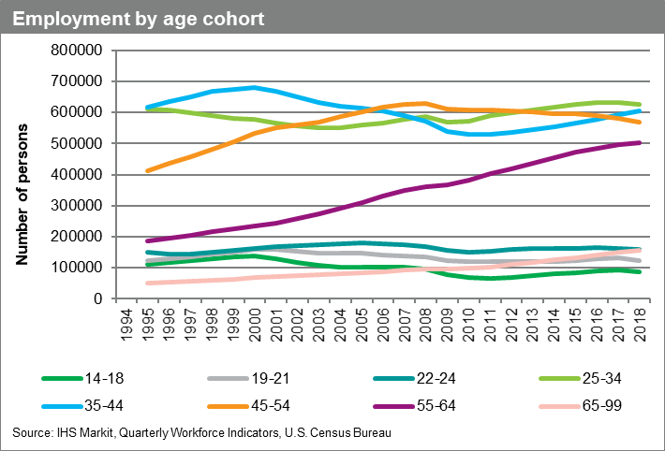
Minnesota’s workforce is also aging
Number of workers 55+ growing almost 1 percent a year since 2002
Number of workers
30 to 54 declined nearly
6 percent since 2002
Workers ages 45 to 54 declining since 2009
Source: IHS Markit
Notes:
Relative to workforce, Minnesota’s proportion of workers ages 55+ has been growing, up nearly one percent per year each year since 2002.
The proportion of workers ages 30 to 54 declined almost six percent in the same period.
And, the proportion of Minnesota workers ages 45-54 has been declining since 2009.

Slide 27
International migration adds to Minnesota’s population, domestic migration has largely been subtracting
Source: IHS Markit, 2019
Notes:
Population growth has three parts: Babies… the so-called “natural rate of increase (births subtracting deaths), domestic migration (the number of Americans moving here, minus the number of Minnesotans moving away), and International migration (the number of immigrants and new Americans arriving from other countries, minus those who move away).
As you can see, international migration has been adding to our population, in blue, while domestic migration, in red, has largely been subtracting. We’ve seen some improvement the past few years, but it’s clear net domestic migration remains an issue.
Where Minnesota performs better… is in attracting new residents from other countries. So population-wise, continuing to be a welcoming place for new residents is actually a growth strategy for Minnesota’s economy.

Slide 28
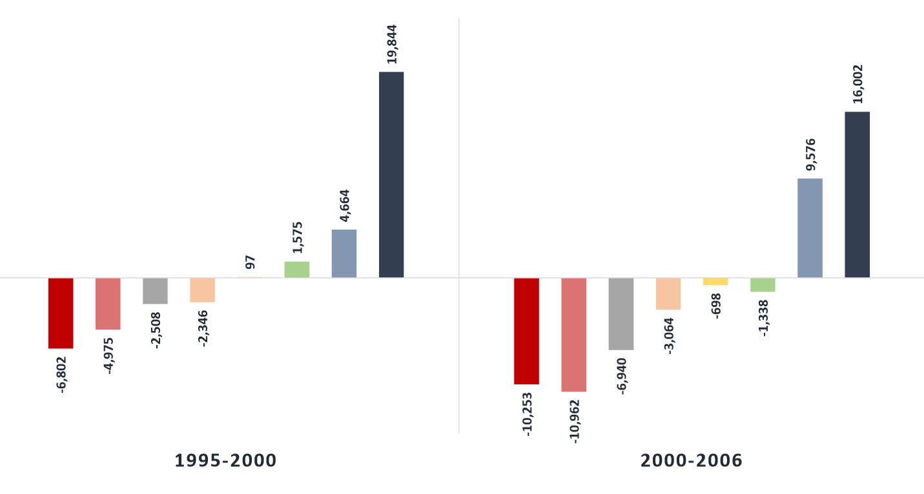
Population gains from Midwest neighbors decelerated, losses to Southwest, Southeast, Western states accelerated
Minnesota’s Net Migration Gains/Losses by Region
Southwest
Southeast
West Coast
Mountain West
Deep South
Northeast/Mid-Atlantic
Foreign
Midwest
Source: Internal Revenue Service
Notes:
Domestically, the formula has long been that Minnesota attracts new residents from neighboring Midwestern states… offsetting the loss of Minnesotans to other states, primarily in the Southeast and Southwest.
At least that used to be the formula.
More recently, we’ve seen population gains from our Midwest neighbors decelerate, while population losses to the Southwest and Southeast – and to western states and the West Coast – have accelerated.

Slide 29
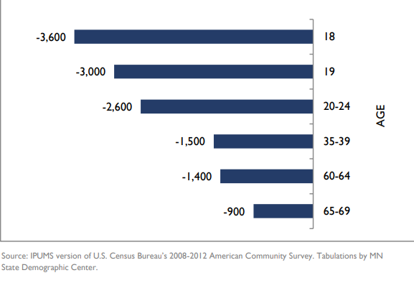
It’s not just retirees and snowbirds…
Age Groups with Net Losses from Migration to Other States (Annual Average Losses): 2008-2012

Slide 30
Minnesota has net losses to neighboring counties nearest the state border

Slide 31
Economic growth has been concentrated in the sunbelt and west coast this century

Slide 32
Metros in only a handful of states have captured a large share of economic growth
45 of the top 100 fastest growing metro economies were in only 5 states: California, Texas, North Carolina, Florida, and Washington.
Minnesota’s MSA Rankings (2000-2019)
Rochester = 42
Mankato = 83
Mpls-St Paul = 176
St Cloud = 216
Duluth = 221

Slide 33
Minnesota’s “Growth Portfolio” is not where the
growth has been
Minnesota’s economy relative to the U.S. economy
Higher Share
Roughly the Same
Lower Share
Mgmt of Companies
Agriculture
Manufacturing
Finance & Insurance
Health Care
Wholesale
Utilities
Local Gov’t
Arts/Entertainment/Rec
Other Services
Retail
Educational Services
Trans & Warehousing
Prof. Services
Information
Construction
State Gov’t
Accom & Food Service
Real Estate
Admin/Waste
Fed Gov’t
Mining and Oil
Top 5 fastest growing sectors in U.S. economy
Minnesota lags U.S. growth rate
Minnesota leads U.S. growth rate

Slide 34
Minnesota’s high tech job growth lags peer states
Minnesota
Massachusetts
Washington
North Carolina
Colorado
U.S.
Source: IHS Markit
Notes:
That combination has meant Minnesota is – and has been – trailing key state peers and certainly the national leaders in tech growth – both jobs and output.
The red line here is Minnesota.
The purple line is Washington. The blue line is North Carolina and the green line is Colorada. The U.S. average is in gray.

Slide 35
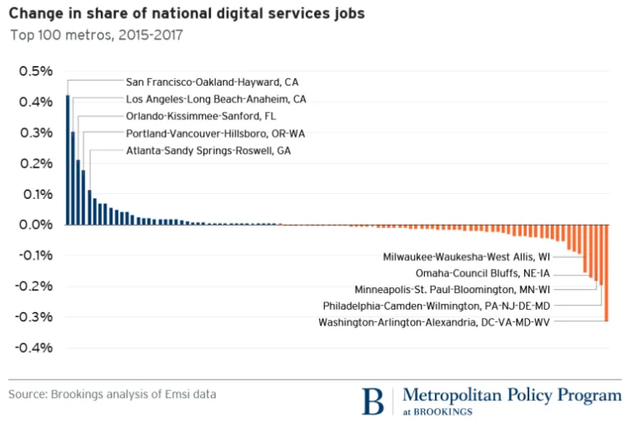
In fact, the Twin Cities metro is near the bottom of the top 100 metros in tech industry growth
MSP 2010-2017 Rank: 96
MSP 2015-2017 Rank: 94
Source: Brookings Institution
Notes:
In fact, the Twin Cities metro is near the bottom of the top 100 metros in tech industry growth – at 94th.

Slide 36
Minnesota’s productivity growth has been slowing
Productivity grew 1.3 percent per year on average: 1990 to 2018
Productivity grew just .5 percent per year: 2010 to 2018
Minnesota worker productivity outpaced the U.S. in 2017, 2018
Source: IHS Markit
Notes:
So how are we doing on productivity?
Well, results on that front are not entirely encouraging either.
Productivity growth in Minnesota averaged 1.3 percent per year from 1990 to 2018 – quite strong – but those numbers were front-end loaded by innovations like the PC, cell phone and Internet.
Since 2010, however, productivity gains have been averaging .5 percent per year.
We did better in 2017, and quite a lot better in 2018 - outpacing the U.S. in productivity growth both years.
With only modest population growth projections, however, getting to reasonable economic growth is likely going to require significant productivity growth. Which seems like a tall order.

Slide 37
Formula for Minnesota’s Economy (Pre-COVID19)
Leverage Minnesota’s strengths (workforce participation, innovation, key sectors, etc)
+
Address factors constraining growth (domestic migration, productivity growth, etc)
+
Foster growth across demographic groups and regional economies

Slide 38
Impact of COVID-19 on Minnesota’s Economy & Future Economic Outlook

Slide 39
April Jobs Report: Unprecedented 1-month job losses
Source: DEED, Current Employment Statistics

Slide 40
Sector breakdown: May Jobs Report
Worse than U.S.
Better than U.S.

Slide 41
Minnesota’s recovery slowed in July after strong gains in June
Minnesota needs to gain another 259,800 jobs to recover to 2019 levels

Slide 42
Minnesota Economic Recovery Tracker

Slide 43
Minnesota unemployment remains below U.S. levels
Source: DEED, BLS

Slide 44
Minnesota’s most specialized industries reveal more strengths than liabilities so far
 |  | Y-Y%
Mining and Logging |  | -19.90%
Local Government |  | -12.20%
Total Nonfarm |  | -9.10%
Health Care and Social Assistance |  | -6.80%
Fabricated Metal Product Mfg |  | -5.70%
Management of Companies and Enterprises |  | -5.70%
Transportation Equipment Mfg |  | -5.70%
Wood Product Mfg |  | -4.00%
Machinery Mfg |  | -2.80%
Food Mfg |  | -2.50%
Medical Equipment and Supplies Mfg |  | -2.40%
Insurance Carriers |  | -1.30%
Depository Credit Intermediation |  | -0.50%
Nav, Measuring, Electromedical, Control Instruments Mfg |  | 0.90%
Source: DEED, Current Employment Statistics

Slide 45
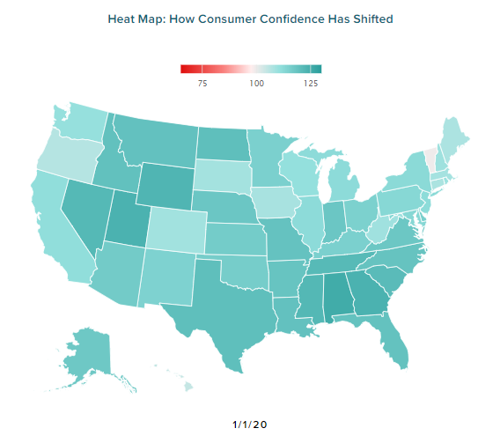
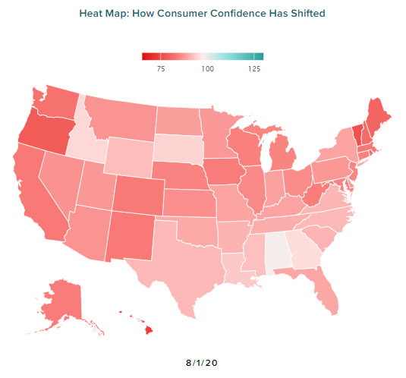
Consumer confidence has plunged since January in Minnesota and rest of the U.S.
MN = 115
MN = 87.6
Source: Morning Consult

Slide 46
Consumer Confidence and Hourly Work Levels Have Moved (or not moved) in Tandem
Source: Morning Consult, When I Work

Slide 47
Rise in seated dining activity could signal improving confidence
Source: Morning Consult, When I Work, Open Table

Slide 48
Total consumer spending in Minnesota has likewise risen
Source: Opportunity Insights

Slide 49
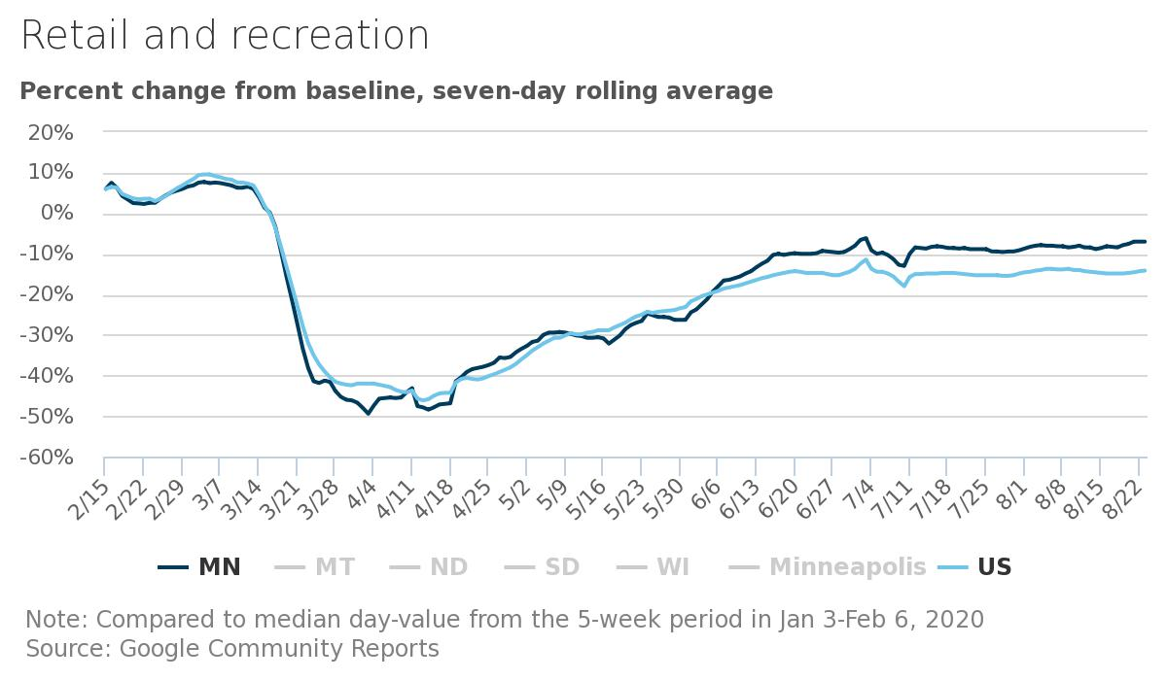
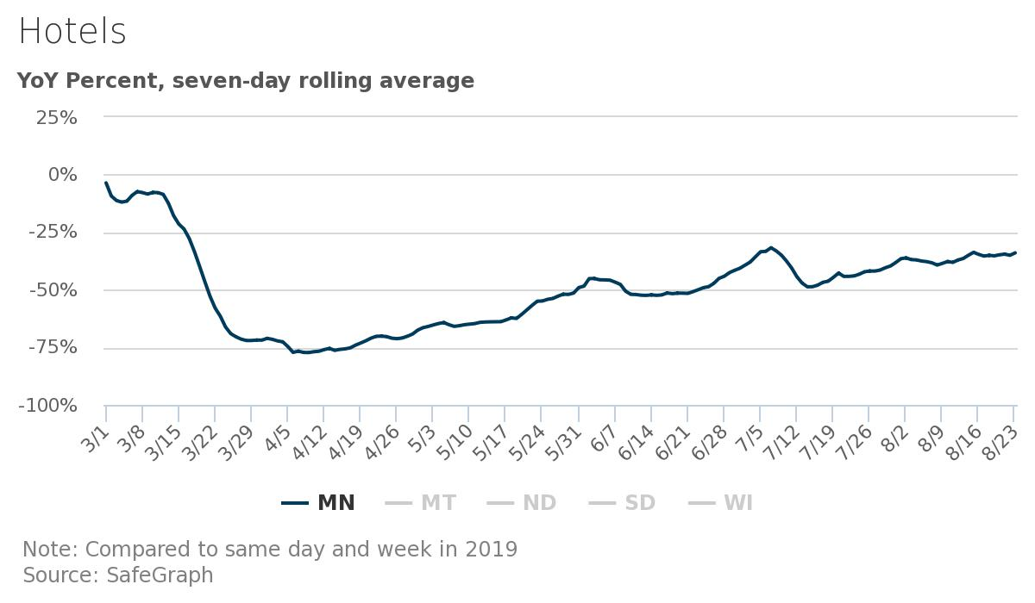
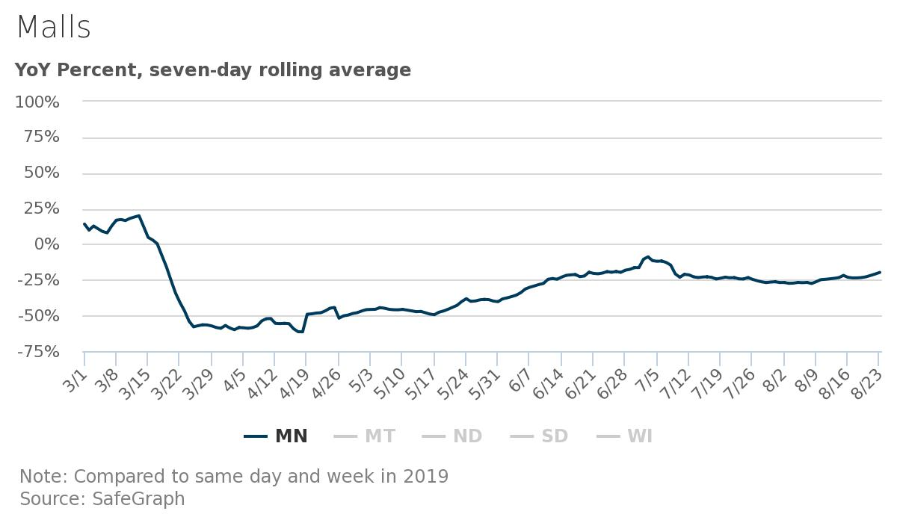
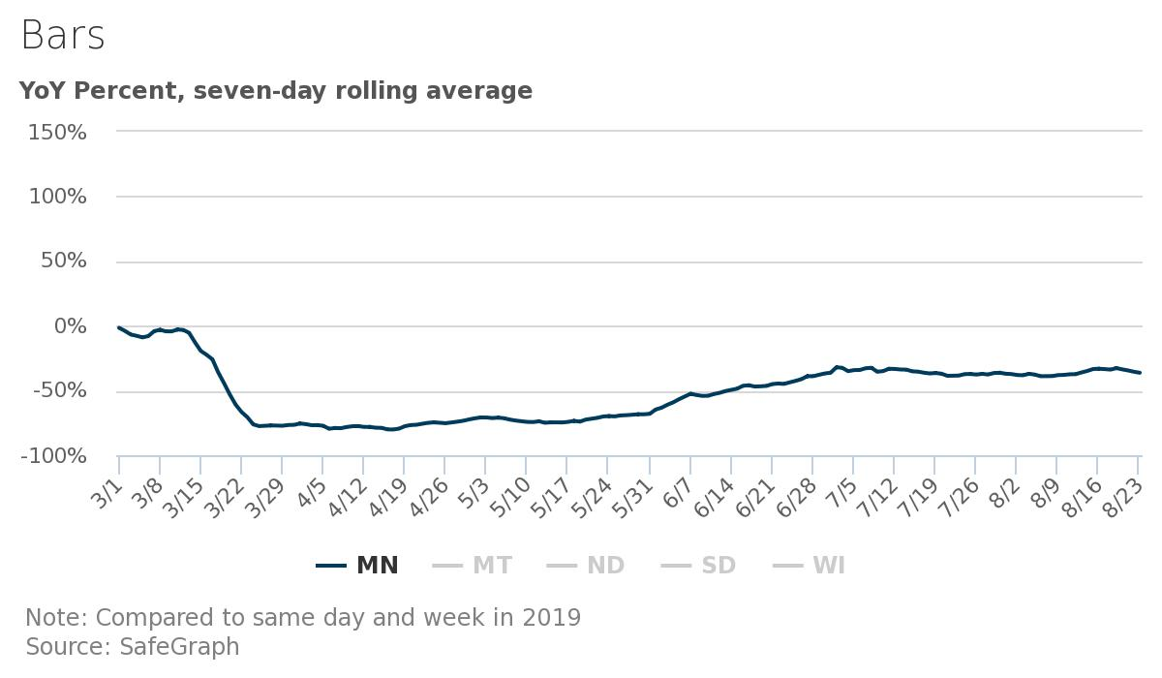
But consumer activity in hardest hit sectors remains subdued
Source: Minneapolis Federal Reserve

Slide 50
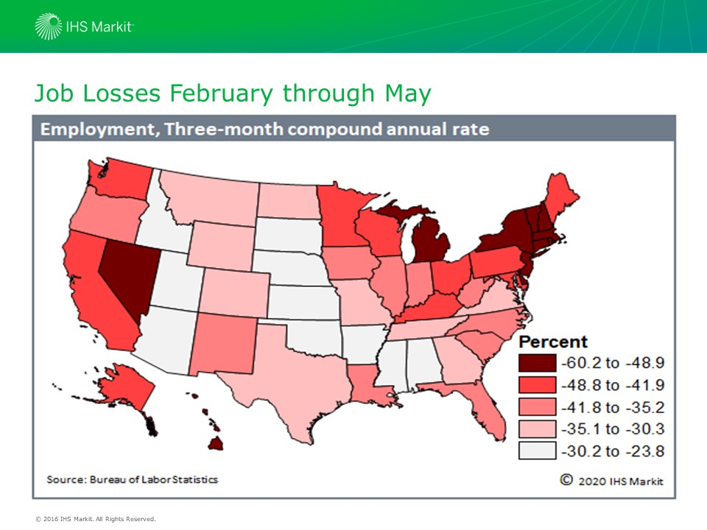

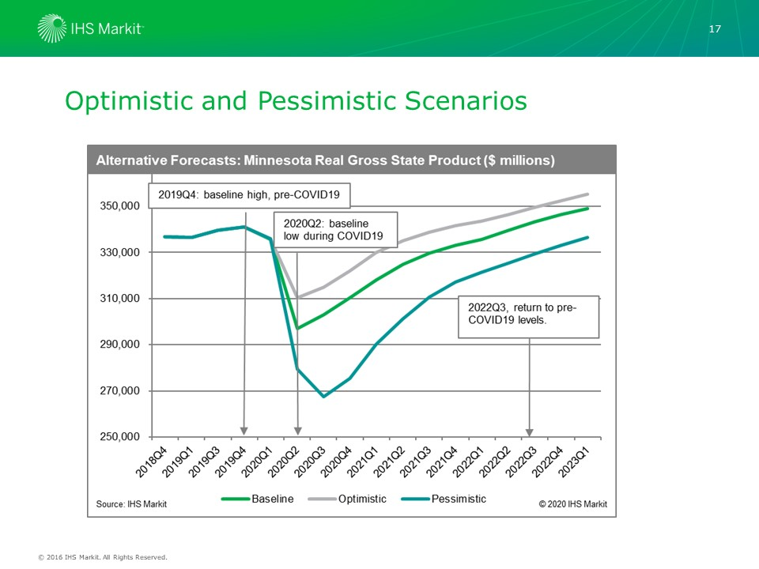


COVID-19 IMPACTS ON MINNESOTA’S ECONOMY

Slide 51
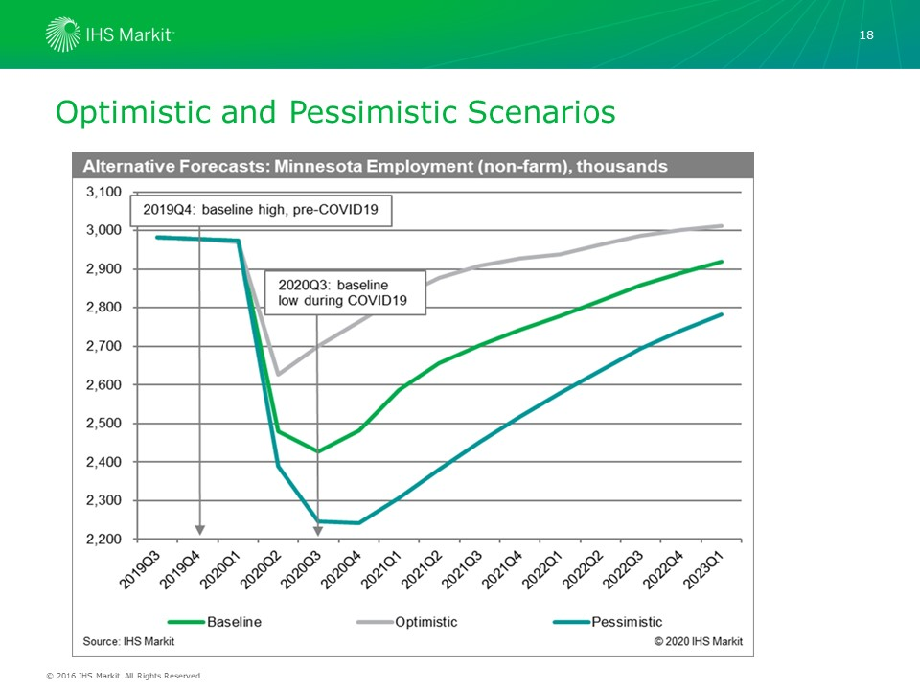
COVID-19 IMPACTS ON MINNESOTA’S ECONOMY

Slide 52
What does a post-COVID economy look like? How will emerging trends position Minnesota?
Future of remote work arrangements?
Automation and productivity?
Global trade and supply chain disruptions?
Future of health care in Minnesota?
Domestic and international migration patterns?

Slide 53
Opportunities to grow and develop Minnesota’s economy

Slide 54
Workforce & Productivity
1. Beat labor force projections through increased net migration and labor force participation among older and underrepresented populations.
2. Give Minnesotans the skills and tools they need to succeed in the workforce and spur productivity
Innovation
&
Key Sectors
3. Accelerate growth and innovation in Minnesota’s key sectors and emerging opportunities
4. Strengthen innovation assets in regional economies
Markets
5. Increase intra-state trade through strategic supply chain development.
6. Grow Minnesota exports to U.S. and international markets

Slide 55
Where do we go from here? Opportunities to grow and develop Minnesota’s economy over the next decade
Workforce and productivity
How can we return to domestic net migration gains rather than losses?
How can we spur productivity in an era of low labor force growth?
Innovation and Key Clusters
What’s next for Minnesota’s corporate sector? Medical sector? Food & Ag sectors?
How do we build on our existing strengths while gaining ground in tech sector?
How can regions with smaller populations flourish through innovation?
Markets Near and Far
What opportunities might COVID-19 open up to strengthen local supply chains?
How can Minnesota exports remain competitive in an period of growing protectionism?
What market opportunities increase sales to other U.S. regions?
How can we entice people into the labor market and give them the skills to succeed?

Slide 56
What’s next?
Blueprint for Economic Recovery
Long Term Economic Growth Strategies

