Slide 1
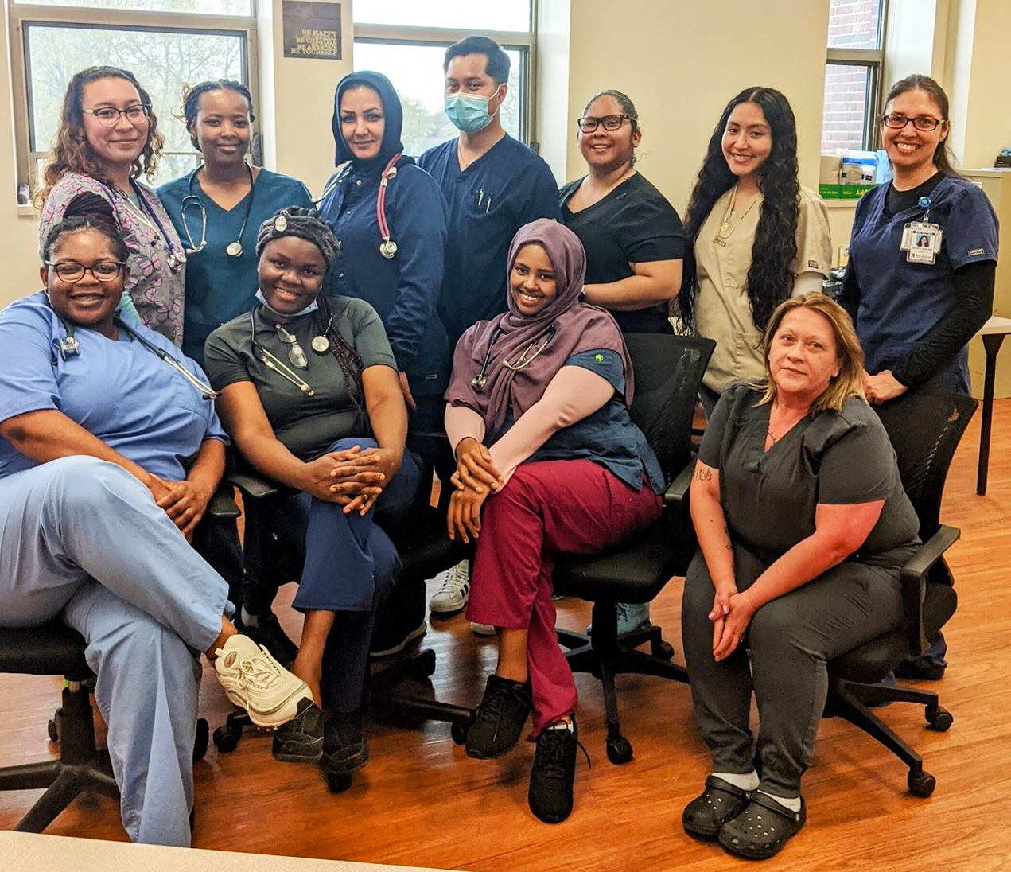
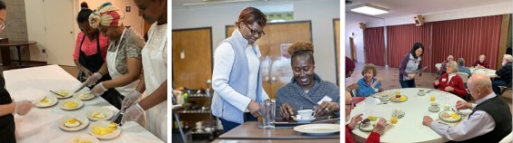
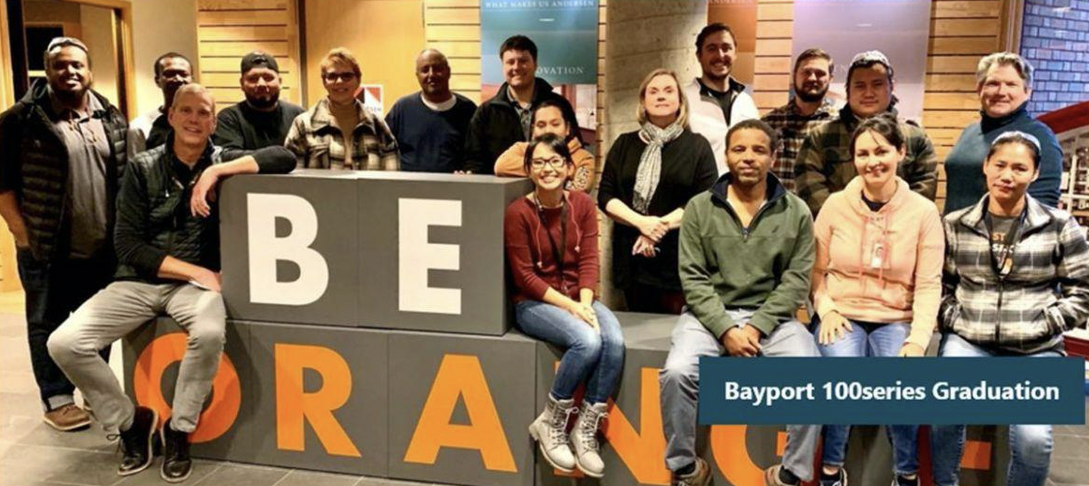
Adult Career Pathways in ABE
Federal Strategies and Promising Practices in Minnesota
2022
Career Pathways
Integrated Education and Training
Workplace Literacy

Slide 2
We’ll explore three strategies as defined by the federal
Workforce Innovation and Opportunity Act (WIOA)
Adult Career Pathways
+
Integrated Education and Training
+
Workplace Literacy
And we’ll spotlight successful examples of their
implementation locally in Minnesota.
Notes:
Adult career pathways aim to serve the unique needs of adult learners as well as local employers.
A career pathway is a comprehensive set of programs and services designed to help working learners earn postsecondary credentials that lead to well-paying jobs in high-demand fields. They are the result of collaborations among local educators, workforce development professionals, and employers. Being attuned to the needs of local industries, career pathways help supply local businesses with skilled labor—while helping students find jobs that pay well and offer room for advancement.

Slide 3
Adult Career Pathways
Federal Definition
The term ‘‘career pathway’’ means a combination of rigorous and high-quality education, training, and other services that—
aligns with the skill needs of industries in the economy of the State or regional economy involved;
prepares an individual to be successful in any of a full range of secondary or postsecondary education options, including apprenticeships...;
includes counseling to support an individual in achieving the individual’s education and career goals;
includes, as appropriate, education offered concurrently with and in the same context as workforce preparation activities and training for a specific occupation or occupational cluster;
organizes education, training, and other services to meet the particular needs of an individual in a manner that accelerates the educational and career advancement of the individual to the extent practicable;
enables an individual to attain a secondary school diploma or its recognized equivalent, and at least 1 recognized postsecondary credential;
helps an individual enter or advance within a specific occupation or occupational cluster.
– Workforce Innovation and Opportunity Act. 29 U.S.C. § 3102 (2020)
Notes:
Adult career pathways aim to serve the unique needs of adult learners as well as local employers.
A career pathway is a comprehensive set of programs and services designed to help working learners earn postsecondary credentials that lead to well-paying jobs in high-demand fields. They are the result of collaborations among local educators, workforce development professionals, and employers. Being attuned to the needs of local industries, career pathways help supply local businesses with skilled labor—while helping students find jobs that pay well and offer room for advancement.

Slide 4
Adult Career Pathways
Adult Career Pathways (ACPs) are designed to help students at all skill levels enter into or advance through careers in high-demand fields. ACPs:
Involve a comprehensive set of programs and services
Are attuned to the needs of local industries, helping to supply local businesses with skilled labor
Help students gain foundational academic skills while also preparing for a specific career.
Are tailored to adult learners with significant work and family responsibilities.
Involve support services to help remove barriers to program completion
Notes:
Adult Career Pathways are the result of collaborations among local educators, workforce development professionals, and employers.
Career pathways are tailored to adult learners with significant work and family responsibilities.
A career pathway includes an integrated series of connected educational and training programs that helps students to advance over time to successively higher levels of education and employment in a given sector.
Working learners move through training programs at their own pace, while reaping on-the-job benefits at each step. Courses are often offered on evenings and weekends and incorporate on-line learning.
Support services are key components of adult career pathways. Support services can include:
- Academic and career counseling, assessment, and planning
- Academic support
- Social support, including referrals to resources and services
- Transition planning to employment or postsecondary education
- Ongoing assessment of an individual’s need for assistance in a variety of areas such as childcare, transportation, and financial aid

Slide 5
Adult Career Pathways
Proven Results
Research demonstrates that career pathway outcomes exceed those of others programs:
Larger foundational skills gains
More college credits completed
More entry-level credentials earned
More likely to earn a training-related credential
More likely to be employed and retained in a training-related job
Higher earnings, with impacts growing over time
(Bragg et al. 2019)

Slide 6

Adult Career Pathways Spotlight
Bridges to Careers in Healthcare
WORKFORCE DEVELOPMENT, INC. + HAWTHORNE EDUCATION CENTER / ROCHESTER ADULT
EDUCATION + ROCHESTER COMMUNITY AND TECHNICAL COLLEGE (RCTC) + LOCAL EMPLOYERS
Bridges to Careers is a nationally-recognized partnership that recruits, trains, and supports diverse students
for in-demand healthcare careers
across the region.
Partners work together to provide an integrated collection of education and training services that build academic skills, knowledge, and confidence—empowering students to succeed.
Innovative Features
Learners earn short-term, industry-recognized certificates while preparing for college courses.
Completers can receive up to seven college credits at RCTC, and may be able to waive the ACCUPLACER©.
Partners meet monthly to coordinate services.
Employer partners recognize Program Completion Certificates and agree to interview and consider hiring program completers.
Notes:
Services include:
- Skills assessment and career planning
- Skills training and preparation for further training and education
- Job search guidance and resources
- Academic and financial support at local higher education institutions
- Individualized supports to help balance life, work, and school
- A Rochester Community and Technical College (RCTC) advisor to help students successfully transition from Hawthorne Adult Basic Education Program to RCTC, with ongoing support while they complete their educational goal
- A career navigator to help remove barriers, connecting students to community resources and—most importantly—helping them transition into employment
Bridges to Careers participants have earned industry-recognized credentials in a number of healthcare careers:
- Certified Nursing Assistant
- Home Health Aide
- Nursing (RN and LPN)
- Phlebotomist
- Patient Care Associate
- Pharmacy Technician

Slide 7
Adult Career Pathways Spotlight
Bridges to Careers in Healthcare
WORKFORCE DEVELOPMENT, INC. + HAWTHORNE EDUCATION CENTER / ROCHESTER ADULT
EDUCATION + ROCHESTER COMMUNITY AND TECHNICAL COLLEGE (RCTC) + LOCAL EMPLOYERS
Impact Since 2013
Educational Success
  947 people enrolled
  660+ industry-recognized credentials earned
  228 students persisted to RCTC
  8.6 credits earned per semester on average
Employment and Self-Sufficiency
  658 employed at 150+ area employers
  Average wage of $16.50, wages as high as $19.07
  122 students co-enrolled in the Minnesota Family Investment Program (MFIP)
  80% of students co-enrolled in MFIP who closed their cases had found employment
Meeting Workforce Needs
  247 individuals have been hired at the Mayo Clinic
  100% hired in departments experiencing workforce gaps
  diverse graduates have made the Mayo workforce more representative of the community it serves
  An additional 160 individuals hired at regional long-term care facilities
Return on Investment
  135% ROI back to the community
Notes:
Services include:
- Skills assessment and career planning
- Skills training and preparation for further training and education
- Job search guidance and resources
- Academic and financial support at local higher education institutions
- Individualized supports to help balance life, work, and school
- A Rochester Community and Technical College (RCTC) advisor to help students successfully transition from Hawthorne Adult Basic Education Program to RCTC, with ongoing support while they complete their educational goal
- A career navigator to help remove barriers, connecting students to community resources and—most importantly—helping them transition into employment
Bridges to Careers participants have earned industry-recognized credentials in a number of healthcare careers:
- Certified Nursing Assistant
- Home Health Aide
- Nursing (RN and LPN)
- Phlebotomist
- Patient Care Associate
- Pharmacy Technician

Slide 8
Adult Career Pathways Spotlight
Bridges to Careers in Healthcare
WORKFORCE DEVELOPMENT, INC. + HAWTHORNE EDUCATION CENTER / ROCHESTER ADULT
EDUCATION + ROCHESTER COMMUNITY AND TECHNICAL COLLEGE (RCTC) + LOCAL EMPLOYERS
Testimonials
“Without [Bridges to Careers’] help, I might not have been able to complete my diploma or be prepared to apply for a job. I’m so happy that I achieved my goal and found the position I was looking for.”
– Mae Saeed
“This partnership has been a valuable investment...
Not only are we generating a diverse, qualified pool of candidates for county employment, we may also be supporting people on a path out of poverty. It’s a win-win for us, every way we look at it.”
– Corrine Erickson
Olmsted County Director of Family Support and Assistance
Notes:
Services include:
- Skills assessment and career planning
- Skills training and preparation for further training and education
- Job search guidance and resources
- Academic and financial support at local higher education institutions
- Individualized supports to help balance life, work, and school
- A Rochester Community and Technical College (RCTC) advisor to help students successfully transition from Hawthorne Adult Basic Education Program to RCTC, with ongoing support while they complete their educational goal
- A career navigator to help remove barriers, connecting students to community resources and—most importantly—helping them transition into employment
Bridges to Careers participants have earned industry-recognized credentials in a number of healthcare careers:
- Certified Nursing Assistant
- Home Health Aide
- Nursing (RN and LPN)
- Phlebotomist
- Patient Care Associate
- Pharmacy Technician

Slide 9

Adult Career Pathways Spotlight
Bridges to Careers in Healthcare
WORKFORCE DEVELOPMENT, INC. + HAWTHORNE EDUCATION CENTER / ROCHESTER ADULT
EDUCATION + ROCHESTER COMMUNITY AND TECHNICAL COLLEGE (RCTC) + LOCAL EMPLOYERS
To
Learn
More
bridgestocareers.org
www.rochesterce.org/hawthorne
Notes:
Services include:
- Skills assessment and career planning
- Skills training and preparation for further training and education
- Job search guidance and resources
- Academic and financial support at local higher education institutions
- Individualized supports to help balance life, work, and school
- A Rochester Community and Technical College (RCTC) advisor to help students successfully transition from Hawthorne Adult Basic Education Program to RCTC, with ongoing support while they complete their educational goal
- A career navigator to help remove barriers, connecting students to community resources and—most importantly—helping them transition into employment
Bridges to Careers participants have earned industry-recognized credentials in a number of healthcare careers:
- Certified Nursing Assistant
- Home Health Aide
- Nursing (RN and LPN)
- Phlebotomist
- Patient Care Associate
- Pharmacy Technician

Slide 10
Integrated Education and Training
Federal Definition
A service approach that provides adult education and literacy activities concurrently and contextually with workforce preparation activities and workforce training for a specific occupation or occupational cluster for the purpose of educational and career advancement.
Adult Education and Literacy Activities
Programs, activities, and services that include adult education, literacy, workplace adult education and literacy activities, family literacy activities, English language acquisition activities, integrated English literacy and civics education, workforce preparation activities, or integrated education and training.
Workforce Preparation Activities
Activities, programs, or services designed to help an individual acquire a combination of basic academic skills, critical thinking skills, digital literacy skills, and self-management skills, including competencies in utilizing resources, using information, working with others, understanding systems, and obtaining skills necessary for successful transition into and completion of postsecondary education or training, or employment.
Workforce Training
May include: (i) occupational skill training...; (ii) on-the-job training; (iii) incumbent worker training...; (iv) programs that combine workplace training with related instruction..; (v) training programs operated by the private sector; (vi) skill upgrading and retraining; (vii) entrepreneurial training; (viii) transitional jobs...; (ix) job readiness training...; (x) adult education and literacy activities... ...provided concurrently with (i)-(vii); (xi) customized training conducted with a commitment by an employer or group of employers to employ an individual upon successful completion.
+
+
– Workforce Innovation and Opportunity Act. 29 U.S.C. § 3272 (2020)
Notes:
IET combines career training, basic skills education, and work readiness preparation to better meet the multi-faceted needs of adult learners, building academic skills and improving work readiness in the context of a career.

Slide 11
Integrated Education and Training
Better Together
Integrated Education and Training (IET) blends career training, basic skills education, and work readiness preparation to get the most out of each.
IET can save students time and money while boosting the practical relevance of their study.
IET programs must fit into broader adult career pathways, per federal guidance on the Workforce Innovation and Opportunity Act (WIOA).
IET can involve co-teaching, with ABE/English as a Second Language (ESL) and career and technical instructors working together in the same classroom.

Slide 12
Integrated Education and Training
Proven Results
Integrated Education and Training (IET) participants have better outcomes than other basic skills students, including those also enrolled in separate workforce training.
They were were more likely to:
Continue into credit-bearing coursework
Earn credits that count toward a college credential
Earn occupational certificates
Make point gains on basic skills tests
– How I-BEST Works (Jenkins et al. 2010)

Slide 13


Integrated Education and Training Spotlight
Hospitality Careers Pathway – Dietary Aide
SAINT PAUL COMMUNITY LITERACY CONSORTIUM + INTERNATIONAL INSTITUTE OF MINNESOTA
Dietary Aide Training is an integrated education and training (IET) curriculum that prepares students for an entry-level position in the dietary aide/nutrition services field.
It is a four-week, 60-hour training that leads into broader career pathways programs in hospitality food services and healthcare.
Local nursing homes and hospitals provide access to supplies and training materials. Students also visit the facilities to receive hands-on training.
Course Topics and Services Provided
Hands-on practical skills training
Digital skills training
Work readiness, including help with job search, applications, and interviews
One-on-one financial coaching
Employment assistance, placement and ongoing employment support after training concludes

Slide 14

Integrated Education and Training Spotlight
Hospitality Careers Pathway – Dietary Aide
SAINT PAUL COMMUNITY LITERACY CONSORTIUM + INTERNATIONAL INSTITUTE OF MINNESOTA
Population Served
All students are foreign-born immigrants and refugees:
80% of our students are women
80% are dependent on public transportation
Most have been in the country less than 5 years
Average age of 42
Program Impact
125 students trained
50% hire rate after graduation
Hourly wages increased from $12.50 to $15-17 over the 5 years since program began
Many graduates have gone on to additional training to become Nursing Assistants

Slide 15
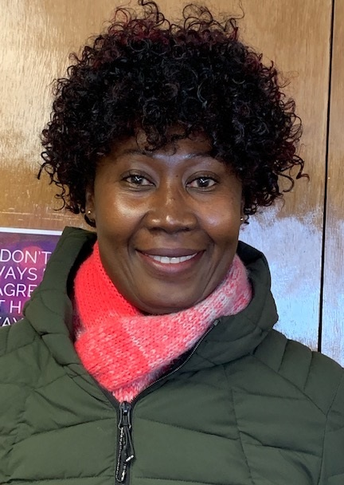
Integrated Education and Training Spotlight
Hospitality Careers Pathway – Dietary Aide
SAINT PAUL COMMUNITY LITERACY CONSORTIUM + INTERNATIONAL INSTITUTE OF MINNESOTA
Rose’s Story
“I started my current job as a chef with Presbyterian Home Services... This career was appealing to me because I have always loved cooking, and I was a prep cook and restaurant operator in my home country of Ghana.
“I love my job as a chef because I enjoy serving food to people and putting a smile on their faces. Without the necessary training that was provided for me through the dietary aide program, I would not have been able to find this job. Everything I learned from safe food handling, cooking temperatures, food storage, kitchen hygiene to utensil usage are all applied to my job every day. Also, understanding dietary restrictions, intolerances and allergies as well as health conditions of residents is an important part of my daily work.
“The training and help I received from my teachers changed my life. I was able to get a stable job and support my family.”

Slide 16

Integrated Education and Training Spotlight
Hospitality Careers Pathway – Dietary Aide
SAINT PAUL COMMUNITY LITERACY CONSORTIUM + INTERNATIONAL INSTITUTE OF MINNESOTA
To
Learn
More
www.iimn.org/programs/workforce-development/
hospitality-careers/dietary-aide-training/

Slide 17
Workplace Literacy
Federal Definitions
Workplace Adult Education and Literacy Activities
Adult education and literacy activities offered by an eligible provider in collaboration with an employer or employee organization at a workplace or an offsite location that is designed to improve the productivity of the workforce.
Workforce Preparation Activities
Activities, programs, or services designed to help an individual acquire a combination of basic academic skills, critical thinking skills, digital literacy skills, and self-management skills, including competencies in (i) utilizing resources, (ii) using information, (iii) working with others, (iv) understanding systems, and (v) obtaining skills necessary for successful transition into and completion of postsecondary education or training, or employment.
– Workforce Innovation and Opportunity Act. 29 U.S.C. § 3272 (2020)
Notes:
Employer-educator partnerships don’t only take place in the classroom. They can also extend into the workplace, with a goal of boosting workplace preparedness and productivity. Work-based learning opportunities can increase workplace literacy while building English proficiency and academic skills.

Slide 18
Workplace Literacy
A Collaborative Effort
Working together, educators and employers ensure that adult education programs build career-relevant skills—helping students succeed while fostering a competitive workforce that bolsters local and regional economies.
Employer-educator partnerships can:
Increase foundation skills within a work context
Build job skills that lead to employment and/or promotion
Teach work-readiness “soft skills” critical to job success
Providing opportunities to build professional relationships
Provide entry points and stepping stones for low-wage, entry-level workers
Ensure education and training programs are responsive to workforce needs

Slide 19
Workplace Literacy
Educator Roles
Work to foster alignment in the goals of education and employers in high-demand sectors
Promote the value of adult education to employers and employees
Facilitate the meaningful participation of employers with the education and training ecosystem
Organize groups of employers with similar workforce needs to multiply the impact of new education and training offerings
Help individuals develop foundational skills for current and future jobs
Build flexible programs that accommodate regular work hours
Employer Roles
Identify training needs and gaps in workforce skills
Work with education and training organizations to build career pathways and talent pipelines
Collaborate with peer companies to improve existing education and training offerings
Partner with training programs to integrate hands-on work experience with classroom learning
Providing resources and opportunities for work-based learning, mentoring, apprenticeships, internships, and tuition assistance
Make commitments to hire or promote program graduates
Offer externships, i.e. teacher training opportunities

Slide 20
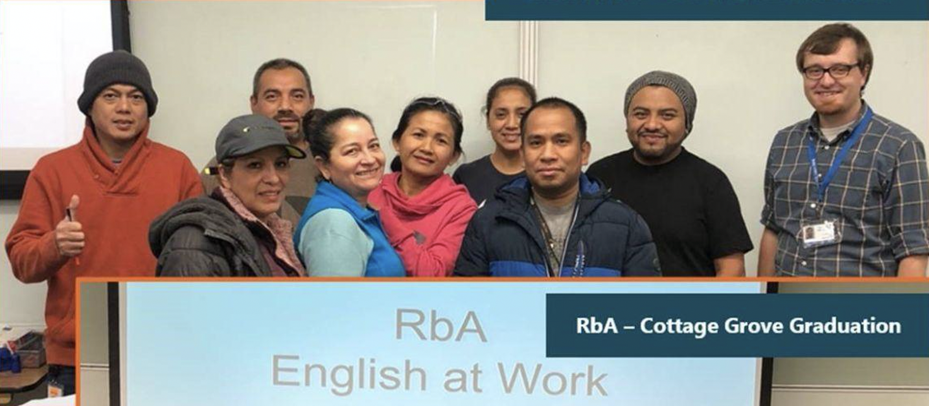

Workplace Literacy Spotlight
English @ Work // Language 4 Leaders (L4L)
GREAT RIVERS ADULT EDUCATION + ANDERSEN WINDOWS AND DOORS + RENEWAL BY ANDERSEN
Storm Door — Des Moines Graduates
Working hand-in-hand, partners created two programs to serve adult education participants working in entry-level and intermediate positions:
English @ Work is designed for beginning and intermediate-level positions at Andersen Windows & Doors and Renewal by Andersen.
Language for Leaders (L4L) is geared towards intermediate-to-advanced employees interested in pursuing an opportunity in shift leadership and beyond. L4L serves as a bridge between English @ Work and the Team Lead Development Program at Andersen Corp.
RbA - Cottage Grove Graduation
Working with the companies’ Training and Human Resource departments, curricula for the two programs was developed to boost workplace literacy and preparation while building academic skills.

Slide 21
Workplace Literacy Spotlight
English @ Work // Language 4 Leaders (L4L)
GREAT RIVERS ADULT EDUCATION + ANDERSEN WINDOWS AND DOORS + RENEWAL BY ANDERSEN
Classroom Topics
Benefits Literacy: Annual Open Enrollment
Digital Literacy: Email, Intro to Word
Processing, Presentations, Spreadsheets
Skill Building: Sending Professional Emails
Let’s Practice: NorthStar Digital Literacy Platform
Advancing Careers: Understanding the roles
of a Value Stream Team Lead and a Value
Stream Supervisor
Role Play: Common Interview Questions
Discussion: Drafting a Resumé, Navigating a
Job Application
Bayport 100series Graduation

Slide 22
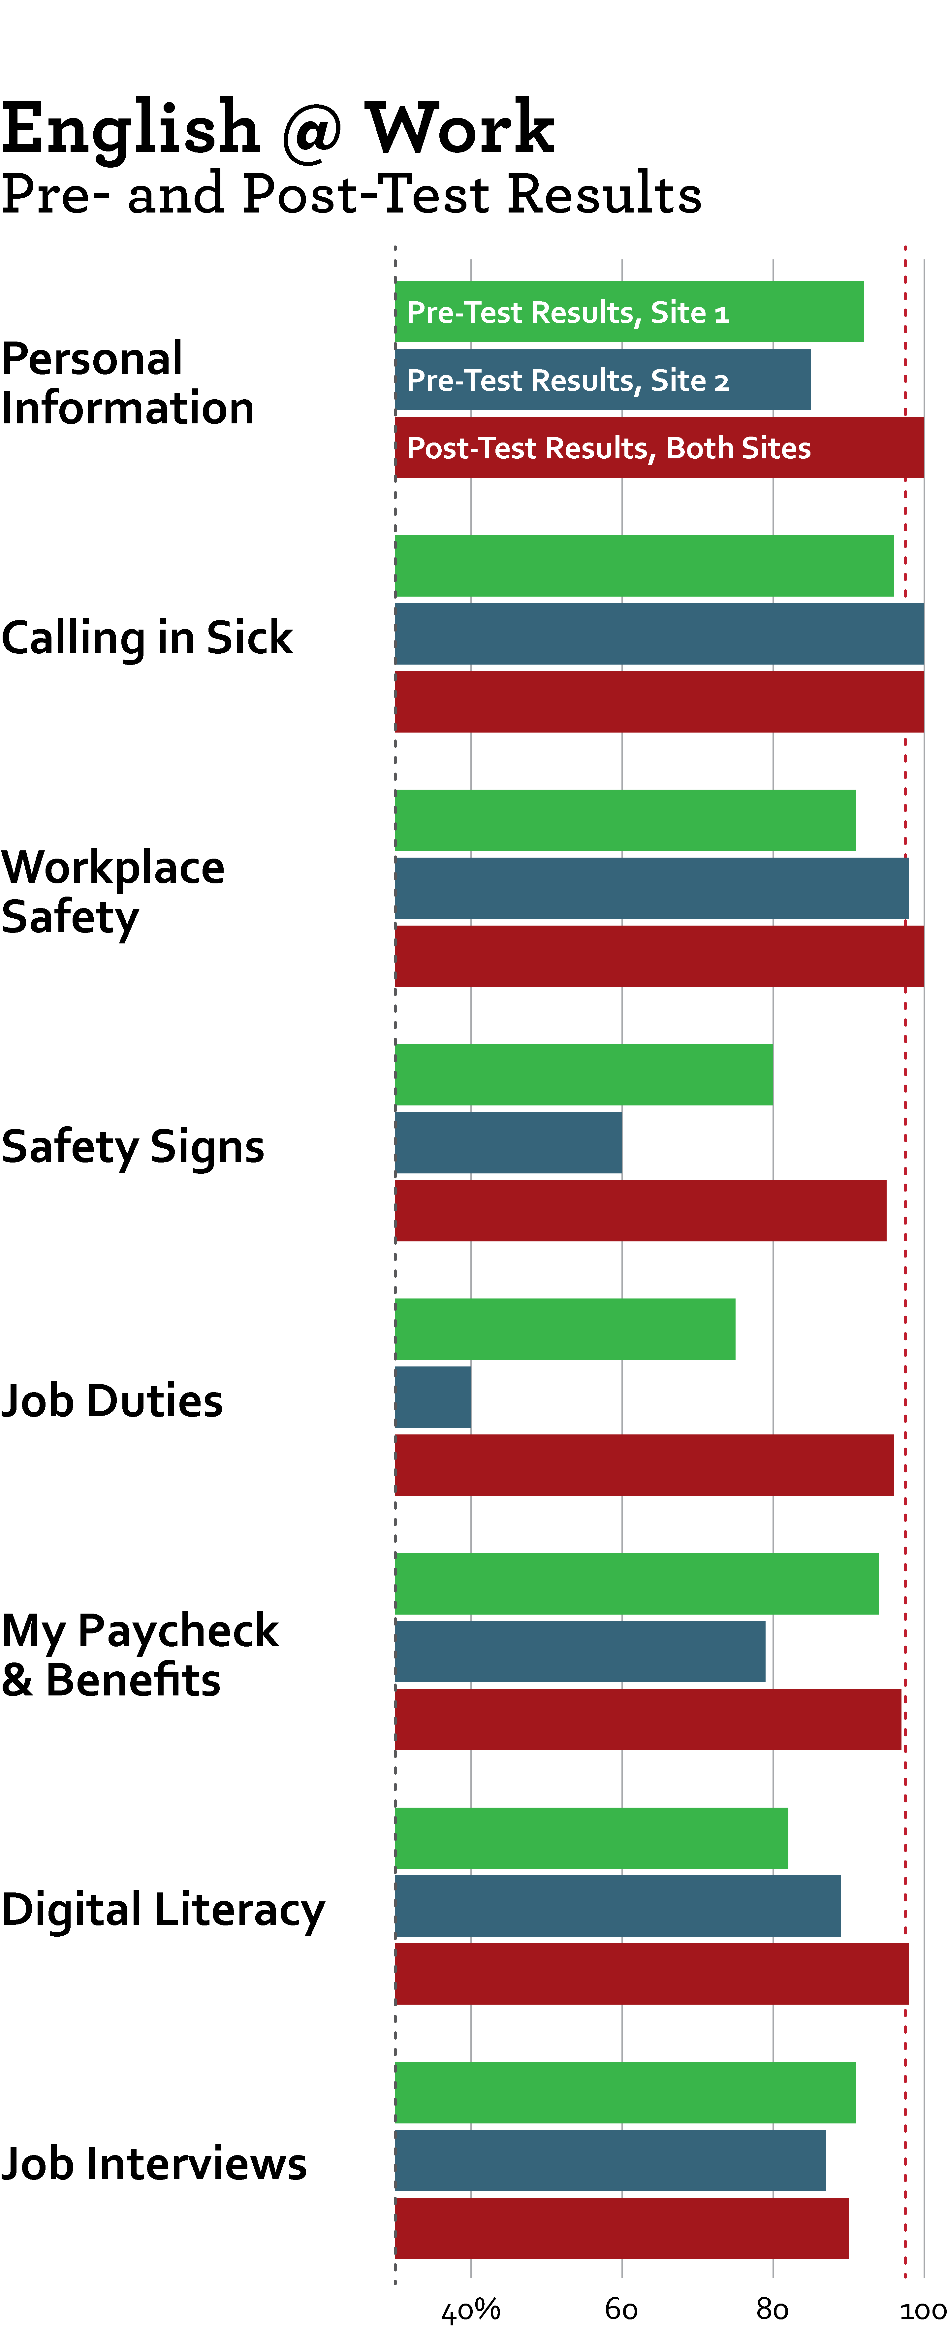
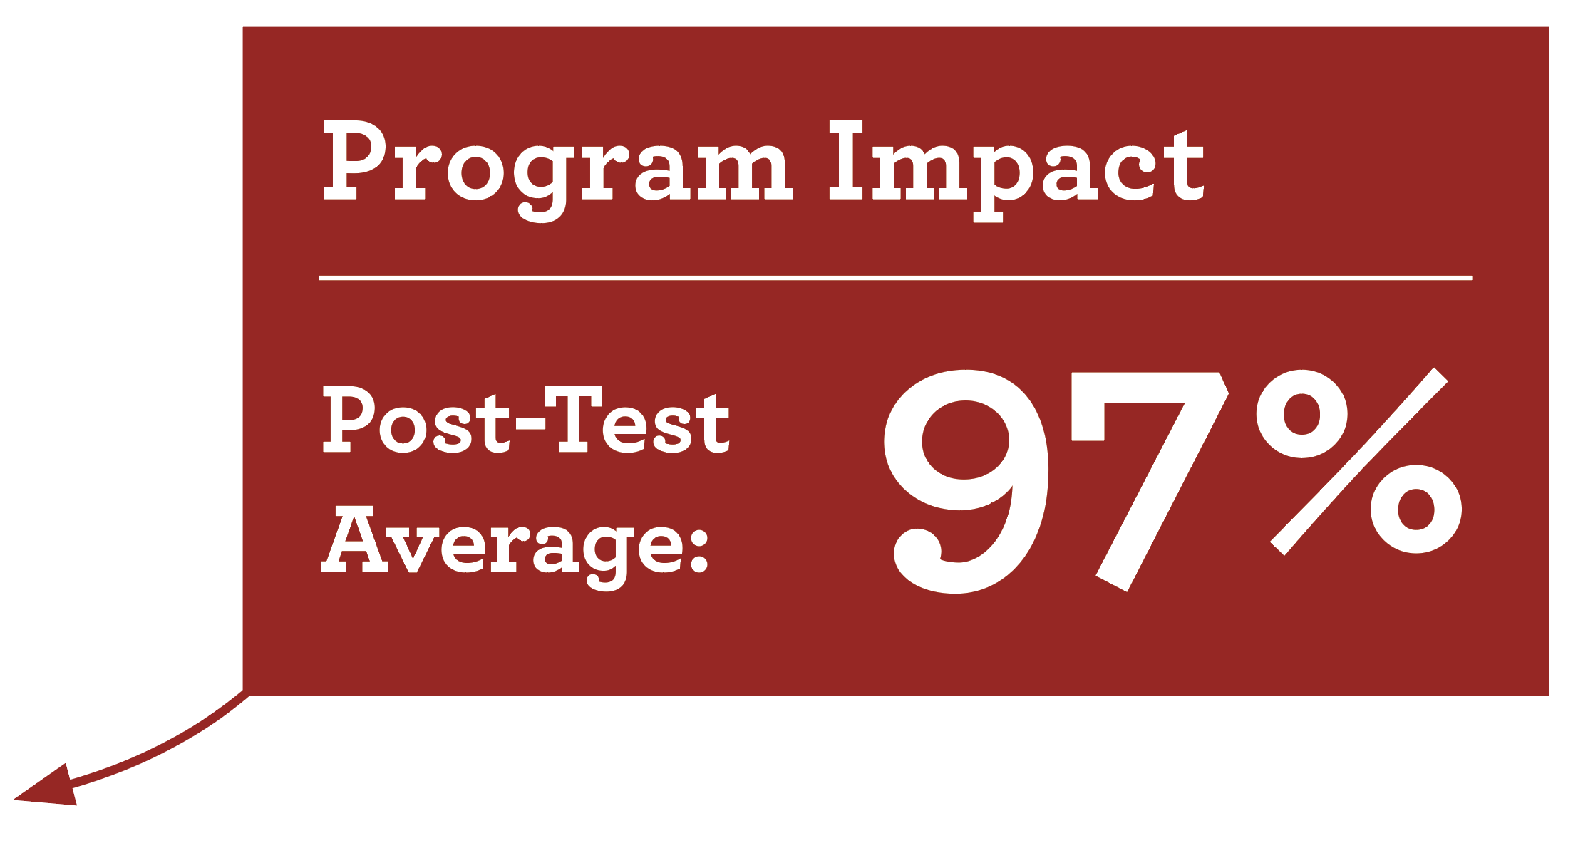
Workplace Literacy Spotlight
English @ Work // Language 4 Leaders (L4L)
GREAT RIVERS ADULT EDUCATION + ANDERSEN WINDOWS AND DOORS + RENEWAL BY ANDERSEN

Slide 23

Workplace Literacy Spotlight
English @ Work // Language 4 Leaders (L4L)
GREAT RIVERS ADULT EDUCATION + ANDERSEN WINDOWS AND DOORS + RENEWAL BY ANDERSEN
To
Learn
More
commed.sowashco.org/adults/great-rivers-adult-education
www.hastingscommunityed.com/adults/adult-basic-education
www.facebook.com/GreatRiversAEC

Slide 24
Thank You!
Notes:
Adult career pathways aim to serve the unique needs of adult learners as well as local employers.
A career pathway is a comprehensive set of programs and services designed to help working learners earn postsecondary credentials that lead to well-paying jobs in high-demand fields. They are the result of collaborations among local educators, workforce development professionals, and employers. Being attuned to the needs of local industries, career pathways help supply local businesses with skilled labor—while helping students find jobs that pay well and offer room for advancement.

