Slide 1

MAWB Meeting
2/15/2024

Slide 2

Agenda
Introductions/ Welcome
Overview of Minnesota Dual-Training Pipeline
Overview of Minnesota Registered Apprenticeship
Wrap up/ questions

Slide 3
About the Department of Labor and Industry
DLI Programs:
Registered Apprenticeship
Minnesota Dual-Training Pipeline
Youth Skills Training Program
Child Labor Outreach and Compliance
Workplace Safety Consultation
Worker’s Compensation Administration
OSHA Compliance
Wage and Hour Compliance
Construction Codes and Licensing
Office of Combative Sports
DLI’s VISION is to be a trusted resource, service provider and impartial regulator.
DLI’s MISSION is to ensure Minnesota’s work and living environments are equitable, healthy and safe.

Slide 4

What is Minnesota Dual-Training Pipeline?
Source of support to employers to develop their own employment-based, dual-training programs
An innovative approach to address current and future workforce needs in the key industries of advanced manufacturing, agriculture, health care services, information technology, transportation, childcare, and legal cannabis
Private Investment, Public Education, Labor and Industry Experience

Slide 5
Employment-Based Training
Structured on-the-job training
Taking a variety of forms
Related Instruction
with a chosen training provider
Powerful learning
Engaged employee
Benefit
to all

Slide 6
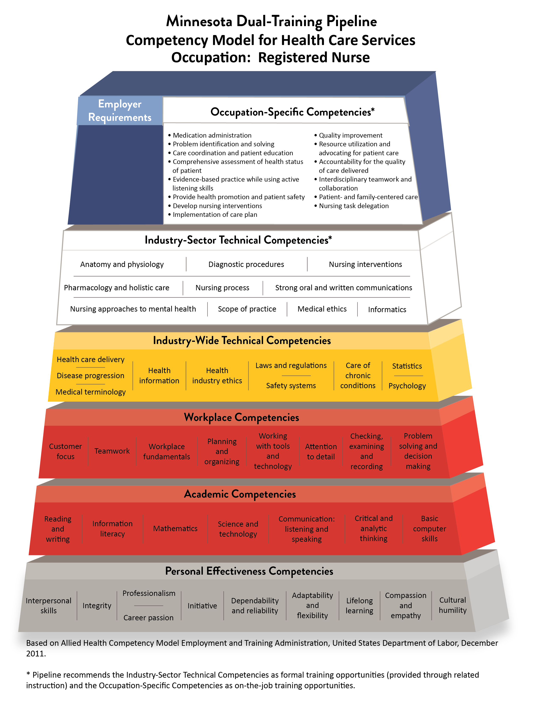
Minnesota Dual-Training Pipeline Competency Pyramid
https://www.dli.mn.gov/sites/default/files/pdf/Health-RN.pdf

Slide 7

Benefits of Employment-Based Training
Employers:
  Build and shape their own workforce
  Creates new skilled worker pipeline
  Workers produce as they train
  Improve productivity overall
  Reduce employee turnover
Workers:
  Employment
  Job Training
  Wages increase with progress
  Master in-demand skills
  Credentials

Slide 8
Minnesota Dual-Training Pipeline Strategies
Industry Forums: Inform and direct Minnesota Dual-Training Pipeline on industry trends and needs through discussion and strategic planning aimed to expand dual training.
Competency Councils: Define and identify specific occupational competencies for the four key industries.
Dual-Training Consulting: Create and disseminate dual training resources for employers, employees and dual trainees: toolbox, grants, and expanding mentorship networks to set up dual training.

Slide 9

Dual Training Grant
An eligible DTG applicant must meet all of the following:
Be an employer or organization of employers
Have or will have a dual-training program
Employ or will employ an eligible dual trainee
Have or will enter into agreement with an eligible related instruction training provider
If annual gross revenue exceeded $25,000,000 in the previous calendar year, pay for at least 25% of related instruction costs
If a current or prior DTG recipient, be in good standing on all grant requirements
If a current or prior recipient of other Minnesota State grant programs, be in good standing on all grant requirements.

Slide 10
Dual Training Grant
NEW for 2024
Eligible industries added to include Child Care, Legal Cannabis & Transportation
Expenditures expanded to recommended books and supplies
Second funding category for trainee support costs, up to $15,000
Dual trainee maximum changed to $24,000 in a lifetime
  $6,000 annual maximum remains
Organization of employers must identify employer partners at time of application
Online portal system for applying and administering grant
Financial and Capacity Review process during application for most applicants
Note: Industries, occupations, employers partnering with an applicant/organization, and related instruction training providers cannot be added after the application deadline.

Slide 11
Dual Training Grant
The maximum grant request amount is $165,000 and limited among the following budget categories:
Budget Category | Grantee Maximum Amount | Grantee Match Required | Expenditures | Dual Trainee Maximum Amount
Related Instruction Costs | $150,000 | 25% match required, up to $2,000, if annual gross revenue exceeded $25,000,000 | Tuition Fees Required & recommended books Required & recommended materials | $6,000
Trainee Support Costs *Connected to related instruction | 10% of grant request amount, up to $15,000 | None | Transportation and/or mileage Lodging Meals Tutoring services Translation and/or interpreter services | None

Slide 12

Timeline
Application OPENS
mid-March
Plan for Dual-Training Pipeline Program for 2024-2025
Contact Pipeline Consultants with questions or to learn more
Apply for Dual Training Grant
Employers having a difficult time filling occupations in specific industries learn about the Pipeline Dual-Training model of combining education with on-the-job training.
Employers create a dual-training program including at least one Pipeline occupation. Establish partnership with one or more education provider. Develop on-the-job training to complement education.
Carefully read the Request for Application on the Office of Higher Education website. Complete the online application process by the April deadline.

Slide 13
Timeline
Fall term at
Minnesota State Colleges and Universities starts 8/26/2024
Begin Dual-Training Program *August*
Setup Grant Documents *June*
Sign Contract *July*
Grant Documents may include: training provider agreement, work plan and budget, dual trainee participation agreement, 2024-2025 FAFSA completion (if program is financial aid eligible).
Must register with SWIFT through State of Minnesota and must have contract in place before dual-training program can begin.
Dual Training Grant Contact:
Jacquelynn Mol Sletten
Assistant Manger of Grants & Workforce Initiatives
651.355.0609
jacquelynn.mol.sletten@state.mn.us

Slide 14

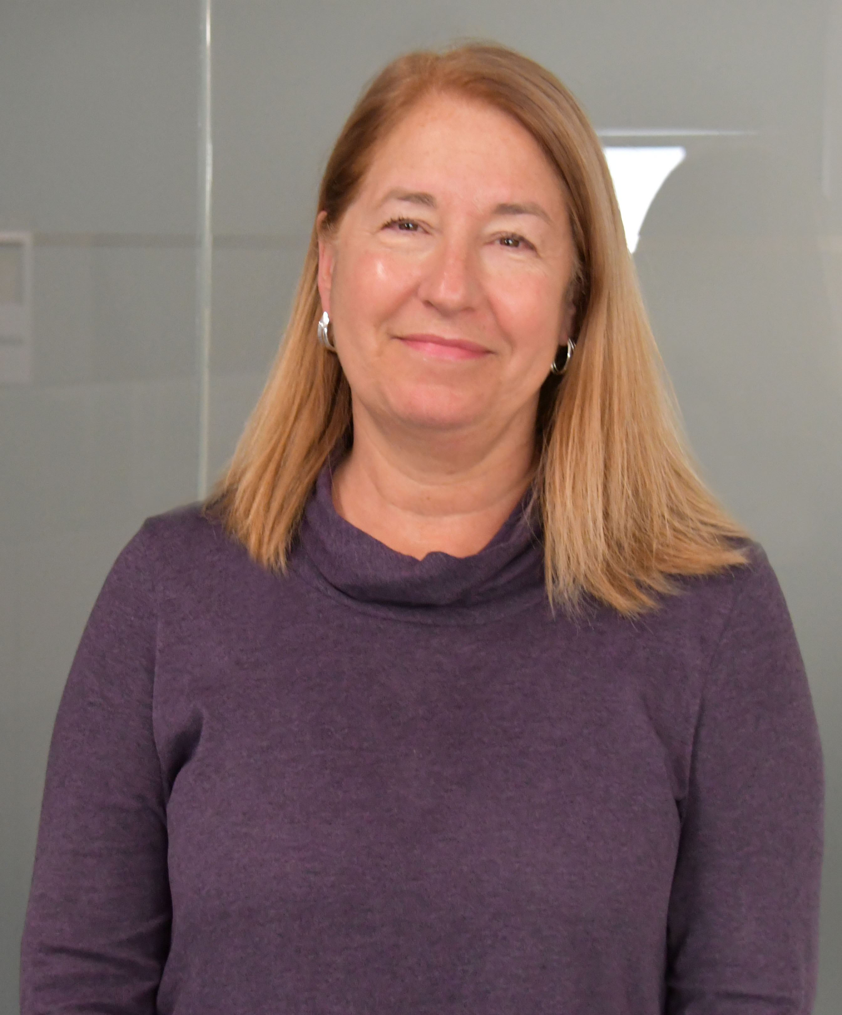
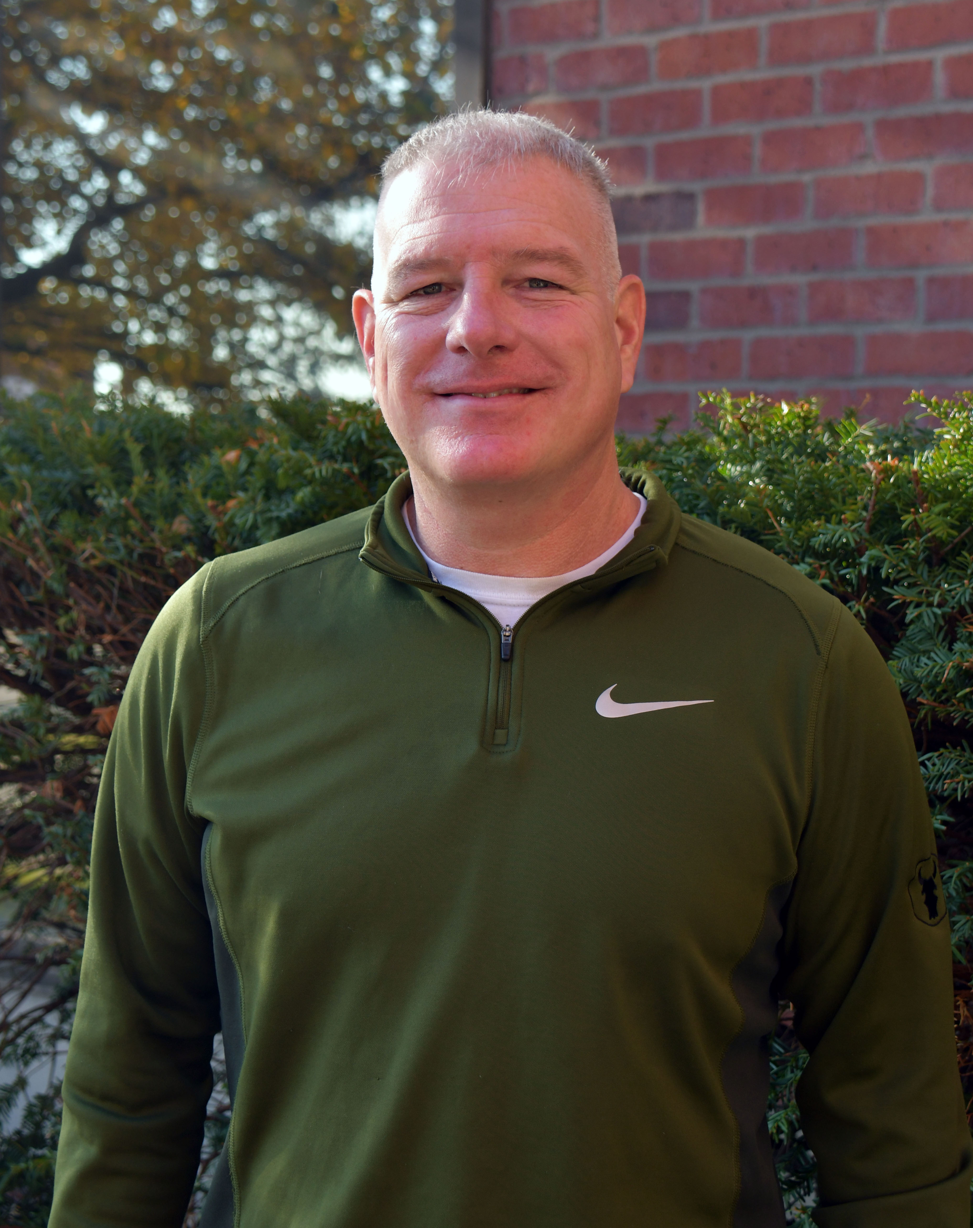
Thank You!
Dan Solomon
Program Manager
651-284-5355
dan.solomon@state.mn.us
Kathleen Gordon Program Consultant
651-284-5388
kathleen.gordon@state.mn.us
Madolyn Martini
Program Consultant
651-284-5088
Madolyn.martini@state.mn.us
Erik Holtan
Program Consultant
651-284-5082
erik.holtan@state.mn.us

Slide 15


Registered Apprenticeship
Erin Larsen | Director

Slide 16



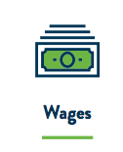
| What is Registered Apprenticeship?
Essential Program Components of Registered
Apprenticeship
A time-tested model to:
recruit, train and retain a highly skilled and diverse workforce.

Slide 17


Registered Apprenticeship vs Traditional Model
EXPERTISE
(Education + Experience)
Time
(in years)

Slide 18

| Employer Return on Investment
$1.47
RETURN for every dollar spent on apprenticeship by employers
93%
Of registered apprentices are employed
upon completion of their apprenticeship
$28
In benefits for every $1 invested by the government
$77K
$300K+
Completers earn per year on average
Apprentices’ lifetime earning average
Data provided by www.apprenticeship.gov

Slide 19

2023 Apprenticeship Program Snapshot
Active programs | 233
New programs | 9
Active Apprentices | 11,546
New Apprentice Registrations | 4,229
Apprentice Completions | 1,598
Notes:
2023 Calendar Year
Active programs (has at least one apprentice currently enrolled)
New programs (included early childhood educator, community health worker, digital marketer, quality control technician, ophthalmology technician)
Active apprentices: 11,546 (23% POC, 8% women, 6% veterans, 1% people with a disability)
New apprentice registrations: 4,229
Apprentice Completions: 1,598

Slide 20
| Trades and occupations in Minnesota
UTILITIES
CONSTRUCTION
ADVANCED
MANUFACTURING
HEALTHCARE
TRANSPORTATION
AGRICULTURE
PUBLIC SECTOR
INFORMATION
TECHNOLOGY

Slide 21
What types of occupations are apprenticeable?
Electrical | Arborist
Plumber | Graphic Designer
Pipefitter | Community Health Worker
Millwright | Meat Cutter
Ironworker | Coach Operator
Operator | Massage Therapist
Welder | Outboard Motor Technician
Carpenter | Window Cleaning
Insulator | Early Child Educator
Painter | Industrial Manufacturing Technician
Boilermaker | CNC Operator
Cement Mason | Software Developer
Notes:
Apprenticeship can be found in all industries and many different occupations, including all of those you see on the screen. Those on the left are some of the more common apprenticeships you see across the country, however, there are a number of emerging fields, and you can see some of those listed on the right hand side of the chart.
US DOL defines an apprenticeable occupation as any trade, form of employment or occupation approved for apprenticeship by the Secretary of Labor and Employment, which requires for proficiency more than three months of practical training on the job supplemented by related theoretical instructions
-accounting
-paralegals
-teachers

Slide 22
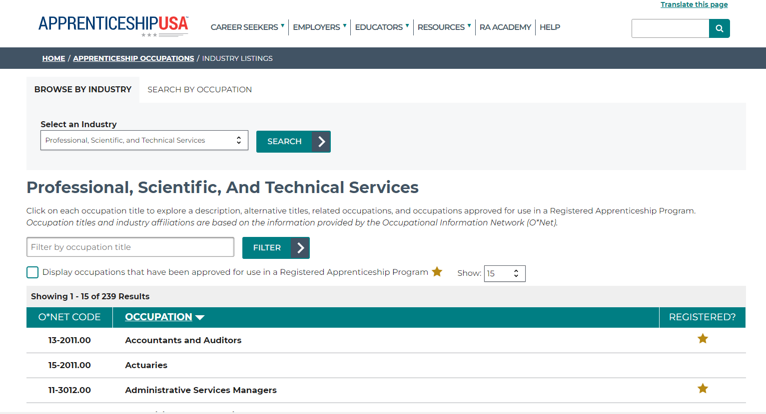
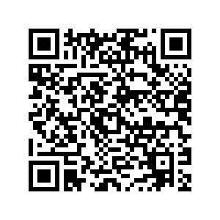
|Apprenticeable Occupations
Visit https://www.apprenticeship.gov/apprenticeship-occupations/industry-listings?industryCode=54

Slide 23
Early Childhood Education Apprenticeships
Partnership with Child Care Aware of Minnesota
Registered apprenticeship program launched in August 2023
18 apprentices enrolled in 7 childcare centers across the state
Child Care Aware of Minnesota is coordinating a work group to identify how to implement registered apprenticeship in a family childcare provider setting
Apprenticeship Minnesota | apprenticeship.mn.gov
Notes:
Call out couple highlights from federal grant--Childcare apprenticeships
Program is two years long, participants earn college credits, leverage T.E.A.C.H. grant funding for tuition
Child care centers are in Rochester, Minneapolis, Detroit Lakes, Inver Grove Heights, Plymouth, and North Branch

Slide 24
K-12 Teacher Apprenticeships
Statewide Partnerships
  Minnesota Department of Education
  Professional Educator Licensing and Standards Board
  Education MN
Developed statewide model standard for teacher registered apprenticeship programs
  Elementary Education and Special Education Licensure
Fall 2024 Launch
  Minneapolis & Owatonna
  Intermediate District 916, 917, 287,288
Fall 2025 Launch
  Four other districts exploring options for different licensure areas
Apprenticeship Minnesota | apprenticeship.mn.gov
Notes:
Call out a couple highlights from the federal grant: K-12 Teacher apprenticeship
Over the last year, several districts have been collaborating to develop a teacher apprenticeship program; model standard is 6000 hour program
Apprenticeship Minnesota hosted a roundtable discussion at the Carpenters Training Institute in St. Paul on Nov. 3 that drew nearly 75 Minnesota educators, administrators, paraprofessionals, union leaders, state agency representatives and more, to discuss development of registered apprenticeship programs for teachers. The goal of the event was to review the potential role of registered apprenticeships in education and allow participants to provide input about what apprenticeship programming could bring to workforce development within the field of education.
Districts: ISD 287, 288, 916, and 917
Launch Summer 2024
Related Technical Instruction Partner: Minnesota State Mankato
Union: Education Minnesota Local Unions
Licensure Areas: Autism Spectrum Disorder and Emotional Behavioral Disorder
Minneapolis Public Schools and Owatonna Collaborative
Launch Fall 2024
Related Technical Instruction Partner: Minnesota State Mankato
Union: Education Minnesota Local Unions
Licensure Areas: Academic and Behavioral Specialist
Minneapolis Public Schools
Launch Fall 2024
Related Technical Instruction Partner: Metro State University
Union: Education Minnesota Local Unions
Licensure Areas: Elementary Education with PrePrimary Endorsement
Other Teacher Apprenticeship Programs in Development (Launch 2025)
District RTI Provider Licensure Area
Willmar Southwest State Elementary-ABS
North Branch Lakes Country Service Coop Career and Technical Education
Prodeo Southeast Service Coop English as a Second Language
Hiawatha

Slide 25
Semiconductor Industry Apprenticeships
Partnership with DEED
Currently one program registered
  Skywater Technology
  Equipment Maintenance Technician
  Five registered apprentices
Three other companies developing programs
Notes:
Federal grant highlight-semiconductor industry

Slide 26
Apprenticeship Funding
Labor Education Advancement Program (LEAP)
Facilitate the recruitment and retention of people of color, Indigenous people and women in registered apprenticeship programs
Community-Based Organizations, Non-profits, and Tribal Governments
$1 million annually
Clean Economy Occupations Grant
Grow apprenticeship in clean economy occupations
Registered apprenticeship programs in Minnesota
$3 million in one time funding
Federal Funding
Targeted funds for childcare, K-12 teachers, and semiconductors
Anticipate a larger competitive award which will broaden grant opportunities

Slide 27


Publications
www.apprenticeshipmn.com
News and events
Follow us on social media:
  Facebook
  LinkedIn
  Instagram

Slide 28

Keep in touch!
Erin Larsen | Apprenticeship Director
Erin.Larsen@state.mn.us

