Slide 1
The Minnesota Business Succession and Transition (BST) Study
Michael Darger, with Cameron Macht
z.umn.edu/BSTresearch
Notes:
Thanks to the MN Association of Workforce Boards for this presentation. And to Cameron Macht and DEED for collaborating to get our research
into Minnesota Economic Trends.
I’m happy to share about Extension’s research on this topic. Some call it Business Succession Planning. But I prefer Business Succession and Transition since succession planning is kind of about the leadership aspects. And transition is about the actual legal transfer of the ownership. We need both to happen right?

Slide 2
Webinar goals
Why does BST* matter?
Share some of the research results (watch for poll questions)
Invite your ideas for research on the buyer side
Share some resources
Get your referrals for audiences who could benefit
Discussion
*Business Succession and Transition

Slide 3
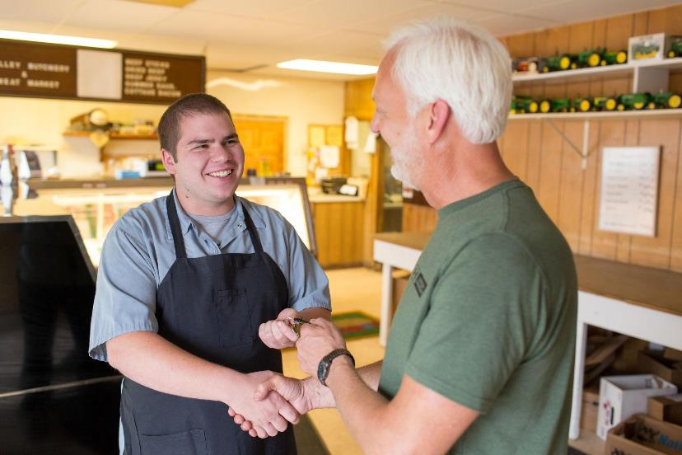
Why is Business Succession and Transition (BST) important?
Rural Business Transitions: Approaches to Community Training and Education
Small business - the lifeblood of local economies
Employment
Taxes
Quality of Life
Support for this project was and is provided by University of Minnesota EDA Center, with grant funding from the U.S. Economic Development Administration (EDA)
Notes:
This may be obvious to you all, but bear with me a bit:
to start, when we are supporting BST work we are supporting small businesses
Small businesses are the lifeblood of local economies.
They contribute to local governments fiscal health
responsible for the majority of new private-sector jobs throughout the country. Cameron and I did an article about that in 2019
They are particularly critical for smaller communities.
More and more, people now realize that established firms are often owned by folks nearing retirement age who have no plan in place for transition.
More on this in a minute.

Slide 4
How Extension Community Development is involved
https://z.umn.edu/BizSuccession
Notes:
A little history here.
Extension BST program started about a decade ago when former extension educator Liz Templin was approached by a community leader who was concerned about businesses in his town closing because they couldn’t find new owners when the current proprietor was ready to sell (for retirement, family, or health reasons - what we call the 5 Ds).
Our community BRE surveys also showed a trend of lack of preparedness for BST.
Liz did some nice research on rural BST
When Liz retired, we continued to see business succession as a concern for community leaders and we know we couldn’t just stop this work so my colleagues Jennifer Hawkins and John Bennett managed this program for a few years and now it’s in my lap.
They did a bunch of good stuff including workshops and developed a course to prepare businesses for transition. we’ll show these resources later.
And this is why we’re here - building off years of work but Extension and many other organizations from around the state.

Slide 5
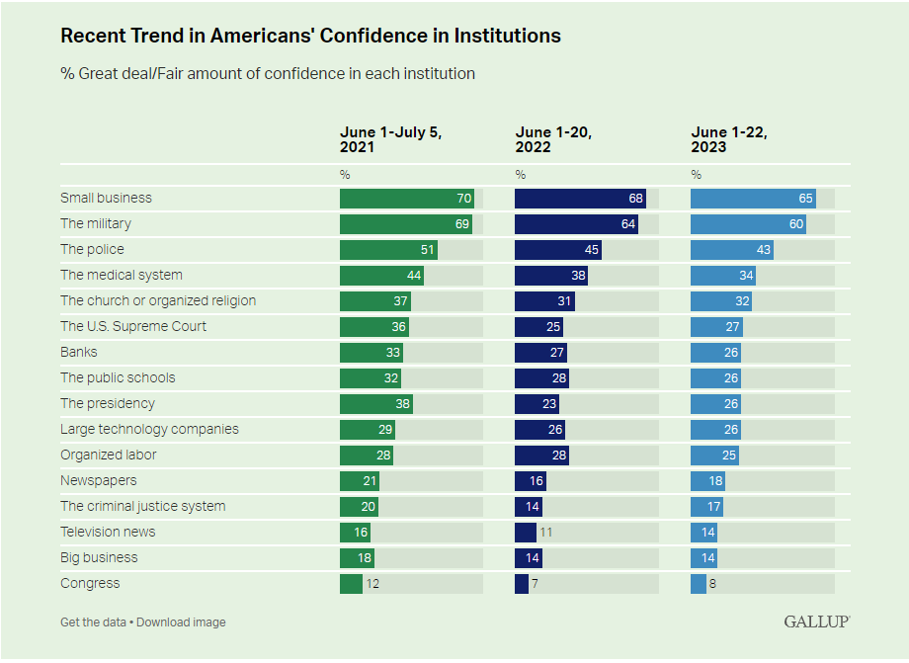
Source: https://news.gallup.com/poll/508169/historically-low-faith-institutions-continues.aspx
Notes:
We all know that belief in American institutions is slipping. Not so much with small biz.
Look at the top line. According to a recent Gallup survey, since 2021 Small business are the institutions that americans have the most confidence in
beside the military, small businesses are the only institutions here that the majority of americans express confidence
Clearly these are important to our communities

Slide 6
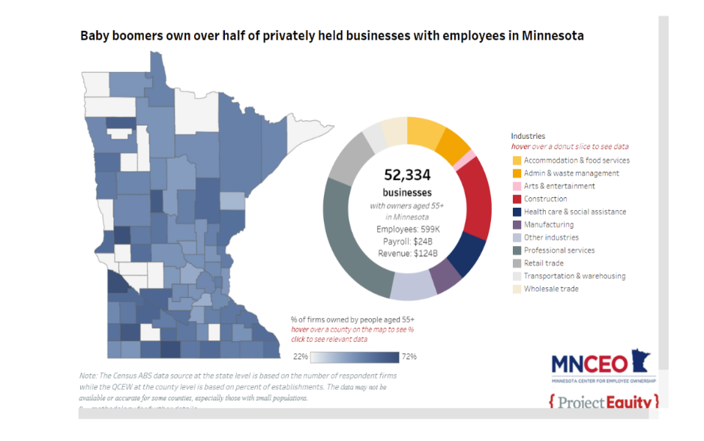
https://project-equity.org/communities/small-business-closure-crisis/
Notes:
The MN Center for EO published these data a couple years ago and it’s a nice data dashboard that allow the user to drill down by county and industry mix. Check it out, it’s cool and it’s still salient.
You get the point, lots of aging business owners are holding on to their businesses. So What can we do to help them? And, of course, it’s not just about boomer and greatest generation owners. Everyone needs an exit plan right?

Slide 7
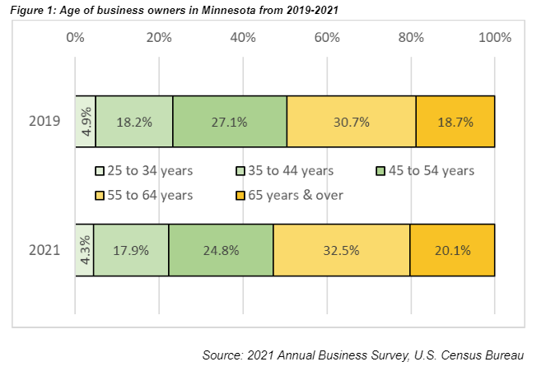
Notes:
Cameron

Slide 8
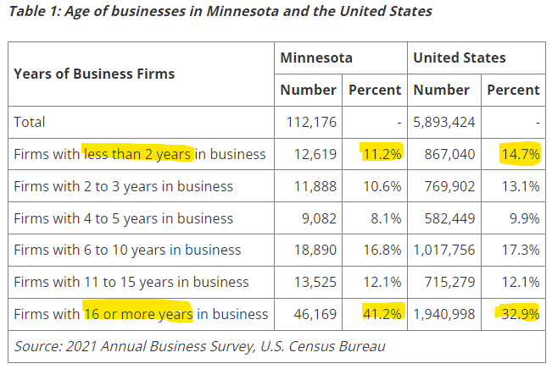
Notes:
Cameron
Question: Does this reflect that MN is less entrepreneurial? Or better at retaining businesses? Let’s save that to another day but it
interesting to muse about right?

Slide 9
Extension Research, 2017
Why aren’t they doing BST planning?
Top barriers
Time
Cost
Confidentiality
Lack of awareness about the value of planning
Also,
Not interested/ready to pass it on
Valuation is too low/overestimated
Don’t know where to begin
Seems important but not urgent
Personal readiness
Source: Templin, E., et all (2017), Power of Planning, Wilmington Trust (2017)
Notes:
This is from Liz Templin’s research and the literature reviews that her graduate student did

Slide 10
Extension research today
Surveyed businesses across the state (April-June 2023))
1,500 biz with 5-500 employees.
all 87 counties represented in the 3,000 business contacts. Most counties had 1+ respondents.
341 responses received; 286 were usable/valid
69% are family owned (58% 1st gen, 27% 2nd gen.)
Results, articles, data, dashboards, methods
z.umn.edu/BSTresearch
Notes:
So with all that context laid out, now we can talk about the current research I’ve been leading
Briefly overview the slide

Slide 11
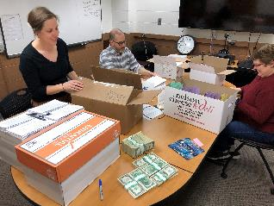
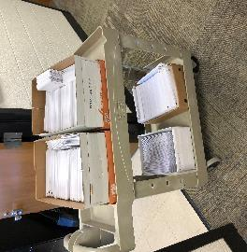
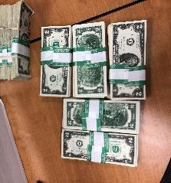
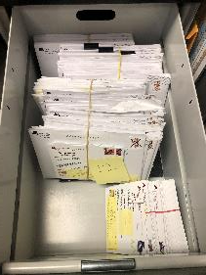
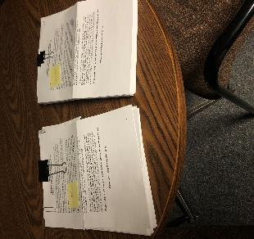
An old school big push, paper survey
Notes:
This is what it looked like a year ago.

Slide 12
Zoom Poll #1
Where do owners turn to for information and advice on business succession and transition planning?
Notes:
Wait for it
Look at poll results.
We have 2 questions that addressed this, kind of a big buckets question and a more specific question that drilled down.

Slide 13
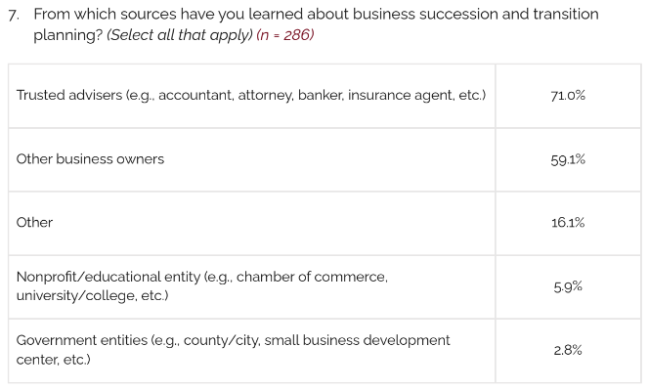
Big picture categories
Notes:
Here’s the big bucket

Slide 14
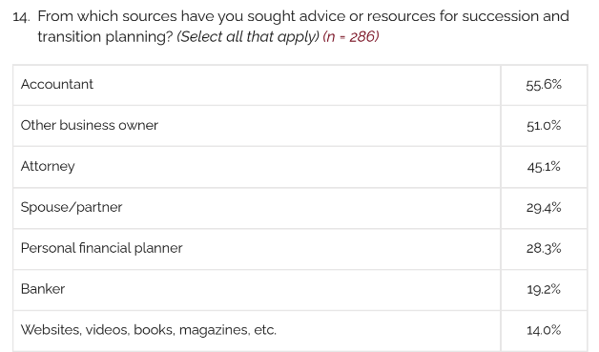

Slide 15
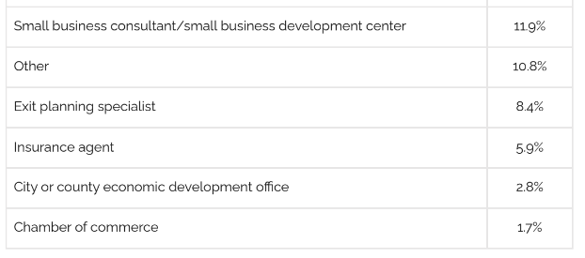
Notes:
And here we see who is NOT being consulted. The plain truth folks is that businesses do not turn to Extension ppl like me or ED or workforce folks
like you all. The SBDC folks get a little bit of traction but not much.
More on this later but here’s an example of some behavior change that I needed to do.

Slide 16
Usual audience above, new audience below
Notes:
As you just saw, our research (and the literature itself) indicates that accountants are the single most important advisors to owners.
I was doing a BST workshop last year in Brainerd and a CPA there challenged my Extension colleague and I to engage with accountants.
So here are two of my publications on these BST data. Which you can find on our research site under “Stories We’re Finding”.
DEED is obviously a long-time partner for me. And it’s the 2nd time Cameron and I have collaborated to release research findings.
But CPAs are an audience that no one in our team has tried to engage for the last 20 years or so. That took some effort to get connected, but after a few months of talking with MN Society of CPAs, they agreed to run some small articles as I submit them.

Slide 17
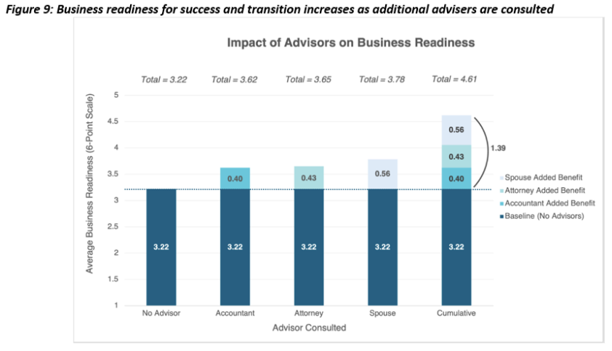
It take a “village” of key advisers
Notes:
One more thing about advisers. Some advisers matter more than others. And one thing is clear from the literature and this current
research. No one adviser is sufficient by themself. You need a team. Liz Templin’s research showed successfully transitioned rural businesses had
and average of 3.8 advisers help them.
We asked about owner readiness for BST. And separately about the business’ readiness for BST. Those are 2 separate but related issues. But I digress. See our research website to learn more about the readiness stats and there’s a nifty data dashboard there. Here in this slide we show the effect that 3 of the 4 most important advisers (see q. 14 in the survey results) have on “business readiness”. This shows the added effect on business readiness for the accountant, attorney and spouse/partner. As you can see, they each add about .5 point but together wthey added almost a 1.5 point boost in readiness on average. And these are statistically significant.
You can find this in the article by my team and Cameron.

Slide 18
Zoom Poll #2
Which of these factors related to succession and transition planning were most important to the business owners? (what would they say, not you)
Notes:
Wait for it. Now just take a best guess at what you think owners likely said
Look at poll results.
We have 2 questions that addressed this,
Q11. How did owners rate the importance of about 10 factors on a 6 point scale where 6=to a great extent
Q12. How did owner rank the importance of those 10 factors

Slide 19
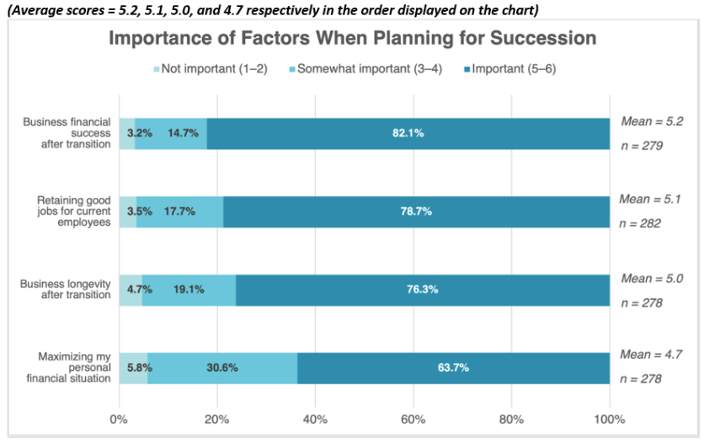
Notes:
So here’s that question 11 with the ratings. I copied this figure from our article in Minnesota Economic Trends
We broke the data up into 3 segments.
Important = scores of 5 or 6 is the dark blue
Somewhat important = scores of 3 or 4 is the medium blue
and Not important was the scores of 1 or 2
Notice that the maximizing the owners’ wealth was important but three other factors rated higher.

Slide 20
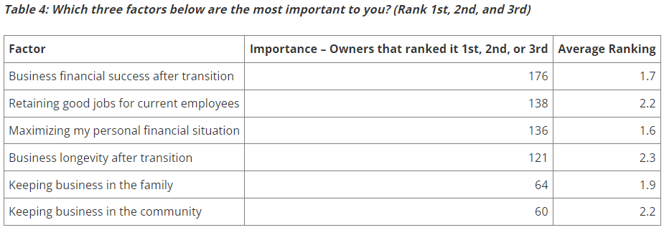
Notes:
So here’s the data from question 12 with the ranked factors. Again, I copied this table from our article
Now here we’re asking the owner which item was 1st or 2nd or 3rd most important. So that’s an “ordinal” ranking and we see slightly different results from the rating question above.
Note that maximizing their wealth has the highest ranking by a slight amount (average of 1.6 vs. 1.7 for the 2nd highest). It had 136 rankings as 1st, 2nd or 3rd. However, 40 more owners ranked biz finl success (so 176 rankings) than those who selected maximizing their wealth.
And keeping biz in the family scores fairly high here (1.9 average), but with far fewer owners. Presumably they’re family biz. This is interesting but only 64 owners ranked it (remember that 69% of respondents were family biz; ~184)

Slide 21
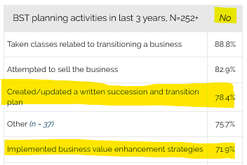
OK, the bad news on BST preparation
Notes:
Now I’ll pivot to some data on BST planning activities.
First the bad news. I don’t know if there is a pecking order as to the most valuable planning activities except for
one thing. There seems to be a consensus that a written BST plan is the single most important thing an owner
can do. We found 4 out of 5 had not done this in previous 3 years.
And the second item I highlighted is about owners intentionally doing things to up-value their biz for a future sale. Very important.

Slide 22
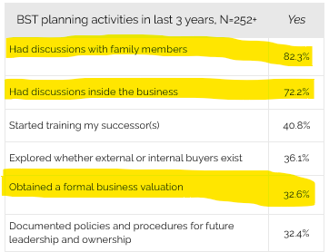
And some good news too
Notes:
Good news is a low bar here. Here’s the items that ⅓ of the owners had done.
I would say here that getting an outside valuation is a very important, concrete step. Invariably, they’re not going to
like what they see. But it gives them a chance to implement those value enhancement activities
The other 2 things - bringing it up seem important. Not as good as writing down a plan. But doing a plan that no has
seen or heard about, that’s a problem too right?

Slide 23
Zoom Poll #3
Which type of business ownership transfer do you think is most likely to improve the business, retain employees, and increase the longevity of the business?
Notes:
Wait for it. Look at poll results.

Slide 24
There probably isn’t a “best” model for either business ownership or BST
research on employee owned (EO) companies
Higher performance year over year
Employees achieve greater wealth accumulation
Slower to hire; slower to layoff
Did better during the Pandemic
Common sense
Notes:
We have some data on who they will transfer their business to.
But first, a couple points on employee ownership, or even “shared ownership”.
Go over the slide

Slide 25
I have two hypotheses on Employee Ownership and Business Retention and Expansion (BRE)
EO is the most likely form of business transition to keep a business local.
EO is not at the level it could be if there was
greater awareness of the benefits
more capacity to assist businesses AND employees on EO transitions
Notes:
I can’t prove either of these.
Quickly

Slide 26
Notes:
We had a few questions that addressed transfer routes.
Qs 8, 9 explored owner awareness of internal and external options for transferring ownership
Q 21 explored their actual intentions for transferring ownership
It’s pretty complicated so I will let you look at the details on your own in one of the articles on our website. However, I can say a couple simple observations here.

Slide 27
Awareness
Owners were most aware of transfers to family, strategic buyers, partners, 3rd-party buyers and managers.
They were quite unaware of 3 employee ownership options for transfer
Intentions
Only 2 options were likely (i.e. 50%+)
Strategic buyers (4.0 on 6 point scale)
Family (3.6)
Owners more likely to liquidate than sell to employees
Notes:
Here’s the quick takeaways.

Slide 28
Zoom Poll #4
This BST research was with business owners/sellers. If research on potential business BUYERs were to happen, what suggestions do you have? What are logical target audiences, groups, places to conduct such research?
(This is a fill-in-the-blank question)
Notes:
Wait for it. Look at poll results.

Slide 29
Extension BST resources
Short Videos
z.umn.edu/BSTplaylist
Business Course
z.umn.edu/BSTclass
Virtual workshop for community leaders
Notes:
Now I’ll pivot to resources for BST. Extensions website is also a great place to look for more resources. Extension has a great curated selection of free resources available here including

Slide 30
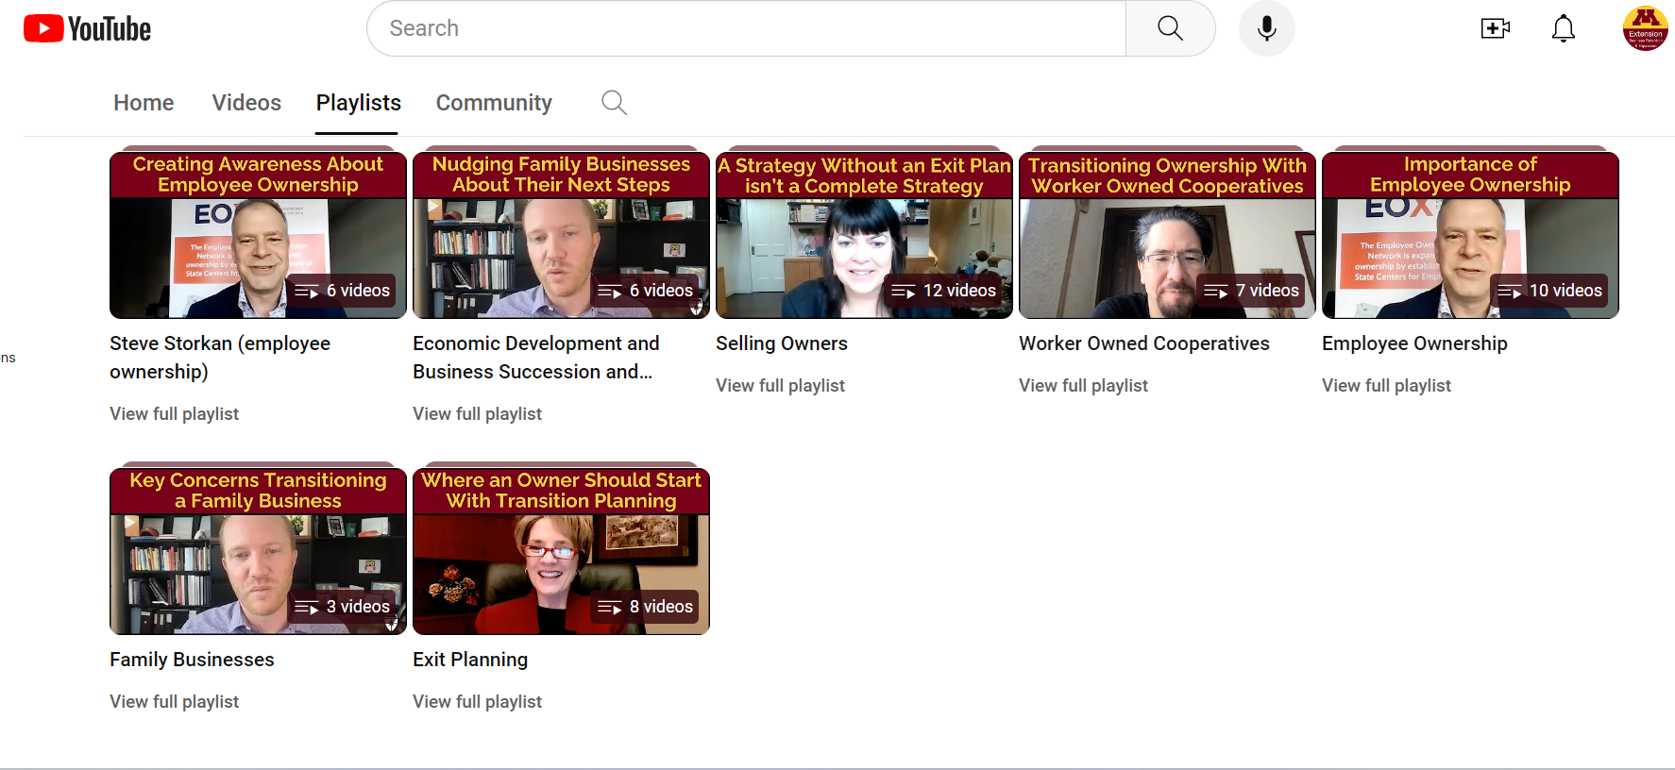
Here’s an easy way to start
https://z.umn.edu/BSTvideos
Notes:
3 examples
Poke the Bear - Family BIz -start the conversation with a biz or in the community
Small Town makes it a priority - see ED list
Where to start - Exit Planning
Go to YouTube and show a video?

Slide 31
More BST resources
Extension class for businesses
z.umn.edu/BSTclass
$500 for 5 week via Zoom
“I did not know about this class prior to us getting our succession plan in order. It would have been so helpful and saved us a lot of time” -spring 2023 participant
“I think a lot of people and businesses would benefit from this course. The time it takes to sit in the online classes and the homework is small compared to the amount of time and effort that will be needed to actually properly implement a successful transition.” - 2020 participant
Notes:
Besides our online resources, we have a class for business owners and their teams. It meets weekly and features live instruction by an experienced exit planner, Lori Moen. There’s a handout about that class, which is available in the fall and we’ll post other sections for next year.
The other is a free, self-guided virtual workshop for people like yourselves.

Slide 32
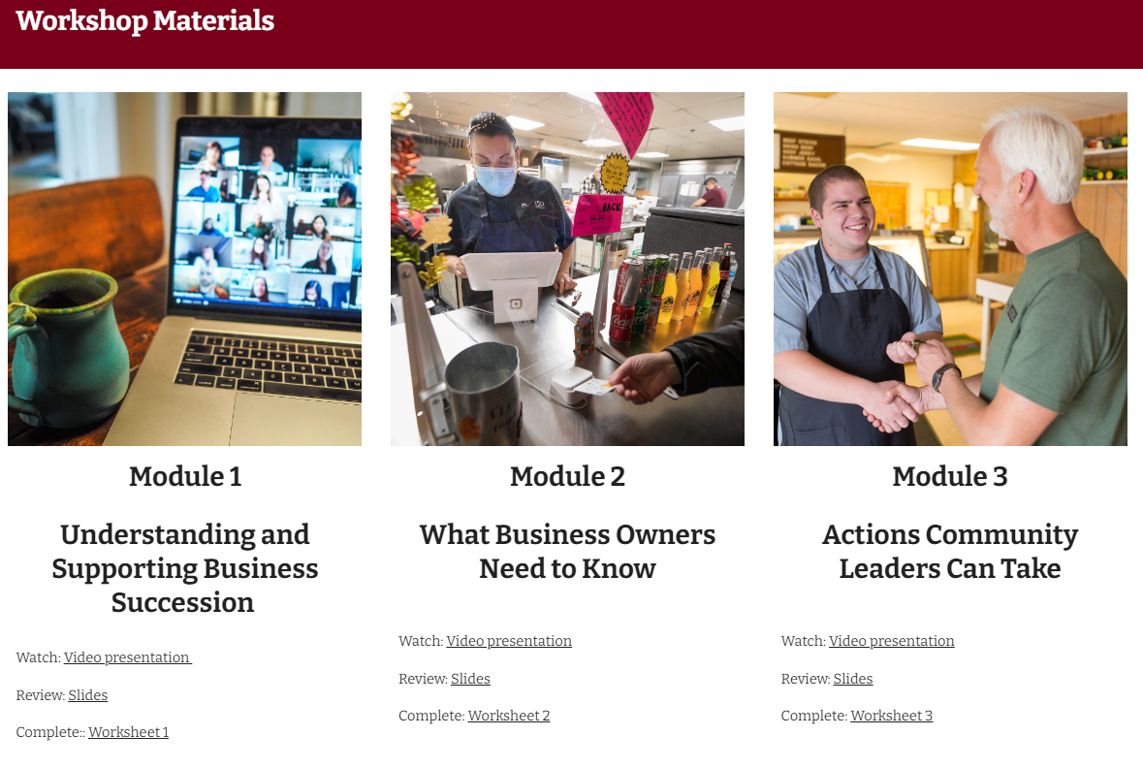
z.umn.edu/bizsuccession
Notes:
Here’s the free, online workshop for people like yourselves. The online workshop is self paced - meaning you can pick an chose what modules you want to complete and you can spend 1 hour or the whole day in the workshop - that’s up to you.
You can find it at the bottom of our BST page at that trusty link.
Also on this page is own curated videos

Slide 33
Referrals Welcome - darger@umn.edu
Presentation of this research
To our resources
Lots of people care about this issue
BST Ecosystem group meets bi-monthly (DEED, SBDC, RDCs, Family Biz Center, Nexus, CDS, MNCEO, et al)

Slide 34
Discussion
z.umn.edu/bizsuccession
Michael Darger
darger@umn.edu

