Slide 1
Addressing the Child Care Crisis

Slide 2
The Need
Data release by First Children’s Finance as of late 2023 shows a 5,668 slot deficit for the UWCM service area. (https://www.ruralchildcare.org/data)
Central MN as a whole has a deficit of 16,055 slots if every child under the age of five had access to a slot.
Recruitment and Retention of staff:
Lack of Thriving Wage
Starting wage at Target: $15/hr
Lack of Benefits

Slide 3
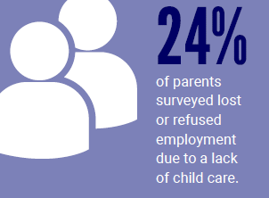
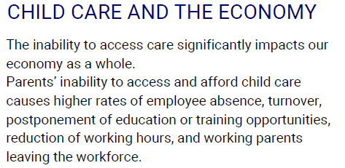
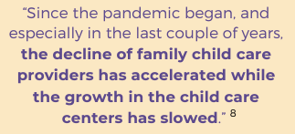
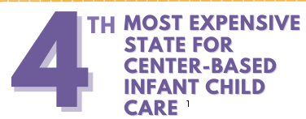
The Numbers
https://www.minneapolisfed.org/article/2023/minnesota-child-care-sector-struggles-as-business-model-changes

Slide 4
History of the Work
Jan 2020: With Initiative Foundation’s support, UWCM and GSDC host a Child Care Information session with businesses
June 2020: UWCM and other community partners provide COVID relief dollars for providers to help maintain available care
September 2020: Through a generous donation, the Central Minnesota Child Care Response Fund is established.
2020: Advisory Council established
2021: Child Care Coordinator position is created
February 2023: Initial SSA funding is awarded
January 2024: Child Care Summit hosted
October 2024: First Mobile Provider Appreciation Event held

Slide 5
Current Work
Secure funding and increase provider supports under the SSA
Building connections with potential providers, child care centers, and city/county entities to bring child care resources where they are needed
Mobile Outreach and Provider Appreciation events in rural MN
Connections with businesses and cities/towns to find solutions for their child care needs

Slide 6
Child Care and Business Toolkit
https://www.unitedwayhelps.org/childcare-business

Slide 7
Shared Service Alliance
The Shared Services Alliance is designed to work in partnership with licensed Early Child Care Programs in Region 7W (Benton, Sherburne, Stearns, and Wright Counties) to offer the services needed to help you grow your businesses, achieve financial stability, enhance your knowledge and education, all while providing time to focus on quality of care and most important... the Children.
The Shared Services Alliance aims to provide a comprehensive service approach, which includes access to a wide range of programs and resources without limitations.
Furthermore, whenever you require assistance, you can contact us, and we will take the responsibility of connecting you with suitable resources, thereby saving you the time and stress of searching for them yourself.

Slide 8
5 ways to support Child Care in Central MN
Speak to your employees to assess their child care needs and struggles.
Research and evaluate employee child care support options to find a fit.
Collaborate and advocate with other business and community organizations… child care is an community issue!
Connect with organizations such as UWCM who are working towards community solutions.
Reach out and recognize our community’s child care providers!

Slide 9
THANK YOU!
Contact:
Sara Hagen
Community Child Care Coordinator
shagen@unitedwayhelps.org

