Slide 1
CareerForce Updates
Jeanna Fortney

Slide 2
CareerForce Updates
Security Concerns
Employer Engagement
  Scheduled meetings with the new D45 grant recipients
  Collaborating with WSC team to develop menu of services we can offer to employers
  Hired new EE Specialist for the Metro, Betsy Helmeke. She came to us from Twin Cities Rise and will be housed at the South Minneapolis CF location
Business services employment metrics discussion

Slide 3
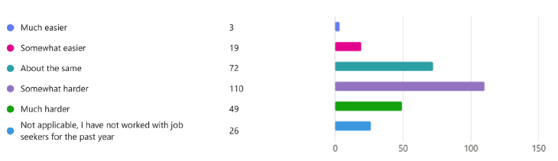
Job Search Experience Survey
On average compared to 1 year ago, how would you rate the ease with which your job seeking clients are finding employment?
1
On
63% say harder than 1 year ago
1
On
Notes:
This is one of the high-level results from the most recent Job Search Experience Survey, which closed last Friday, January 16
Nearly 63% of respondents say it is harder for job seekers they serve to find work now compared to a year ago.
Just under 9% of respondents say it is easier for job seekers to find work now than a year ago.
This is one of the topline results form the survey will be shared in a blog post a little later today on CareerForce.MN.gov – we wanted to share the topline results with you first.
A total of 279 LWDA staff, DEED staff, and workforce development partner staff completed the survey in January
THANK YOU so much for sharing the link with your staff during the first really busy weeks of January
Luke Greiner from the LMI team will be putting the results into a Tableau to allow you to break out results by LWDA…and to view changes over time.
The next survey goes live in late June and close in early July – the survey is being done just twice a year to avoid survey fatigue

Slide 4
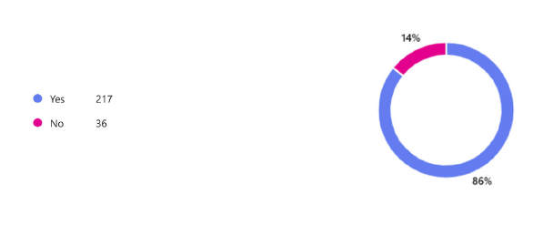
Job Search Experience Survey
Have you provided services to clients who are unhoused or at risk of becoming unhoused?
1
On
Notes:
Here’s another high level result: 86% of respondents have provided services to clients who are unhoused or at risk of becoming unhoused.
We should have had a date range on there of during the past year.

Slide 5

Job Search Experience Survey
Ease of which job seekers are finding employment compared to 1 year ago
Considerably harder:
IT and Math Experts
Creative Professionals and Media Workers
Managers and Leaders
Considerably easier:
Food Service Workers
Healthcare Support Workers
Cleaning and Maintenance Workers
1
Notes:
And…the final topline result I’ll share this morning from the survey:
Topping the list of occupational groups for which it is CONSIDERABLY HARDER for your job-seeking clients to get hired for now compared to 1 year ago:
IT and Math Experts (e.g., Software Engineers, IT Support Specialists,) is noted by most respondents as being harder than a year ago
Creative Professionals and Media Workers (e.g., Graphic Designers, Writers)
Managers and Leaders (e.g., Business Executives, School Principals, Construction Managers)
Top 3 Occupational groups for which it is CONSIDERABLY EASIER for job-seeking clients to get hired for now compared to 1 year ago:
Food Service Workers (e.g., Chefs, Servers, Bartenders) is noted by most respondents as being easier than a year ago
Healthcare Support Workers (e.g., Nursing Assistants, Personal Care Aides)
Cleaning and Maintenance Workers (e.g., Janitors, Landscapers, Housekeepers)

