Slide 1

2026 MFIP/Tribal TANF Award Winners

Slide 2
Eligibility Worker of the Year
Notes:
Nomination Criteria:
Significant contributions to the MFIP/DWP/Tribal TANF program
Nominee has positively impacted and improved the lives of participants and/or co-workers.
Creating/implementing innovative approaches in providing services for participants.
Narrative examples of a nominee’s impact on the quality of services received by participants.
Volunteering for, and working on, special projects above and beyond the nominee’s everyday duties
Demonstrated exceptional performance within their role
Anecdotal evidence: This anecdotal evidence may occur via phone, email, or letters written by others that recognize the nominee’s achievements.
Recognition by management and peers: Nominee is recognized among management and/or their peers as a key contributor and leader.
Demonstrated commitment to participants
Individual motivates or inspires participants.
Individual displays exceptional cultural competency and sensitivity to the unique challenges faced by participants.
Individual advocates on behalf of their participants and assists in problem resolution.
Demonstrated effective skills
Individual collaborates with others and supports cross-agency coordination.
Individual promotes diversity in the workplace and cultural competency in working with participants.
Individual consistently demonstrates initiative and accountability to participants and co-workers.
Demonstrated commitment to DEI

Slide 3
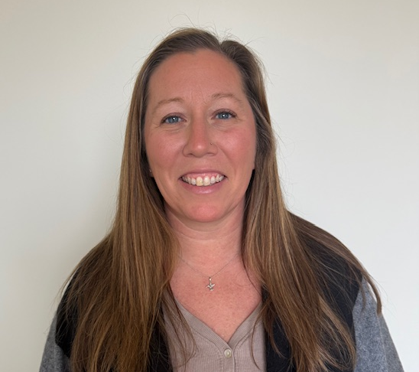
Melissa Mistic
Beltrami County
Melissa:
Has an open-door policy regarding program questions to her team
Is effective in communication and collaborating with people outside of the agency
Holds weekly discussions and trainings to ensure MFIP is issued properly

Slide 4
Employment Counselor of the Year
Notes:
Nomination Criteria:
Significant contributions to the MFIP/DWP/Tribal TANF program
Nominee has positively impacted and improved the lives of participants and/or co-workers.
Creating/implementing innovative approaches in providing services for participants.
Narrative examples of a nominee’s impact on the quality of services received by participants.
Volunteering for, and working on, special projects above and beyond the nominee’s everyday duties
Demonstrated exceptional performance within their role
Anecdotal evidence: This anecdotal evidence may occur via phone, email, or letters written by others that recognize the nominee’s achievements.
Recognition by management and peers: Nominee is recognized among management and/or their peers as a key contributor and leader.
Demonstrated commitment to participants
Individual motivates or inspires participants.
Individual displays exceptional cultural competency and sensitivity to the unique challenges faced by participants.
Individual advocates on behalf of their participants and assists in problem resolution.
Demonstrated effective skills
Individual collaborates with others and supports cross-agency coordination.
Individual promotes diversity in the workplace and cultural competency in working with participants.
Individual consistently demonstrates initiative and accountability to participants and co-workers.
Demonstrated commitment to DEI

Slide 5
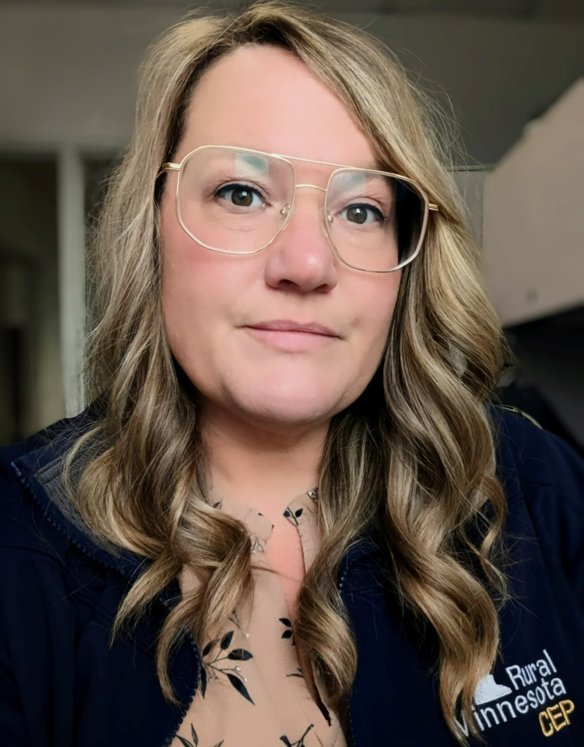
Kirsten Waterman
Rural MN CEP (Little Falls, MN)
Kirsten:
Always comes to work with a positive attitude and is very knowledgeable in her job
Is Always willing to step in and help
Is aware of resources in the area as well as thinking outside the box for motivation and employment needs of individuals in very rural areas

Slide 6
Exceptional Teamwork
Notes:
4 Winning teams or individuals in this category.
Nomination Criteria:
Significant contributions to the MFIP/DWP/Tribal TANF program
Nominee has positively impacted and improved the lives of participants and/or co-workers.
Creating/implementing innovative approaches in providing services for participants.
Narrative examples of a nominee’s impact on the quality of services received by participants.
Volunteering for, and working on, special projects above and beyond the nominee’s everyday duties
Demonstrated strong teamwork
Compelling team projects that result in measurable benefits to participants
Anecdotal examples of the nominees successfully functioning as a team
The presence of effective paths of communication and collaboration amongst nominees and with other organizations and partners.
Demonstrated exceptional performance within their role
Anecdotal evidence: This anecdotal evidence may occur via phone, email, or letters written by others that recognize the nominee’s achievements.
Recognition by management and peers: Nominee is recognized among management and/or their peers as a key contributor and leader.
Demonstrated commitment to participants
Individual motivates or inspires participants.
Individual displays exceptional cultural competency and sensitivity to the unique challenges faced by participants.
Individual advocates on behalf of their participants and assists in problem resolution.
Demonstrated effective skills
Individual collaborates with others and supports cross-agency coordination.
Individual promotes diversity in the workplace and cultural competency in working with participants.
Individual consistently demonstrates initiative and accountability to participants and co-workers.
Demonstrated commitment to DEI

Slide 7
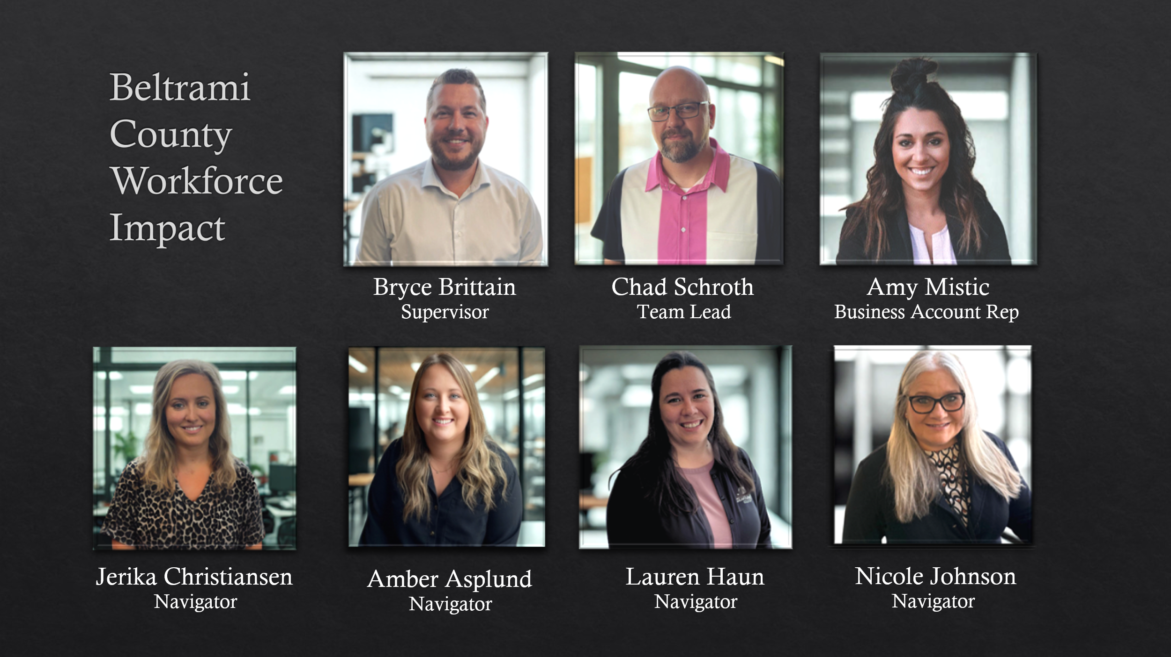
Notes:
Streamlined processes, improved communication across programs, and adapted services to better meet participants needs.
Frequently looked to as a resource for problem-solving, guidance, support, and subject matter expertise.
They go beyond standard expectations to ensure participants receive the support necessary to move forward.
Amber Asplund (Am-bur Asp-lund)
Amy Mistic (A-me Mis-tick)
Jerika Christiansen (Jer-ick-uh Christian-son)
Nicole Johnson (Nick-cole John-son)
Lauren Haun (Lore-in Haw-n)
Chad Schroth (Ch-ad Sh-row-th)
Bryce Brittain (B-rice Britt-in)

Slide 8
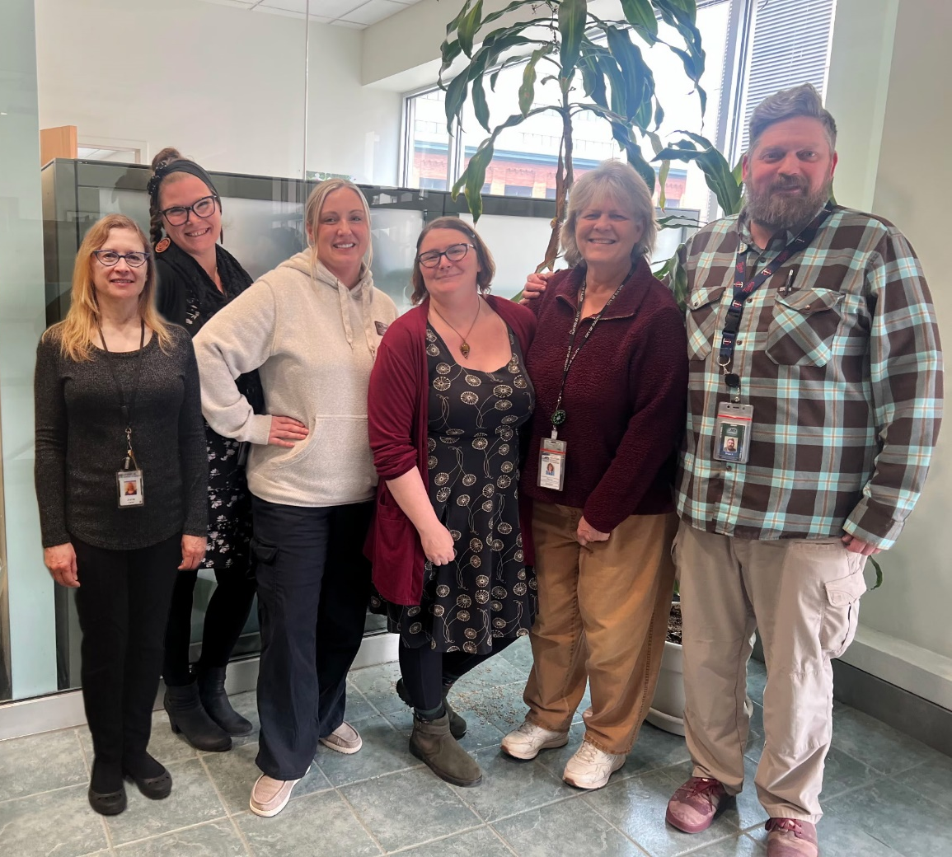
City of Duluth MFIP Team
Offer flexible options for communication and meetings including working with advocates, meeting where people feel most comfortable and accommodating hours for working families.
The team is engaged, cohesive and effective, exceeding WPR rates of their clients.
The team focuses on client relationships, opportunity sharing and encouragement.
From Left to Right: June Carter, Stephanie Randby, Holly Smith, Cole Maki, Penny Godden and Brian Freseman
Notes:
From left to right: June Carter (JOON KAR-tur), Stephanie Randby (STEF-uh-nee RAND-bee), Holly Smith (HAH-lee smith), Cole Maki (KOHL MAH-kee), Penny Godden (PEH-nee GOD-den), and Brian Freseman (BRY-uhn FREEZ-man), Leslie Perrett (not pictured)

Slide 9

Kandiyohi County MFIP Employment Services and SNAP E&T Counselors
Are consistently positive, collaborative, and committed to the mission of serving MFIP/TANF participants.
Their deep community connections help participants feel immediately understood and inspired to pursue goals they didn’t previously think were possible.
They continue to exceed expectations, demonstrating creativity, resourcefulness, and a strong commitment to ensuring rural participants are not left behind.
Georgette Skindelien
Chad Willemssen
Josie Chavez
Notes:
Georgette Skindelien (Likely pronunciations: SKIN-duh-lee-en”,• “SKIN-dell-ee-en”,• “SKIN-duh-leen” (slightly shorter ending)
Chad Willemssen (Likely pronunciations:• “WILL-um-sen”,• “VIL-um-sen” (if following Dutch/German “W” = “V” sound)
Josie Chavez

Slide 10

Mohamed Abdi and Fozia Ali
African Community Services Employment Counselors
Mohamed and Fozia:
Show tremendous efforts and passion to advocate for participants
They support teammates, share knowledge, and step up when needed
They foster an environment where all individuals feel valued, respected, and empowered to contribute
Notes:
Most common pronunciations of “Fozia”:
• FOH-zee-uh (long “o,” like “foe”) • FAH-zee-uh (short “a,” like “father”) • FOH-zee-ya (slightly lighter final syllable)

Slide 11
Exceptional/Innovative Leadership
Notes:
Nomination Criteria:
Significant contributions to the MFIP/DWP/Tribal TANF program
Nominee has positively impacted and improved the lives of participants and/or co-workers.
Creating/implementing innovative approaches in providing services for participants.
Narrative examples of a nominee’s impact on the quality of services received by participants.
Volunteering for, and working on, special projects above and beyond the nominee’s everyday duties
Demonstrated exceptional performance within their role
Anecdotal evidence: This anecdotal evidence may occur via phone, email, or letters written by others that recognize the nominee’s achievements.
Recognition by management and peers: Nominee is recognized among management and/or their peers as a key contributor and leader.
Demonstrated commitment to participants
Individual motivates or inspires participants.
Individual displays exceptional cultural competency and sensitivity to the unique challenges faced by participants.
Individual advocates on behalf of their participants and assists in problem resolution.
Demonstrated effective skills
Individual collaborates with others and supports cross-agency coordination.
Individual promotes diversity in the workplace and cultural competency in working with participants.
Individual consistently demonstrates initiative and accountability to participants and co-workers.
Demonstrated commitment to DEI

Slide 12
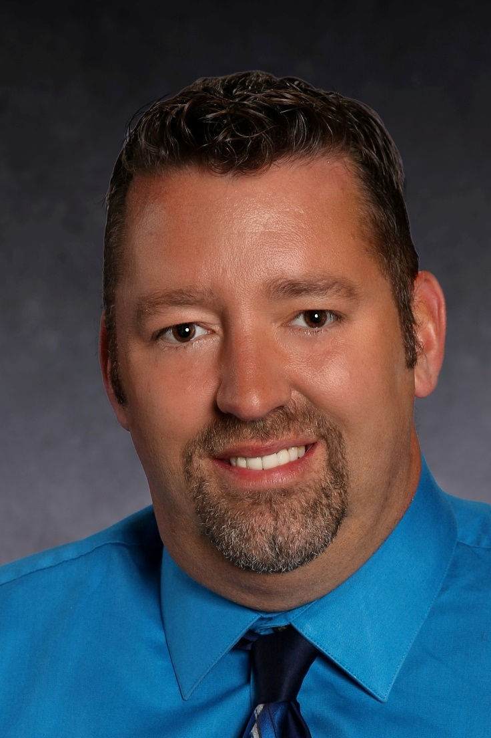
Brandon Larson
Rural MN CEP Team Leader
Brandon:
Advocates for staff needs, encourages professional development, and recognizes individual strengths within the team
Their leadership directly enhances team morale, program integrity, and the quality of services we provide to families
Effectively coaches staff through challenging cases, helping break down policies into practical steps while reinforcing confidence and professionalism

Slide 13
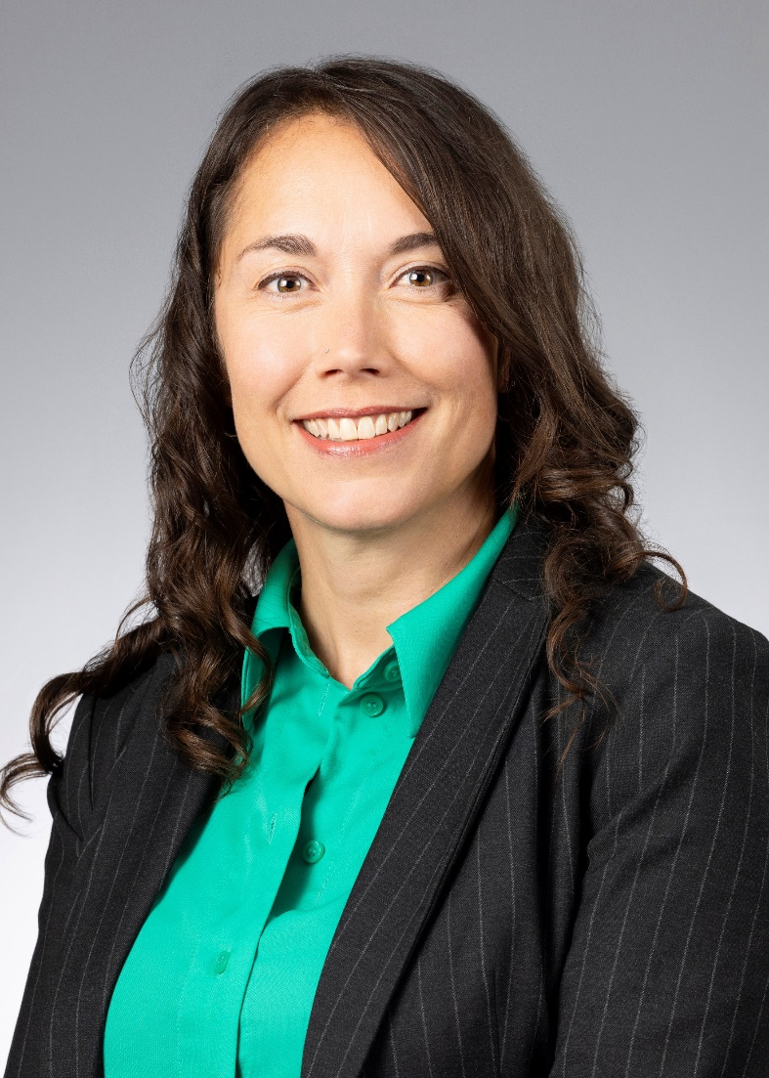
Elena Foshay
Director of Workforce Development for the City of Duluth
Elena:
Relies on data, leverages team strengths, and encourages continuous learning and adaptation – all while avoiding micromanagement
Consistently centers the communities we serve, promoting ongoing conversations about user experience and opportunities for improvement
Her inclusive and steady leadership is a major reason people choose to stay and thrive at Duluth Workforce Development
Notes:
(Ee-lay-nuh Foe-shay)

Slide 14

Charlita Holley
Hennepin County Well-Being Program Manager
Charlita:
Listens deeply and approaches every conversation with respect and genuine curiosity
Recognizes the emotional and human aspects of this work and consistently offers compassion, encouragement, and guidance
Advocates for equitable access, encourages staff to consider multiple perspectives, and creates an environment where everyone feels valued and heard

Slide 15
Rising Star
Notes:
Less than 3 years of service.
Nomination Criteria:
Significant contributions to the MFIP/DWP/Tribal TANF program
Nominee has positively impacted and improved the lives of participants and/or co-workers.
Creating/implementing innovative approaches in providing services for participants.
Narrative examples of a nominee’s impact on the quality of services received by participants.
Volunteering for, and working on, special projects above and beyond the nominee’s everyday duties
Demonstrated exceptional performance within their role
Anecdotal evidence: This anecdotal evidence may occur via phone, email, or letters written by others that recognize the nominee’s achievements.
Recognition by management and peers: Nominee is recognized among management and/or their peers as a key contributor and leader.
Demonstrated commitment to participants
Individual motivates or inspires participants.
Individual displays exceptional cultural competency and sensitivity to the unique challenges faced by participants.
Individual advocates on behalf of their participants and assists in problem resolution.
Demonstrated effective skills
Individual collaborates with others and supports cross-agency coordination.
Individual promotes diversity in the workplace and cultural competency in working with participants.
Individual consistently demonstrates initiative and accountability to participants and co-workers.
Demonstrated commitment to DEI

Slide 16
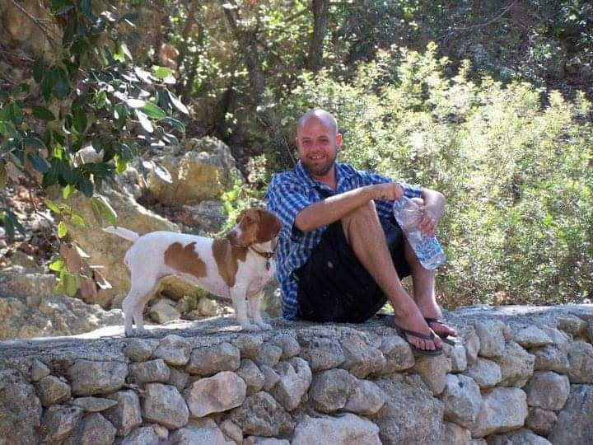
Solomon Wilhelm
JET Career Counselor
Solomon:
Displays passion for helping his participants reach their goals
Frequently the first one to volunteer when another team member requires assistance
Is always seeking opportunities to expand his knowledge of the program, services available to his participants, and overall career counseling skills
Notes:
SOL-uh-muhn (/ˈsɒləmən/ or /ˈsɑːləmən/). (Will-helm)
SOL: Sounds like "sol" in "solid".
uh: A short schwa sound (like the 'a' in "about").
muhn: Sounds like "mun" in "money".

Slide 17
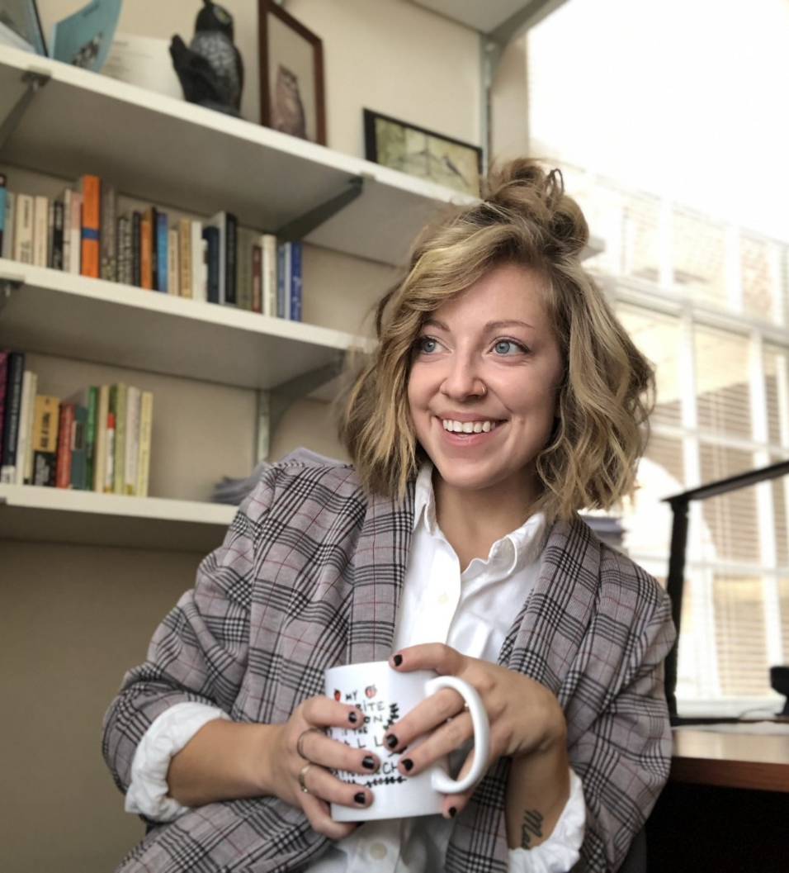
Jamie Hudalla
Ramsey Count American Indian Family Center Employment Counselor
Jamie:
Consistently provides high-quality guidance while helping participants identify career pathways that align with their strengths and long-term goals
Shows outstanding performance through her reliability, compassion, and the strong trust she builds with participants
Regularly goes beyond what is expected, taking initiative on projects, and brings a calm positive presence to the team
Notes:
Jay-me Hoo-da-la

Slide 18
Lifetime Achievement Award
Notes:
20+ years of service.
Nomination Criteria:
Significant contributions to the MFIP/DWP/Tribal TANF program
Nominee has positively impacted and improved the lives of participants and/or co-workers.
Creating/implementing innovative approaches in providing services for participants.
Narrative examples of a nominee’s impact on the quality of services received by participants.
Volunteering for, and working on, special projects above and beyond the nominee’s everyday duties
Demonstrated exceptional performance within their role
Anecdotal evidence: This anecdotal evidence may occur via phone, email, or letters written by others that recognize the nominee’s achievements.
Recognition by management and peers: Nominee is recognized among management and/or their peers as a key contributor and leader.
Demonstrated commitment to participants
Individual motivates or inspires participants.
Individual displays exceptional cultural competency and sensitivity to the unique challenges faced by participants.
Individual advocates on behalf of their participants and assists in problem resolution.
Demonstrated effective skills
Individual collaborates with others and supports cross-agency coordination.
Individual promotes diversity in the workplace and cultural competency in working with participants.
Individual consistently demonstrates initiative and accountability to participants and co-workers.
Demonstrated commitment to DEI

Slide 19
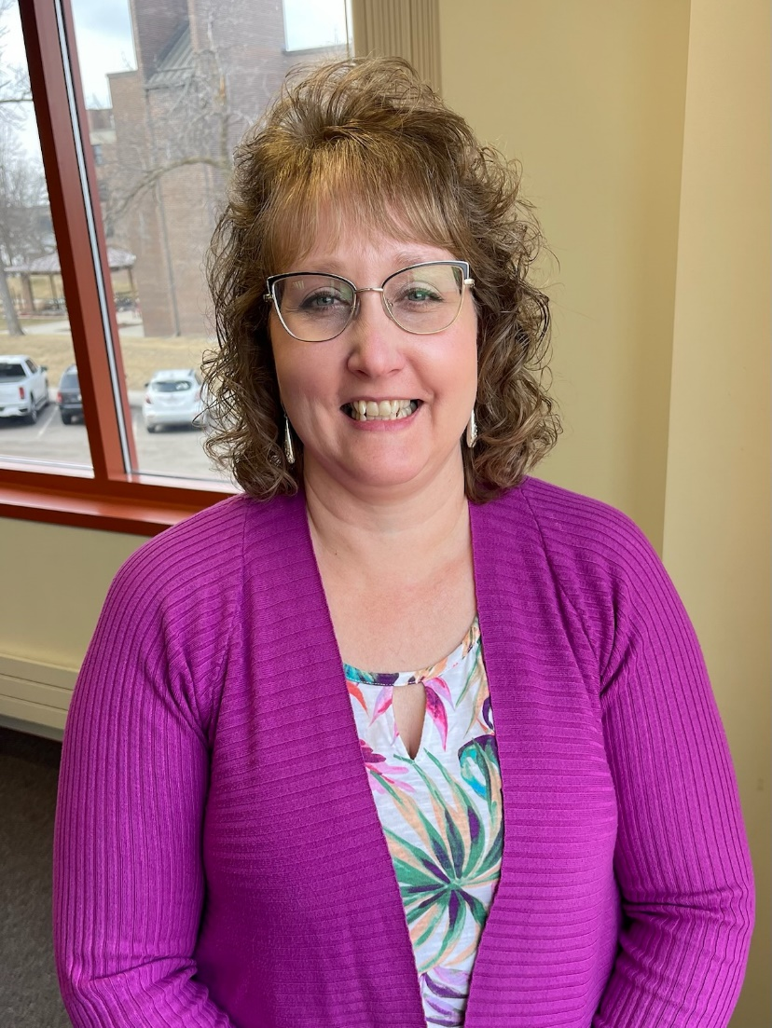
Valerie Syverson
Beltrami County Family Team Eligibility Specialist
25 Years!
Valerie:
Always positive and helps mentor people, even not on her current team
Motivates others to strive and do their best, inspiring them to know policy and procedure
Is a team player, inspires others and supports all eligibility specialists

Slide 20
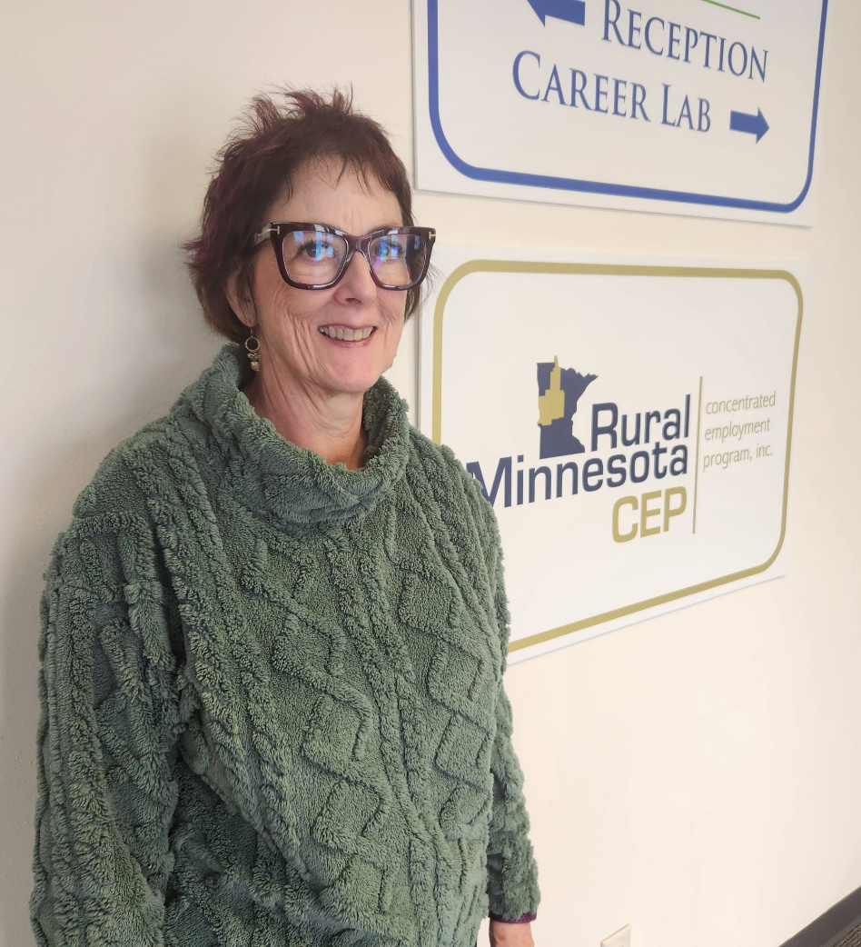
Audrey Lukanen
Rural MN CEP Job Counselor
36 Years!
Audrey:
Her ability to make people feel seen is priceless in getting participants to learn to help themselves
Works diligently to assist participants in finding solutions to their barriers as well as showing them steps to use when they come across new barriers
Assists in training and mentoring new MFIP Job counselors

Slide 21

Congratulations to all the winners!!! An email will be sent out this afternoon to get mailing addresses for your award.

Slide 22

Thank You!
Notes:
Please complete the surveys. The MURAL will be available until close of business on Monday. See you next year.

